Slide 1
Notes:
Explain what gatortech is.

Slide 2
Check-in on gatortechuf.com
Coordinator have been selected!
Retreat 10/15 after GBM
General Meeting 11/19 after GBM
Technology Case Competition Team
Gatortech x UF DSI Tableau Workshop - 10/29
Social - 10/22 after GBM
Notes:
Go to mentimeter for the polls.
Hackathons: https://mlh.io/seasons/na-2019/events
ShellHacks: https://shellhacks.net/
HackGSU: http://hackgsu.com/
HackGT: https://2018.hack.gt/
HackFSU: https://hackfsu.com/
SwampHacks: https://2019.swamphacks.com/
MangoHacks: https://mangohacks.com/
KnightHacks: https://knighthacks.org/

Slide 3
Design your UX Mobile Designs

Slide 4
UX Mobile Design Ideas
Tab bars Layered Content Visual Trends
Notes:
Tab Bars are easy to reach with your thumb. They are always visible, allowing for easy navigation and clear guidance
Layered Content: Keep the user in the original context and overlay additional information only when the user wants to
Visual Trends: Include color and white space

Slide 5
Tech Meme(s) of the Week

Slide 6
data science

Slide 7
Business Intelligence
Business intelligence (BI) is a technology-driven process for gathering, storing, accessing, analyzing data and presenting actionable information which helps executives, managers and other corporate end users make informed business decisions
Includes both“getting data out” and“getting data in”
Notes:
Business intelligence (BI) is a broad term that encompasses applications, technologies, and processes for gathering, storing, accessing, and analyzing data to help business users make better decisions
Includes both“getting data out” and“getting data in”

Slide 8
What is Data Mining?
The process of extracting and sifting through large sets of unstructured chaotic data in order to find patterns, anomalies, or correlations that will help in decision making.
Notes:
https://www.sas.com/en_us/insights/analytics/data-mining.html

Slide 9
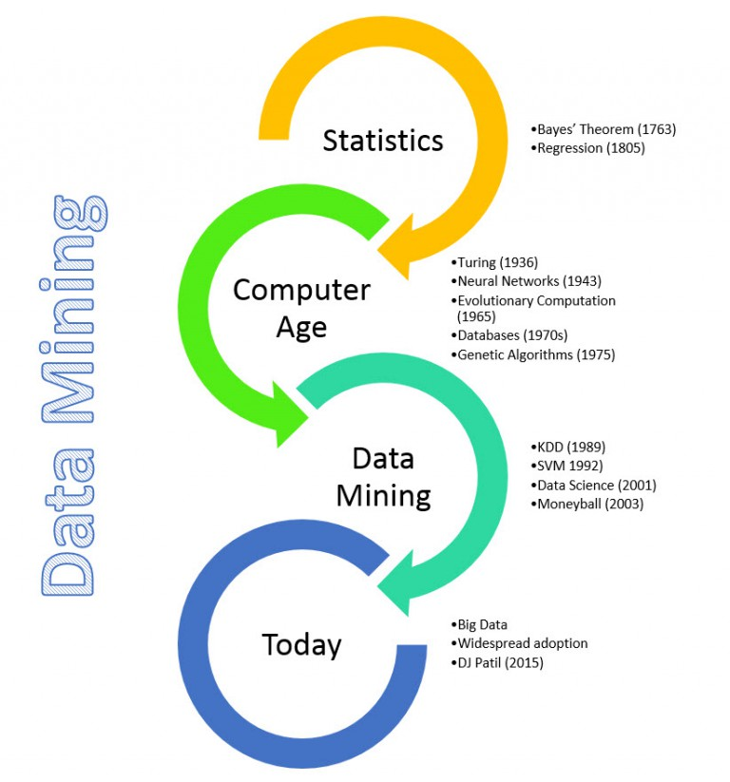
Origin of Data Mining
Bayes’ Theorem 1763: Chances of something happening given something else happened
Databases 1970s: allowed for the storage and access of petabytes of data
Data Mining 1990s
Notes:
https://hackerbits.com/data/history-of-data-mining/

Slide 10
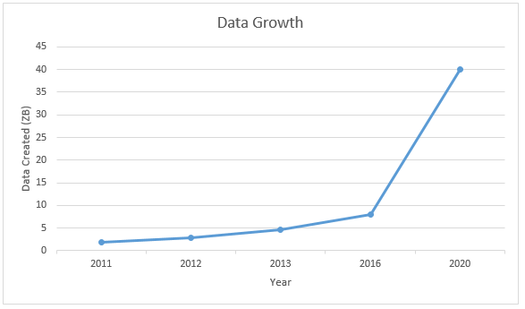
Importance
The ability to extract information from a system that is growing at an exponential rate is as critical as the growth rate
Ex. Google processes over 20 Petabytes or 20,000 Terabytes of data in a single day.
Note: 1 ZB is equivalent to one billion TB.

Slide 11
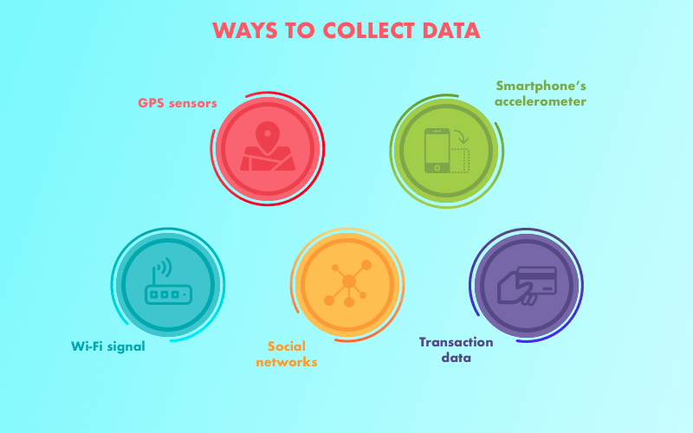
Data Mining Techniques
Three Types
Descriptive
Predictive
Prescriptive
Big Data: large sets of data
Social Data
Machine Data
Transactional Data
Notes:
Includes three kinds: descriptive, predictive and prescriptive analytics
Business values are found --capturing, storing, and analyzing new kinds of data (e.g., social media and clickstream)
Increased volume, variety, and velocity of data ---Big Data
Machine Data is from equipment like industrial stuff, sensors, websites

Slide 12
Descriptive Modeling
Finds similarities or groupings in data to find reason for success or failure
Clustering
Anomaly Detection
Association
Affinity Grouping
Notes:
Modeling:
Descriptive: uses data for finding groups. Provides a better top level view of target groups and demographics
Limited in its ability to predict future groupings and trends, probably better used for something with a consistent data group

Slide 13
Predictive Modeling
Uses data to classify or estimate future events
Regression
Decision Trees
Neural Networks
Notes:
Modeling:
Predictive: uses data to predict future probabilities. A more statistical model used to guide decision making on uncertain tasks or projects

Slide 14
Prescriptive Modeling
Looks at the collected data along with other variables and recommends a course of action
If/Then rules
Marketing Optimization
Notes:
Modeling:
Prescriptive: basically used to make recommendations by analyzing data and find correlations or meeting guidelines set by the company.
Tells you how to market, who to market to, and other marketing information. Allows you to make important decisions using the data you have

Slide 15
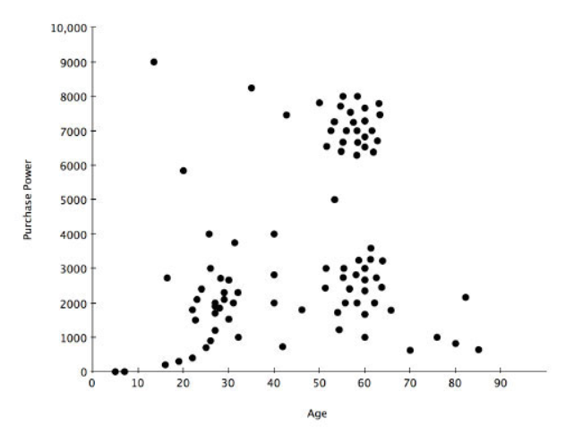
Examples
Descriptive
Notes:
Clustering. The clusters are around the age of 20 and 60 because people of those ages have more disposable income because they don’t have children.

Slide 16
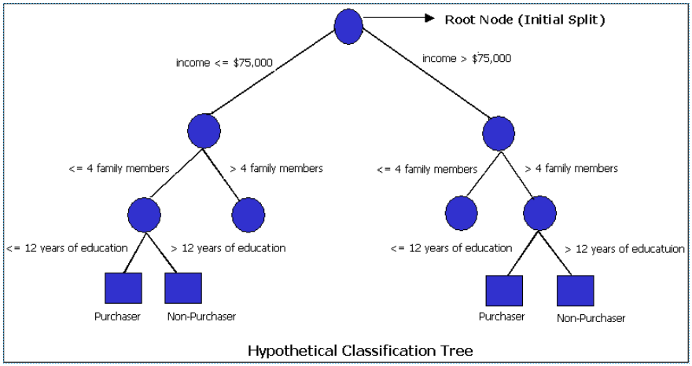
Examples
Predictive
Notes:
Classification Tree. Customers are classified by groups of factors in order to find trends

Slide 17
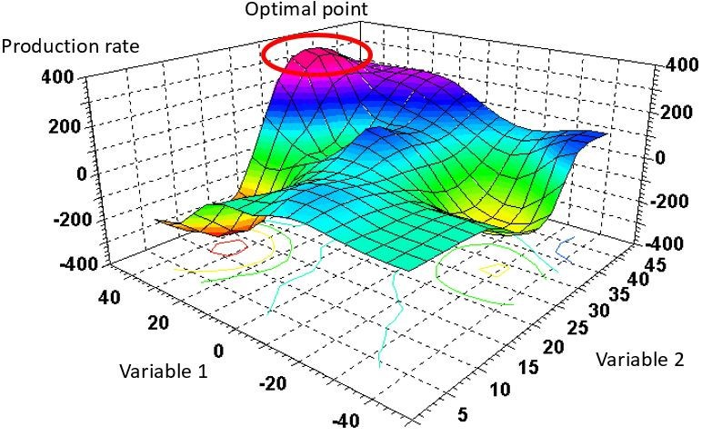
Examples
Prescriptive
Notes:
Plots 2 variables to determine which combination of the two will maximize your production rate.
If you have workers in groups, one variable can be how many people to have in each group, another variable can be how far apart to have each group. Models can help you decide the best combination.

Slide 18
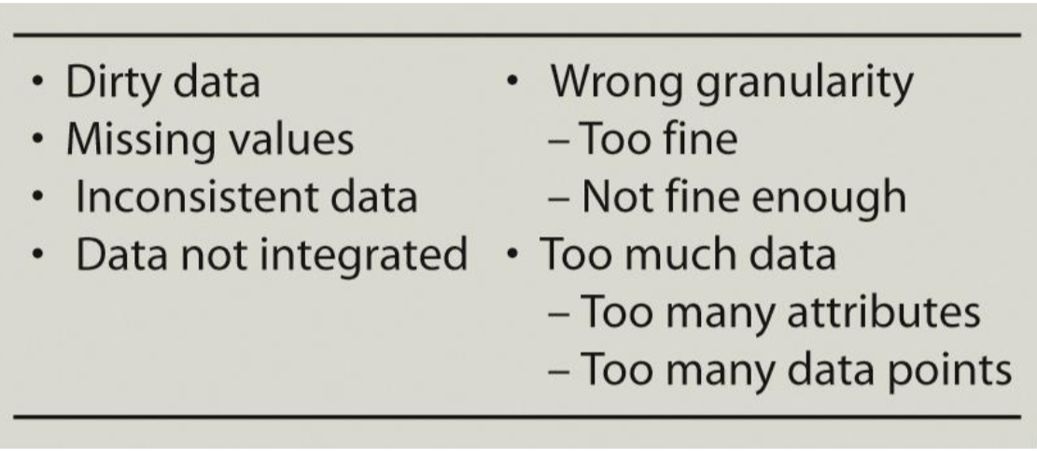
Issues in Data Handling
Problems with Operational Data
Data Integrity Problems
Same person, different spelling
Different abbreviations
Required fields left blank
Using Constantinople instead of Istanbul
Writing down OOO instead of 000
Notes:
https://youtu.be/vsQrKZcYtqg?t=35
Dirty data–mistakes in spelling or punctuation, incorrect data associated with a field, incomplete or outdated data or data that is duplicated in the database.
Too much data causes:
Curse of dimensionality
1.Problem caused by the exponential increase in volume associated with adding extra dimensions to a (mathematical) space.
2.Too many rows or data points
3.With more attributes, the easier it is to build a model that fits the sample data but that is worthless as a predictor.Major activities in data mining concerns efficient and effective ways of selecting attributes.

Slide 19
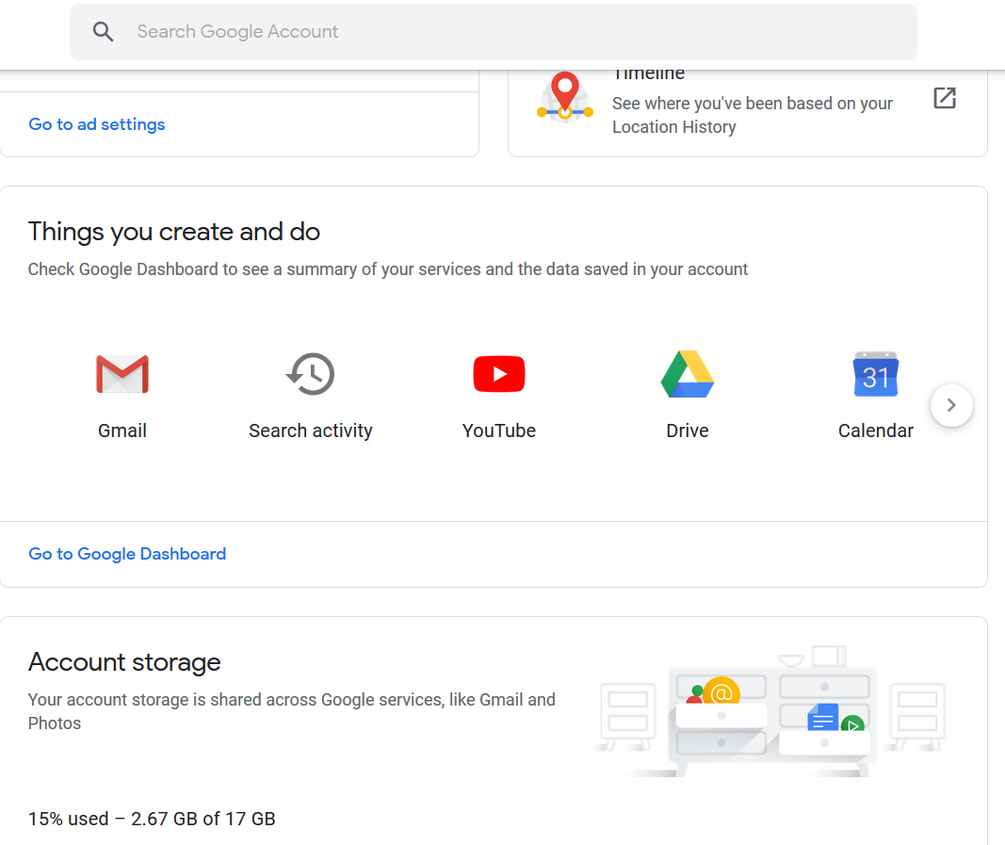
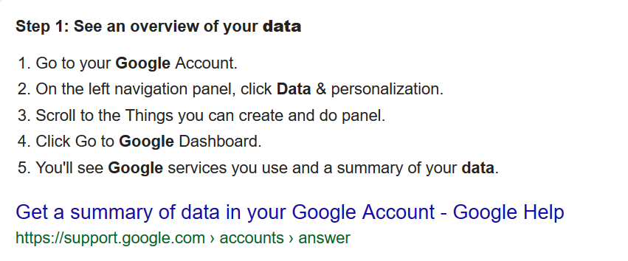
activity
Notes:
https://safety.google/privacy/data/
Bonus - Check what data Facebook has on you

Slide 21
Porsche and Boeing’s ambitious partnership.
Portland’s Renewable Wave Machine

Slide 22
this week in tech:
Porsche and Boeing’s ambitious partnership.
Portland’s Renewable Wave Machine

