Slide 1

welcome to

Slide 2
cybersecurity basics and malware

Slide 3
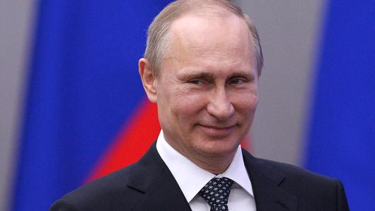

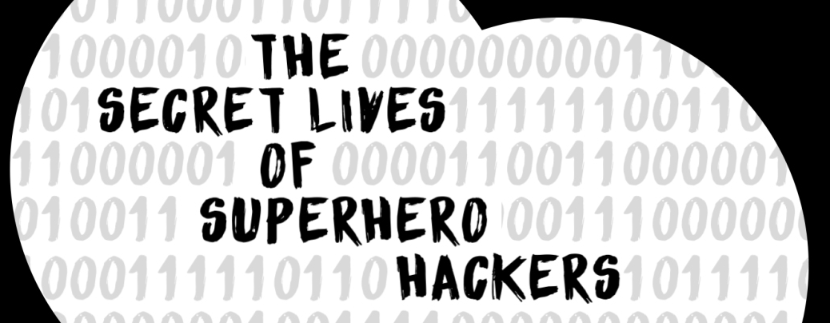
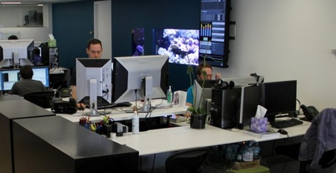

what is cybersecurity?
What the government thinks info sec is
What society thinks info sec is
What I think info sec is
What info sec actually is
Notes:
Cybersecurity is the body of technologies, processes and practices designed to protect networks, computers, programs and data from attack, damage or unauthorized access. In a computing context, security includes both cybersecurity and physical security.
Privacy is the ability of an individual or group to seclude themselves, or information about themselves, and thereby express themselves selectively.
Information privacy, or data privacy is the relationship between the collection and dissemination of data, technology, the public expectation of privacy, and the legal and political issues surrounding them; dealing with the ability an organization or individual has to determine what data can be shared with third parties.

Slide 4

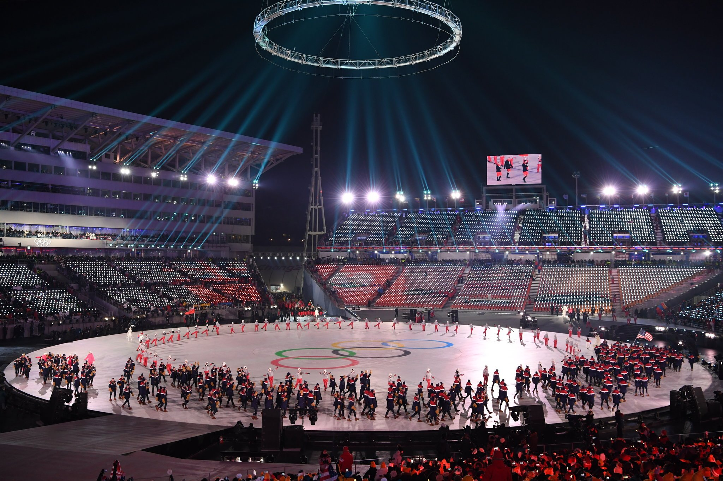
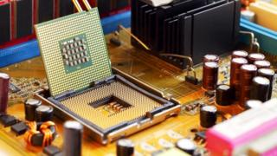
hacker news
Intel Chip Scare: CPU’s vulnerable to hacks
click here
Uber Hid 2016 Data Breach, Paying Hackers to Delete Data
click here
Cyber attack causes Olympic Ceremonies disruption
click here
Notes:
http://www.bbc.com/news/technology-42562303
Privacy is the ability of an individual or group to seclude themselves, or information about themselves, and thereby express themselves selectively.
Information privacy, or data privacy is the relationship between the collection and dissemination of data, technology, the public expectation of privacy, and the legal and political issues surrounding them; dealing with the ability an organization or individual has to determine what data can be shared with third parties.

Slide 5
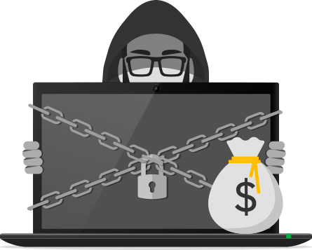

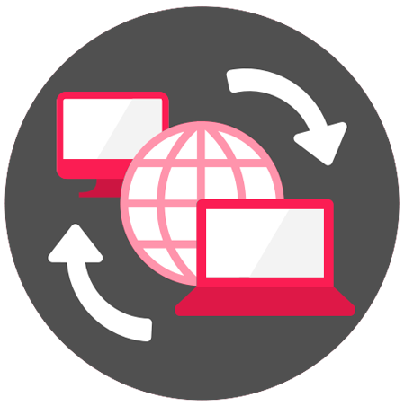



types of malware (malicious + software)
Ransomware
Rootkit
Spyware
Trojan
Virus
Worm
Notes:
The WannaCry ransomware attack was a May 2017 worldwide cyberattack by the WannaCry ransomware cryptoworm, which targeted computers running the Microsoft Windows operating system by encrypting data and demanding ransom payments in the Bitcoin cryptocurrency.
https://en.wikipedia.org/wiki/WannaCry_ransomware_attack
Usually targeting Bugs or user error (bugs = flaw in code)
Adware: pop up ads
Bot: botnets/DDOS, spambots that put ads on websites, and for distributing malware disguised as popular search items on download sites. Websites can guard against bots with CAPTCHA tests. The word Botnet is formed from the words 'robot' + 'network'. Cybercriminals use special Trojan viruses to breach the security of several users' computers, take control of each computer and organise all of the infected machines into a network of 'bots' that the criminal can remotely manage.
Ransomware
Rootkit:Remotely access or control a computer without being detected by users/security.
Spyware: activity monitoring, collecting keystrokes, data harvesting (account info, logins, financial data)
Trojan: disguises itself as a normal file or program (similar sites like Java but actually a trojan)
Virus: inserts malicious code
Worm:Sends itself onto other nodes on a network, containing malicious code, to exploit a vulnerability in an application/operating system

Slide 6
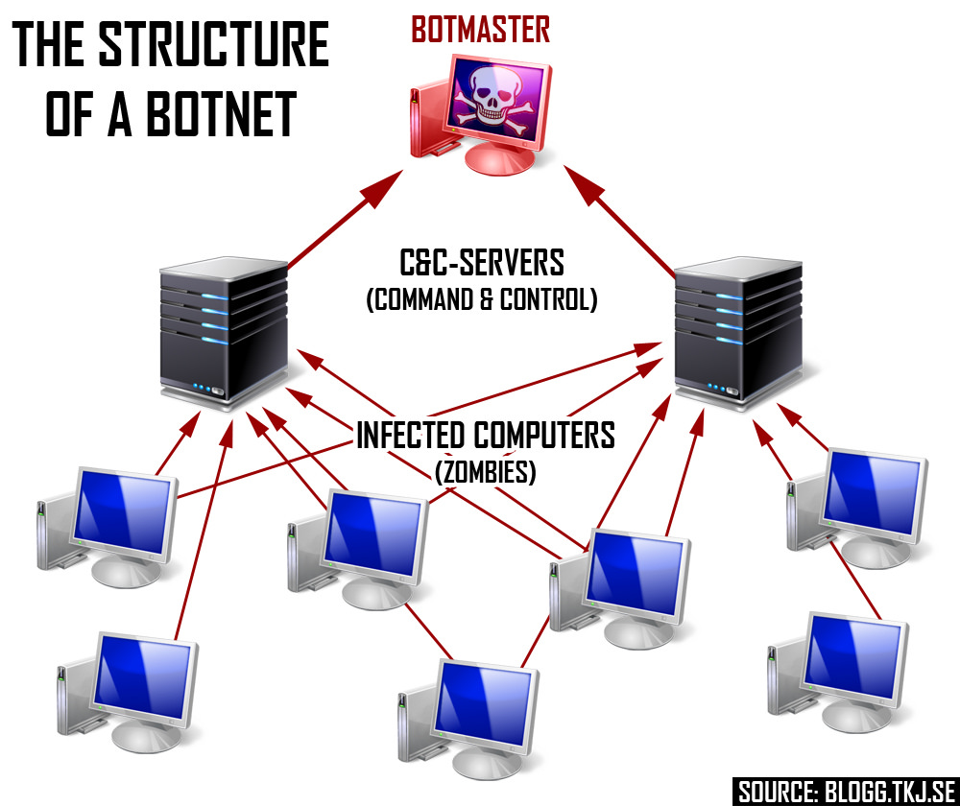
distributed denial of service attack
Computers compromised by malware can be formed into a botnet to attack other computers
DDos: Botnet directs a flood to a single website server with rapid-fire page requests, causing it to slow down or crash.

Slide 7




social engineering
Phishing
Pretexting
Baiting
Quid pro quo
Emails where hackers pose as an organization to obtain personal data
Hacker impersonates trusted person to get info
Hackers leave malware-infected device to be found by user, installing malware and giving threat access
Hacker requests exchange of critical data or login credentials for a service.
Notes:
Experiences in the TAC
When cyber-threat actors target your organization, they research not only your business, but your employees as well. They know that employees outside of IT security aren’t as aware of cyber threats, so they execute cyberattacks that exploit human vulnerabilities. Through the process of social engineering, threat actors manipulate people into giving the access to sensitive information. The most common social engineering attacks include:
Quid pro quo- For example, an end user might receive a phone call from the hacker who, posed as a technology expert, offers free IT assistance or technology improvements in exchange for login credentials. Another common example is a hacker, posed as a researcher, asks for access to the company’s network as part of an experiment in exchange for $100. I

Slide 8
think like a hacker
What motivates hackers?
ACTIVITY
What company you’re hacking
What data are you’re getting
The type of malware/hacking strategy
Name your malware
Notes:
Create your malware!

Slide 9
risk management

Slide 10


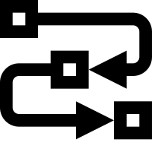

what is risk management?
There are countless threats, limited budgets, and businesses must choose what risks to focus on (depending on what’s relevant for them)
DATA
TECH
PROCESSES
PEOPLE
Notes:
PART 2 OF CYBERSECURITY
risk analysis, risk assessment (framework and methodologies) and risk mitigation.
Business want to protect their assets from misuse, disclosure, unauthorized access, or destruction
OTHER TOPICS TO CONSIDER: IDENTIFYING YOUR RISK

Slide 11

data and privacy
Behind the FB profile you’ve built for yourself is a shadow profile, built from the inboxes & smartphones of FB users
DATA
TECH
PROCESSES
PEOPLE
Notes:
Cybersecurity is the body of technologies, processes and practices designed to protect networks, computers, programs and data from attack, damage or unauthorized access. In a computing context, security includes both cybersecurity and physical security.
Privacy is the ability of an individual or group to seclude themselves, or information about themselves, and thereby express themselves selectively.
Information privacy, or data privacy is the relationship between the collection and dissemination of data, technology, the public expectation of privacy, and the legal and political issues surrounding them; dealing with the ability an organization or individual has to determine what data can be shared with third parties.

Slide 12
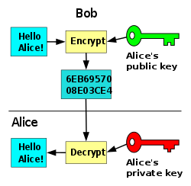
encryption
A security measure using a pair of keys, to encrypt and decrypt data. One is public and shared with everyone, one is private and known only to the recipient.
Protects sensitive data through scrambling with mathematical formulas so that it cannot be read without applying the key to decrypt it.
DATA
TECH
PROCESSES
PEOPLE
Notes:
Cybersecurity is the body of technologies, processes and practices designed to protect networks, computers, programs and data from attack, damage or unauthorized access. In a computing context, security includes both cybersecurity and physical security.
Privacy is the ability of an individual or group to seclude themselves, or information about themselves, and thereby express themselves selectively.
Information privacy, or data privacy is the relationship between the collection and dissemination of data, technology, the public expectation of privacy, and the legal and political issues surrounding them; dealing with the ability an organization or individual has to determine what data can be shared with third parties.

Slide 13
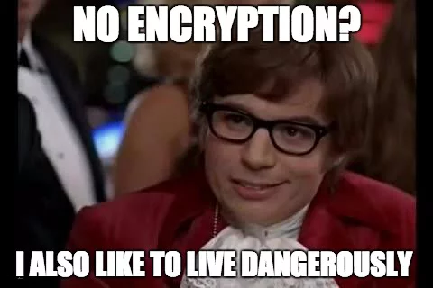
encryption activity
https://sela.io/pgp/
Encrypt and decrypt messages with a friend!
Go to this site, put in an email and password, and WAIT while it loads

Slide 14
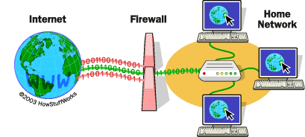
mitigation and defense
Firewall: inspects traffic and either blocks/permits it according to rules the org establishes.
Multi Factor Authorization: user IDs, passwords, PIN, or answering a security question, ID badge, voice detection, fingerprint, etc.
DATA
TECH
PROCESSES
PEOPLE
Notes:
Cybersecurity is the body of technologies, processes and practices designed to protect networks, computers, programs and data from attack, damage or unauthorized access. In a computing context, security includes both cybersecurity and physical security.
Privacy is the ability of an individual or group to seclude themselves, or information about themselves, and thereby express themselves selectively.
Information privacy, or data privacy is the relationship between the collection and dissemination of data, technology, the public expectation of privacy, and the legal and political issues surrounding them; dealing with the ability an organization or individual has to determine what data can be shared with third parties.

Slide 15

training your people
Security awareness and training
Weak passwords
Using one password for everything, sticky notes with passwords
Social engineering and phishing
DATA
TECH
PROCESSES
PEOPLE
Notes:
Cybersecurity is the body of technologies, processes and practices designed to protect networks, computers, programs and data from attack, damage or unauthorized access. In a computing context, security includes both cybersecurity and physical security.
Privacy is the ability of an individual or group to seclude themselves, or information about themselves, and thereby express themselves selectively.
Information privacy, or data privacy is the relationship between the collection and dissemination of data, technology, the public expectation of privacy, and the legal and political issues surrounding them; dealing with the ability an organization or individual has to determine what data can be shared with third parties.

Slide 16
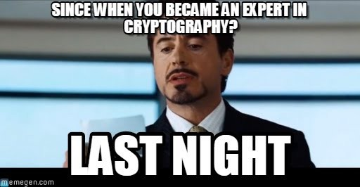
encryption activity
https://sela.io/pgp/
Encrypt and decrypt messages with a friend!
Use Slack DMs but copy and paste RAW TEXT

Slide 17
technology and trust

Slide 18

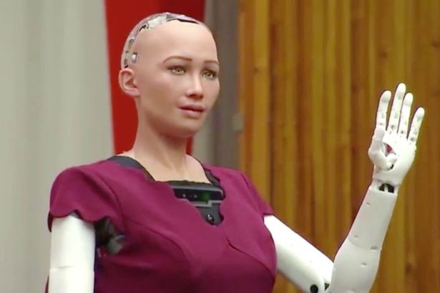
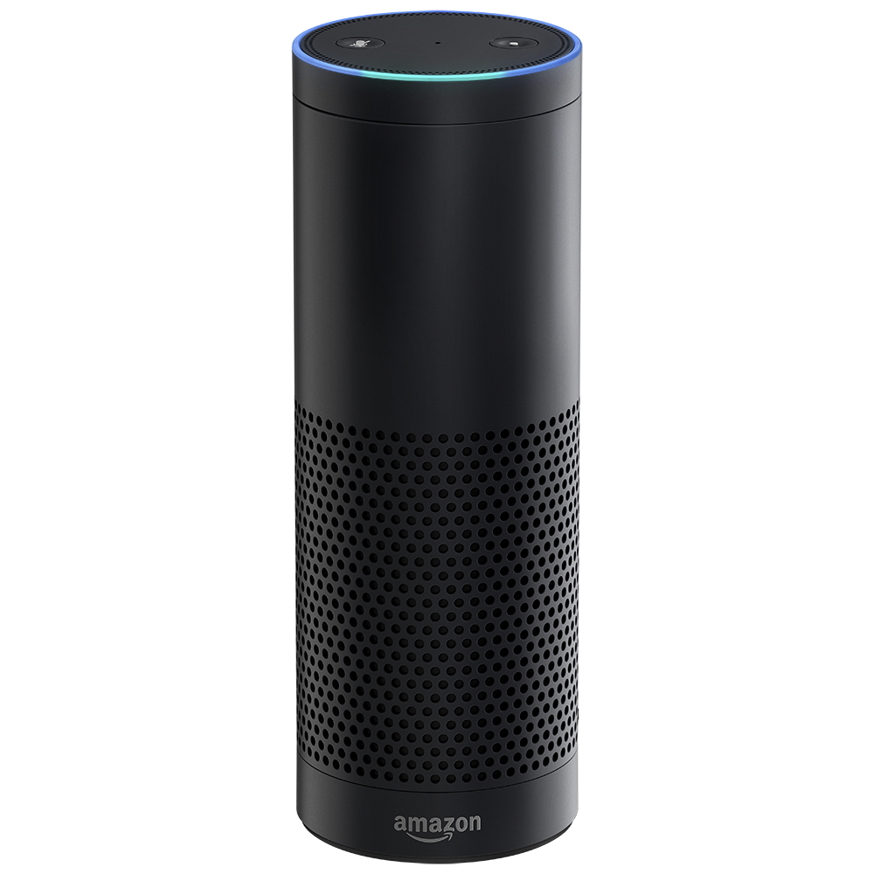


why are so many tech assistants female?
MIT study: Changed gender of self driverless car and people were more forgiving when it was female and did something wrong versus when it was genderless or masculine
Notes:
We see the most popular AI is increasing more female - from siri and viv, to alexa, and even newer models of self driving cars, “Iris”
Making technology feel female in design creates trust!!!!!

Slide 19

how people build trust
Trust - through human connection - needs friction. A team going through a crisis and came out the other side, they have higher levels of trust.
Competence
Reliability
Integrity
Benevolence
Notes:
Competence and reliability: How well you are going to do something?
Integrity and benevolence: Why and how much do you care? Do your intentions align with mine? What are your motives?

Slide 20




tech accelerates trust
80% people share a piece of content just based on the headline.
We make decisions as to whether something or someone is trustworthy based on limited information.
Ask yourself, is this content worthy of my trust?
Notes:
And so, technology doesn’t like friction, but friction is often human connection. Friction is when you consciously slow down and start to ask whether this thing is worthy of your trust. 80% people share a piece of content based on the headline. That’s a really good example of just giving our trust away too easily.

Slide 21
tech: a tool in trust development
Is technology making us smarter about who to trust, or is it encouraging us to place our trust in the wrong people in the wrong places?
ENEMIES OF TRUST:
Madison’s Trust Equation:
TECH (GOOD INFO) + HUMAN (FRICTION) = GOOD DECISION MAKING
Bad Character
Poor Info
Notes:
The two enemies of trust are bad character and poor information. Although technology can’t make bad people good, it can hold people accountable, like through ratings and reviews. Technology here is giving people power to see a complete pic of who the person is. So tech shouldn’t make decisions for us, just provide us with info needed to have friction and make the human decision.

Slide 22


tech companies and trust
WHO DID IT POORLY:
Equifax data breach: there were a number of people who didn’t even realize their data was being stored.
There’s this conversation around transparency being the end goal;
If we need things to be transparent, we’ve given up on trust.
WHO DOES IT WELL:
Tesla’s company behavior is centered on trust: they’re continually telling you where they’re going, their why, and you can visualize them taking us to Mars and self-driving cars. When something goes wrong, like the accident with the self-driving car, they respond quickly, giving details and owning that mistake, and what they’ve learnt from it. You feel like things are changing and evolving, and it was towards sort of a greater goal of human safety and self-driving cars.
Notes:
PART 3

Slide 23
public wifi security measures

Slide 24

public wifi vulnerabilities:
lack of encryption
Some wireless networks may use older standards for encryption.
Wireless Encryption Protocol (WEP) and Wi-Fi Protected Access (WPA) have security weaknesses.
Tools like Aircrack-ng are built to perform brute force attacks to crack weak keys on networks using WEP or WPA.
Notes:
Just because you may need a password to log in, it doesn’t mean your online activities are encrypted. Here are some reasons public wifi are susceptible to an attack
QUES: can you check this when looking at a wifi network?
A brute force attack is a trial-and-error method used to obtain information such as a user password or personal identification number (PIN). In a brute force attack, automated software is used to generate a large number of consecutive guesses as to the value of the desired data.

Slide 25

public wifi vulnerabilities:
joining rouge hotspots
Attacker creates a rogue hotspot with the intent to unleash man-in-the-middle (MITM) attacks on unsuspecting victims that join their rogue network that looks like public network.
Notes:
MITM attack: The attacker intercepts between you and the servers of the websites you visit, eavesdropping your online traffic to capture login credentials, credit card numbers, and social security numbers.

Slide 26

public wi-fi security measures
Don’t use public wifi networks to access sensitive information
Use a VPN on public wifi for an extra layer of security to connection.
Browse websites with HTTPS (encrypted) instead of HTTP. Install an extension like HTTPS-Everywhere to force you to connect using HTTPS.
Configure wireless settings to not connect to available wifi hotspots: Turn off the “Connect Automatically” feature.

