Slide 1
cloud computing

Slide 2
what is cloud computing?
Traditional:
Files and software stored on local computer
Computations done on local computer
Requires large, upfront expense to purchase computers
Hosted by the company
Cloud Computing:
Files and software stored on a remote computer (server)
Computations done on the server
Pay as you go model if using a provider like Amazon Web Services
Hosted by a third party provider

Slide 3
service models
Software as a Service (SaaS)
Google Docs
Platform as a Service (PaaS)
Heroku
Infrastructure as a Service (IaaS)
DigitalOcean

Slide 4
pros and cons of cloud
Pros
Cost
Pay as you go
Scales with your service level
No left over infrastructure
Reliability
High availability
Redundancy
Multiple physical locations
Cons:
Less control
If it does go down, the provider must deal with it
Security risks
Can become too expensive at certain levels

Slide 5
companies that use cloud
CloudSploit tests AWS security
Moved to a “serverless” architecture
Event based, code only runs when it needs to
Huge cost savings by not paying for idle instances

Slide 6
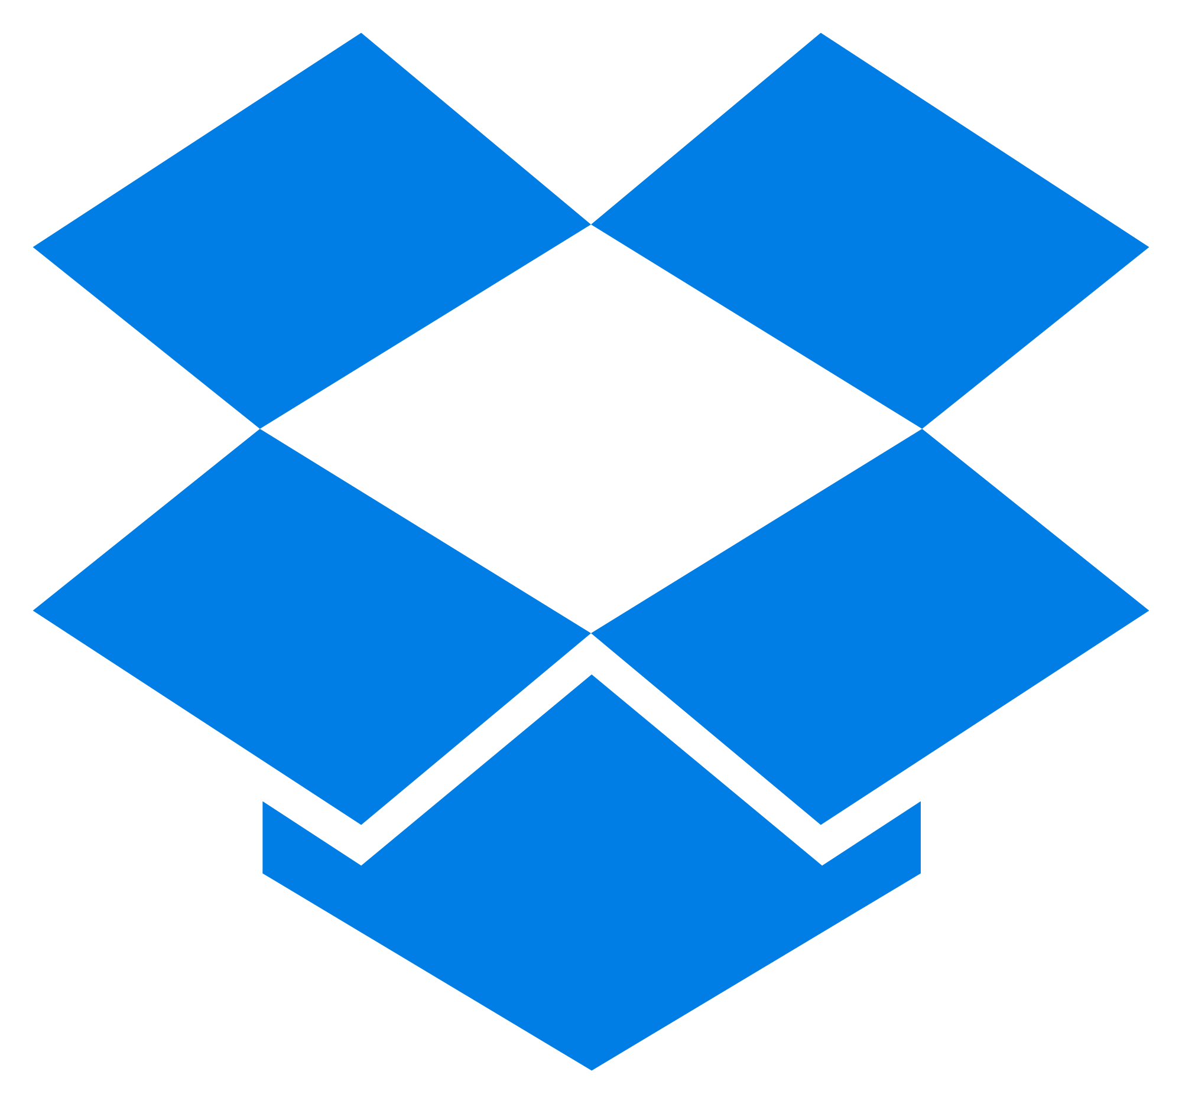
companies that use cloud
Dropbox originally hosted files on Amazon S3 and metadata on internal servers
Grew too large for Amazon Web Services to be worth it
Invested in their own infrastructure

Slide 7
migrating to the cloud
Public Cloud:
AWS, Azure, Google Cloud Platform
Hardware maintained by a third party
Ongoing cost (operating expense)
Adjust capacity as needed
Requires a shift in techniques for development and operations
Private Cloud:
Internal infrastructure
Costly up front investment (capital expenditure)
Capacity is more or less fixed
Maintains status quo

Slide 8
migrating to the cloud
Hybrid Cloud Merges private and public clouds Slowly transition infrastructure to other tasks Slowly transition software to be modular (microservices) Can also help supplement existing infrastructure

