Slide 1
Notes:
Explain what gatortech is.

Slide 2
Check-in on gatortechuf.com
Movie Social - today after GBM
Gatortech x UF DSI Tableau Workshop - 10/29 Hough 240, 6-7:30 pm
Actualize Motivational Speaker: Morris Morrison - 10/24 Bryan Hall 232, 6-7pm
Coordinators ~ general meeting 11/29
HackGT
Notes:
Go to mentimeter for the polls.
Hackathons: https://mlh.io/seasons/na-2019/events
ShellHacks: https://shellhacks.net/
HackGSU: http://hackgsu.com/
HackGT: https://2018.hack.gt/
HackFSU: https://hackfsu.com/
SwampHacks: https://2019.swamphacks.com/
MangoHacks: https://mangohacks.com/
KnightHacks: https://knighthacks.org/

Slide 3
Two Truths and a Lie

Slide 4
Two Truths and a Lie
Get into groups of 4-5
Write down on a piece of paper 2 truths and 1 lie
Once everyone is done, go around the table
The group will decide which one is the lie
**Try to make your statements unique and interesting!

Slide 5
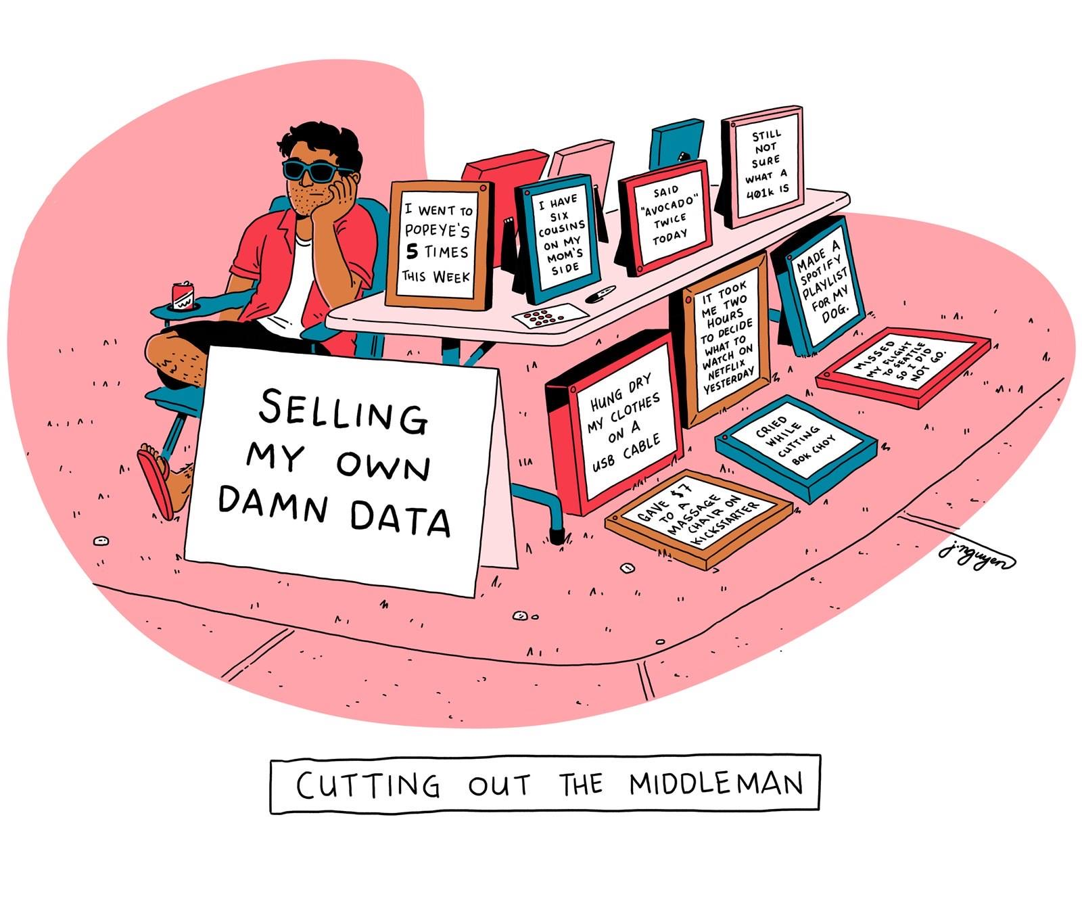
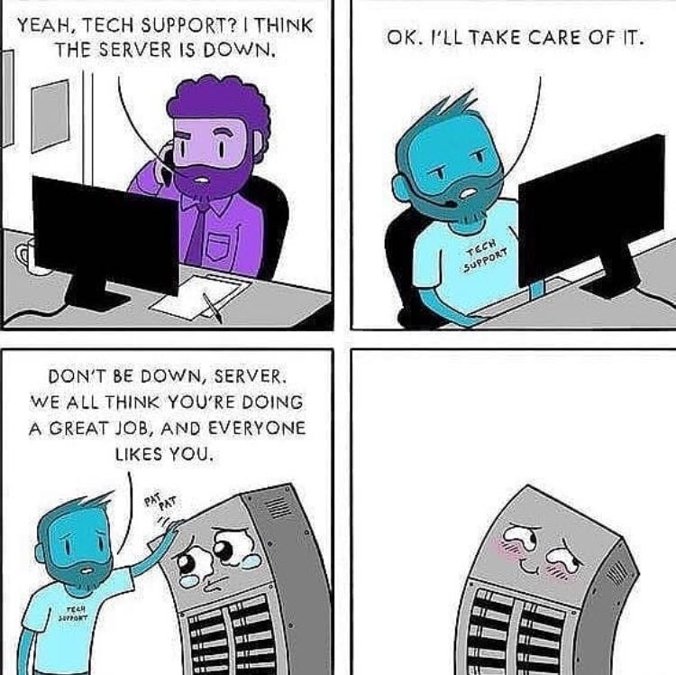
Tech Meme(s) of the Week

Slide 6
data science

Slide 7
data governance
Data governance is the management and protection of a company’s data assets for the purpose of ensuring understandable, complete, trustworthy, and secure corporate data.
Notes:
https://searchdatamanagement.techtarget.com/definition/data-governance
https://bi-survey.com/data-governance

Slide 8
implementation
Owners and overseers of the company’s data assets must be defined
Processes must be defined to determine how data will be stored, archived, backed up, and protected.
Sets of controls and audit procedures must be established to ensure internal and external compliance.
Data must be kept consistent across multiple platforms
Data Governance teams are made to implement policies and procedures for handling data

Slide 9
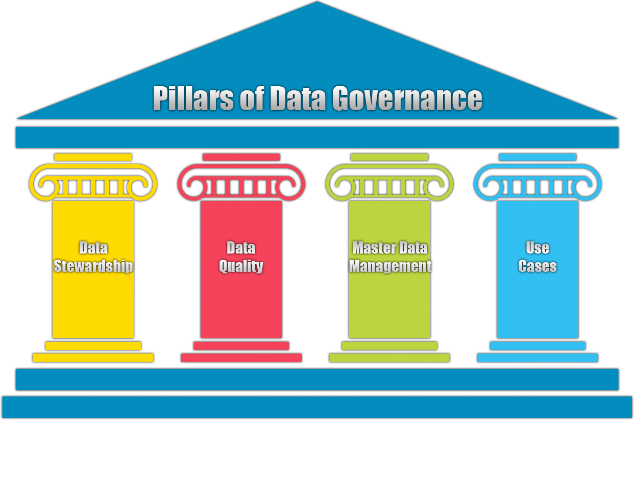
implementation

Slide 10
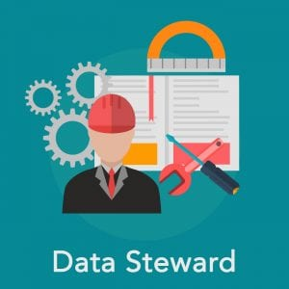
data stewardship
A data steward is management and oversight of an organization’s data assets to help provide users to high quality data in a consistent manner.
Creates processes, procedures, and policies
Ensure compliance and security of data
Maintain quality of data
(Starting median salary is 66k)

Slide 11
data quality
How suitable the data is for the use case at hand.
Completeness: Is there any missing data?
Validity: How reliable is the data?
Uniqueness: Is there duplicated data?
Consistency: Is the data consistent across the entire system?
Timeliness: Is the data relevant chronologically?
Accuracy: Does the data conform to our standards?
Ex. multiple ways to enter phone numbers. Which is the correct way?
352-123-4567 (352)-123-4567
352.123.4567 3521234567
352 123 4567

Slide 12
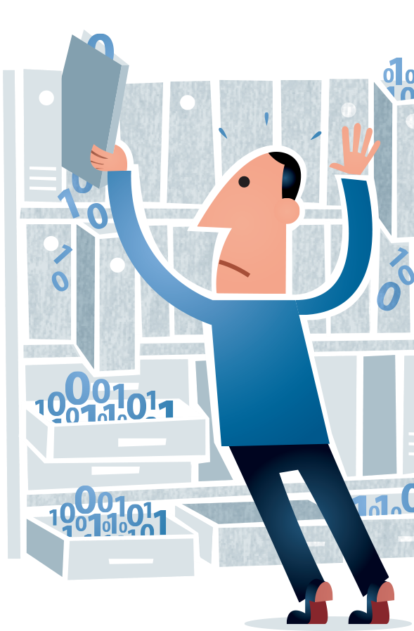
master data management
A method used to define and manage critical data of an organization to provide a single point of reference. By doing so it allows for things such as:
Easier integration with systems if there is a corporate merger or acquisition
Effectively cooperate with different business partners
Building the most optimal customer view that addresses needs in the best way possible

Slide 13
use cases
Data Lake
holds raw uncurated data
unique identifier and metadata tags
Undefined
flat level organization
Data Warehouse
stored in files and folders
relational data
structured and defined
readily available

Slide 14
activity
Where’s That From?!
Location
Date
Time
Resolution
OS
Battery Status
Cookies
Date
Time
Location
Device Name
Size
Location
Device Name
Battery Status
OS
Cust. Name
Payment Method
Tax Details
Website
Pager
Picture
Point of Sale System
Cellphone

Slide 15
activity
Where’s That From?!
Location
Date
Time
Resolution
OS
Battery Status
Cookies
Date
Time
Location
Device Name
Size
Location
Device Name
Battery Status
OS
Cust. Name
Payment Method
Tax Details
Website
Pager
Picture
Point of Sale System
Cellphone

Slide 17
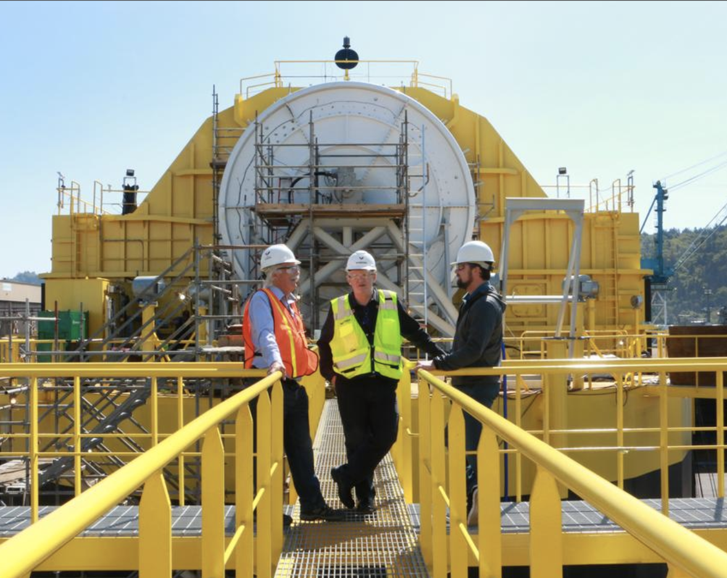
Porsche and Boeing’s ambitious partnership.
Portland’s Renewable Wave Machine

Slide 18
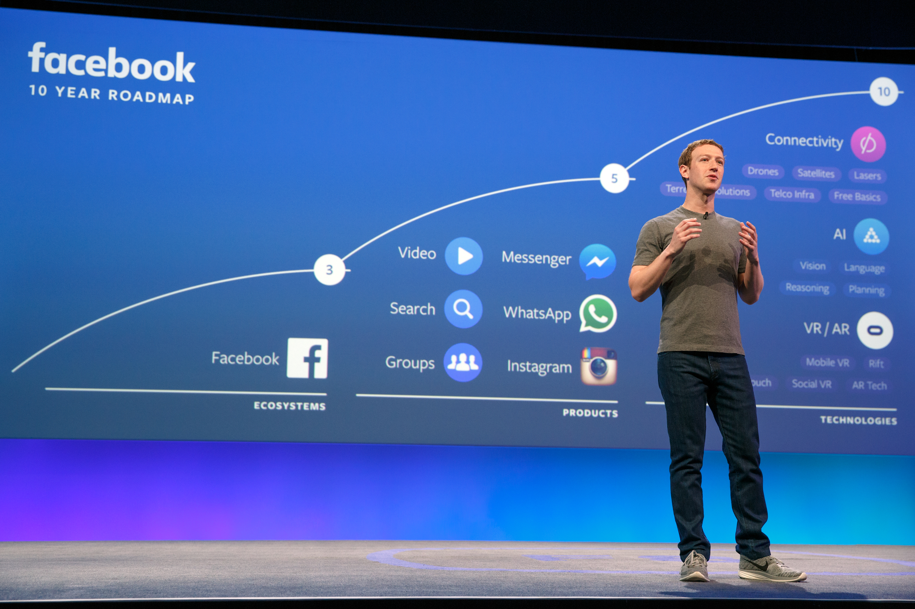
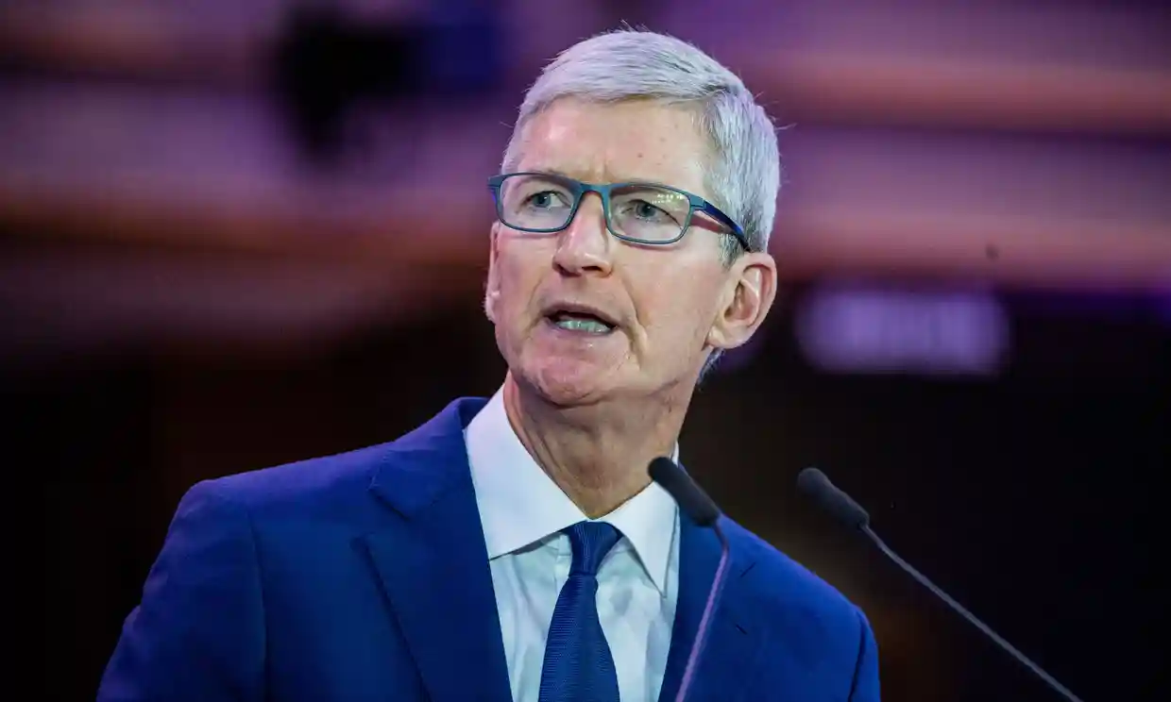
this week in tech:
Tim Cook defends Apple’s decision to remove HKMap app.
Is Facebook: “optimized for outrage?”

