Slide 1
data analytics

Slide 2
analyzing data in business
Big Data Collections of data so large, varied in content, and fast to accumulate, that they’re difficult to store and analyze.
Using data to develop algorithms and recommend products to customers, ones that improve every time a customer responds to or ignores a recommendation - better understanding and retaining customers
Ecommerce
Online retailers track products looked at when navigating through site, influenced by promotions, reviews, and page layouts; tracking similarities across people and groups
DATA ANALYTICS: OVERVIEW STORE ANALYZE VISUALIZE

Slide 3
data storage

Slide 4
data collection and storage
There are multiples types of data collected - structured, unstructured, internal, and external data ETL Cycle: Extract - Data is analyzed and crawled through to retrieve relevant information from data sources in a specific pattern; drawn internally and externally from the company and can be defined or formatted differently. Transform - Data is transformed and cleansed to adhere to common data definitions. Load - Data is loaded into the data warehouse.
DATA ANALYTICS: OVERVIEW STORE ANALYZE VISUALIZE

Slide 5
database types
Relational (SQL) v nonrelational (NoSQL) databases:
Relational databases are when companies often use the same relational database management system for their data warehouse as they use their operational database, but loaded into a separate server and tuned for fast retrieval and reporting.
Nonrelational databases does not use the same system. Typically designed to be easily scalable and able to handle unstructured data.
DATA ANALYTICS: OVERVIEW STORE ANALYZE VISUALIZE

Slide 6
storage in architectures
Hadoop: A scalable, open source software for file storage and local processing that supports processing of big data across up to thousands of computers in the cloud. Pandora uses Hadoop to analyze billions of likes that users click when each
song plays. The company can accurately predict customer preferences
and create tailored playlists, same goes for spotify’s discover weekly!
Others: Virtual federated warehouse, data warehouse appliance, in-memory database, noSQL, data cubes
DATA ANALYTICS: OVERVIEW STORE ANALYZE VISUALIZE

Slide 7
data analysis

Slide 8
database querying
An analyst would use querying to find trends or confirm a hypothesis relevant to the business, retrieving all the information about them from the customers table in the database (typically structured data).
SQL: SELECT * FROM CUSTOMERS WHERE AGE > 45 and SEX = ’M’ and DOMICILE = ‘NE’
DATA ANALYTICS: OVERVIEW STORE ANALYZE VISUALIZE

Slide 9
data mining finds patterns
The practice of examining large databases in order to generate new information.
Used to finding patterns and regularity in the data.
Facebook collects data on their users - current friends, where you live, your workplace, and needs to find a way to say person 1 probably knows person 2 - and that they should see each other in their recommended friend's list.
DATA ANALYTICS: OVERVIEW STORE ANALYZE VISUALIZE

Slide 10
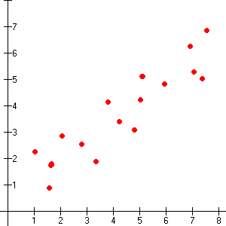
statistical mining
A subfield of mathematics that deals with finding relationships between variables to predict the probability of certain outcomes.
Statistical models embody a set of assumptions concerning the generation of the observed data and similar data from larger populations.
Correlation is not causation
Heat strokes
Ice cream
DATA ANALYTICS: OVERVIEW STORE ANALYZE VISUALIZE

Slide 11
jack sparrow mines for gold
DATA ANALYTICS: OVERVIEW STORE ANALYZE VISUALIZE

Slide 12
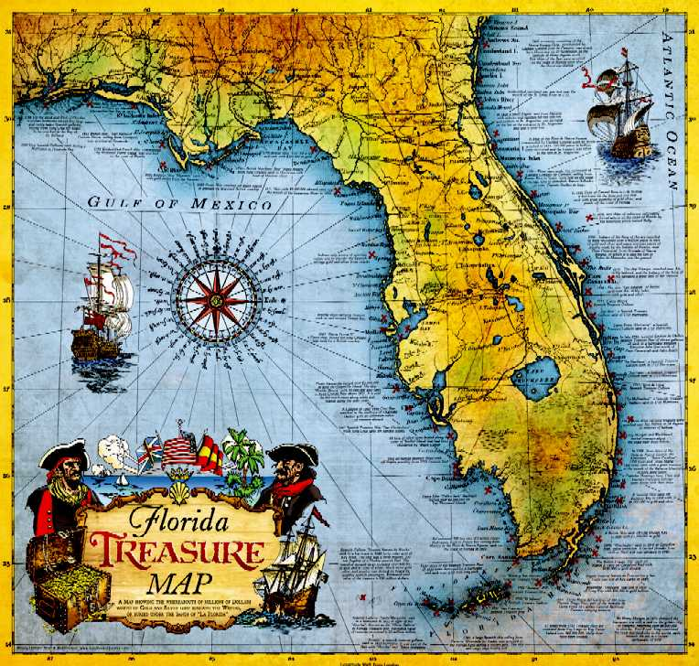
where should he look?
Where treasure had been found by others in the past
Ocean currents
Weather patterns
Sea floor
Routes likely to be taken by the ship’s captains in that era
DATA ANALYTICS: OVERVIEW STORE ANALYZE VISUALIZE
Notes:
Let’s say jack sparrow had the ability to analyze the data. What would he look for to find treasure?
Modeling is simply the act of building a model in one situation where you know the answer and then applying it to another situation that you don't. For instance, if you were looking for a sunken Spanish galleon on the high seas CAPTAIN JACK SPARROW the first thing you might do is to research the times when Spanish treasure had been found by others in the past. You might note that these ships often tend to be found off the coast of Bermuda and that there are certain characteristics to the ocean currents, and certain routes that have likely been taken by the ship’s captains in that era. You note these similarities and build a model that includes the characteristics that are common to the locations of these sunken treasures. With these models in hand you sail off looking for treasure where your model indicates it most likely might be given a similar situation in the past. Hopefully, if you've got a good model, you find your treasure. Computers are loaded up with lots of information about a variety of situations where an answer is known and then the data mining software on the computer must run through that data and distill the characteristics of the data that should go into the model. Once the model is built it can then be used in similar situations where you don't know the answer. For example, say that you are the director of marketing for a telecommunications company and you'd like to acquire some new long distance phone customers. As the marketing director you have access to a lot of information about all of your customers: their age, sex, credit history and long distance calling usage. The good news is that you also have a lot of information about your prospective customers: their age, sex, credit history etc. Your problem is that you don't know the long distance calling usage of these prospects (since they are most likely now customers of your competition). You'd like to concentrate on those prospects who have large amounts of long distance usage. You can accomplish this by building a model. Table 2 illustrates the data used for building a model for new customer prospecting in a data warehouse.

Slide 13
where should he look?
Machine learning is a subfield of Artificial Intelligence, a method for improving the performance of an intelligent agent over time, giving computers the ability to learn.
Detects patterns in data and looks for new, similar patterns to form new conclusions.
Includes subfields such as robotics and computer vision, concerned with issues of agency and cognition.
Snapchat filters use Machine Learning
DATA ANALYTICS: OVERVIEW STORE ANALYZE VISUALIZE

Slide 14
data visualization

Slide 15
where should he look?
What? Displaying data findings through visuals
Why? To use data to tell a story and show trends, focuses, etc. for business people
How? Bar charts, maps, pie charts, scatter plot, histogram, line chart, tables, tree diagram, etc. Tableau
DATA ANALYTICS: OVERVIEW STORE ANALYZE VISUALIZE

Slide 16
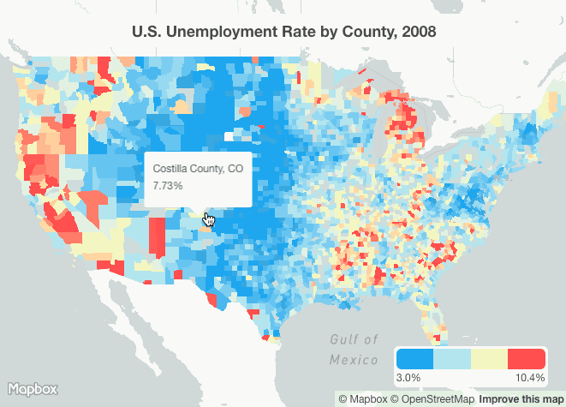
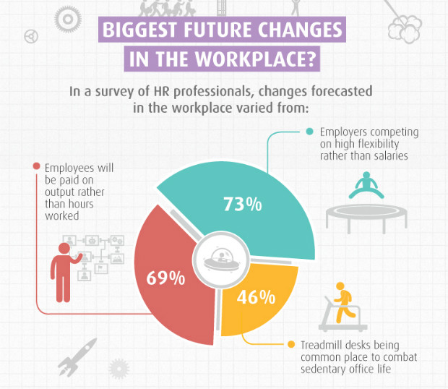
data storytelling
DATA ANALYTICS: OVERVIEW STORE ANALYZE VISUALIZE

Slide 17
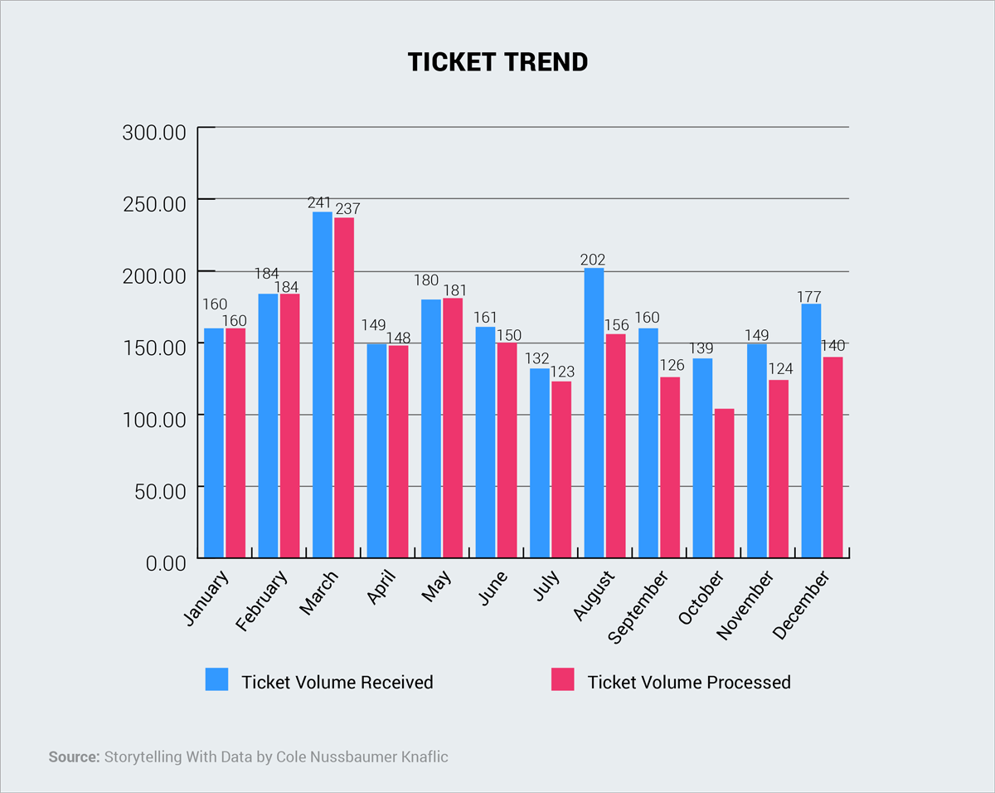
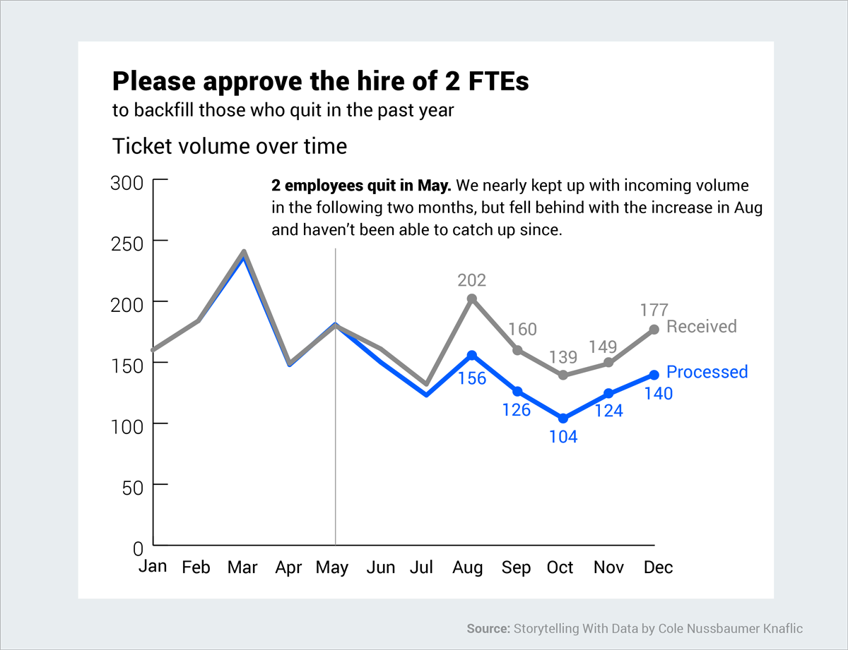
tickets processed and received
DATA ANALYTICS: OVERVIEW STORE ANALYZE VISUALIZE
Notes:
So what?
Before - This bar chart displays the number of tickets received and processed in a year.
After - If your purpose is to convey a message and move someone to a specific action (in this case, the hire of two new employees), then this is much better.

