Slide 1
Notes:
Explain what gatortech is.

Slide 2
fall 2019 mods
Notes:
Explain the mods/content that will be covered this semester.

Slide 3
Check-in on gatortechuf.com
Coordinator applications are open! Applications close 9/22. https://bit.ly/2k7RuTG
Socials
TODAY! - MOD pizza dinner social
Polls: Socials, Hackathons, Workshops
Go to www.menti.com
Notes:
Go to mentimeter for the polls.
Hackathons: https://mlh.io/seasons/na-2019/events
ShellHacks: https://shellhacks.net/
HackGSU: http://hackgsu.com/
HackGT: https://2018.hack.gt/
SwampHacks: https://2019.swamphacks.com/
MangoHacks: https://mangohacks.com/
KnightHacks: https://knighthacks.org/

Slide 4
4 Corners

Slide 5
Strongly agree
Front of the Room
Strongly disagree
Do you think that mobile payment will become the most common form of payment in the next decade?
Somewhat agree
Back of the Room
Somewhat disagree

Slide 6
Strongly agree
Front of the Room
Strongly disagree
Finance will be transformed radically by technology
Somewhat agree
Back of the Room
Somewhat disagree

Slide 7
Zero
Front of the Room
1-3
How many times do you use mobile payment per week?
4-6
Back of the Room
All day erryday

Slide 8
fintech

Slide 9
Kahoot
Go to kahoot.it
Notes:
https://create.kahoot.it/share/fintech-intro/9b677231-139f-4b1d-ad9a-79cefd4d581b

Slide 10
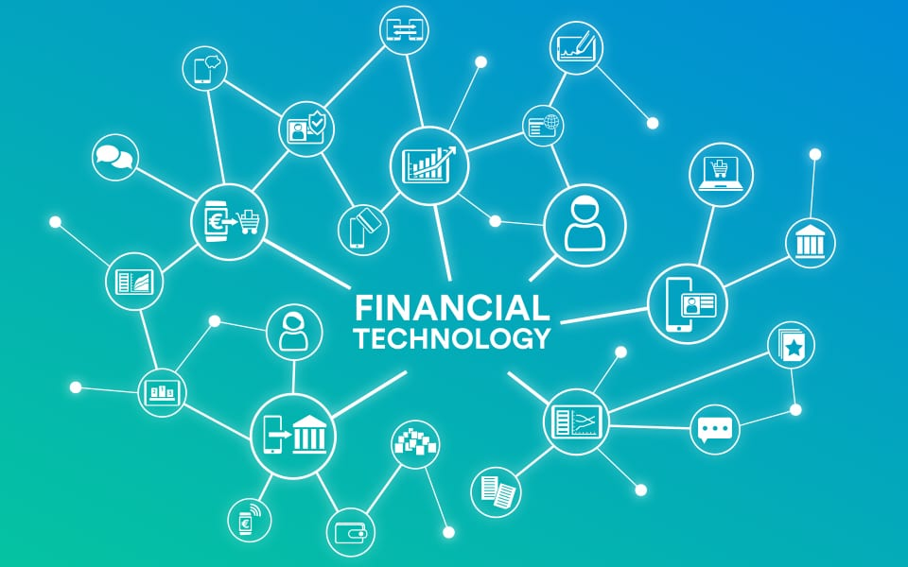
what is fintech?
A combination of the terms “finance” and “technology”
Refers to any business that uses technology to enhance or automate financial services and processes

Slide 11
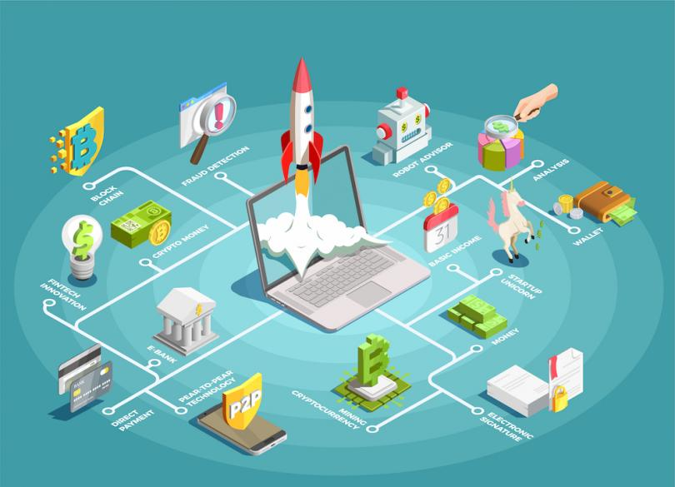
how does it work?
Technology has, to some degree, always been part of the financial world.
Some of the newest advances, however, are utilizing machine learning algorithms, blockchain and data science.
Notes:
Whether it's the introduction of credit cards in the 1950s or ATMs, electronic trading floors, personal finance apps and high-frequency trading in the decades that followed.

Slide 12
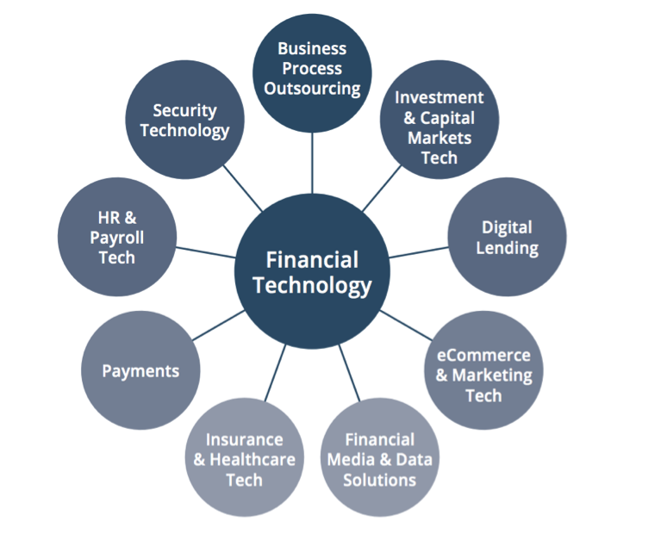
industries in fintech
Banking
Cryptocurrency & Blockchain
Personal Finance
Machine Learning & Trading
Insurance
So many more...

Slide 13
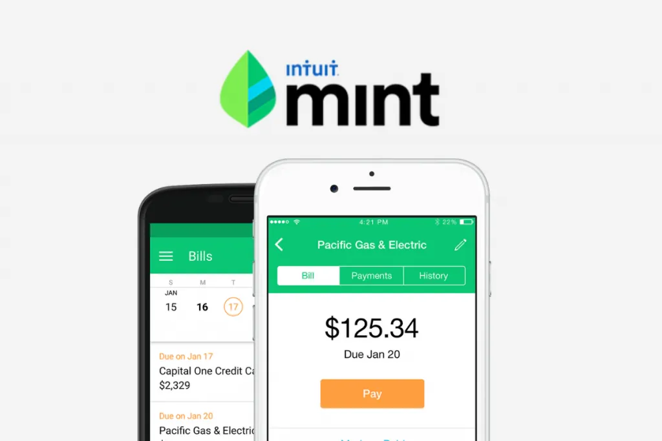
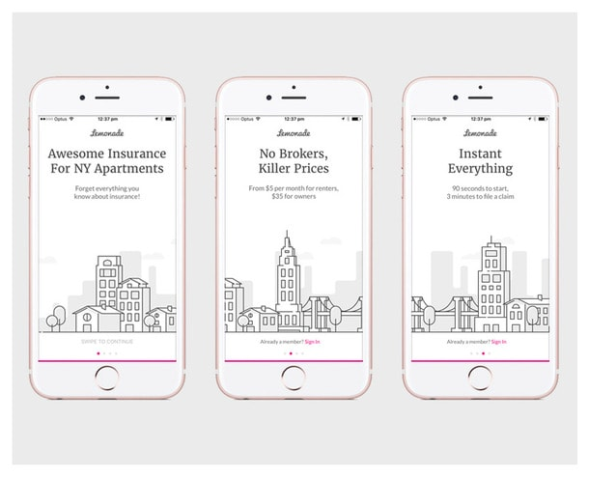
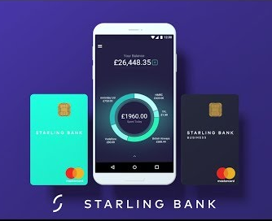
popular fintech apps
Personal Finance
mint
Insurance
Lemonade
Banking
Starling Bank
Notes:
https://artjoker.net/blog/top-10-fintech-and-banking-apps-how-to-develop-fintech-and-banking-apps/

Slide 14
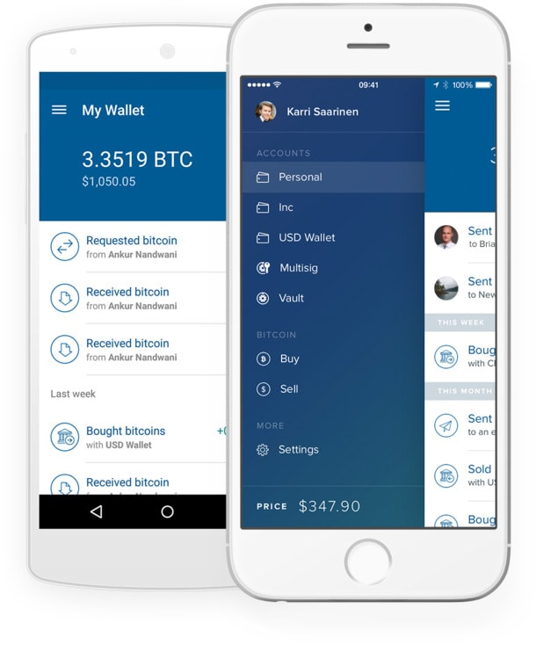
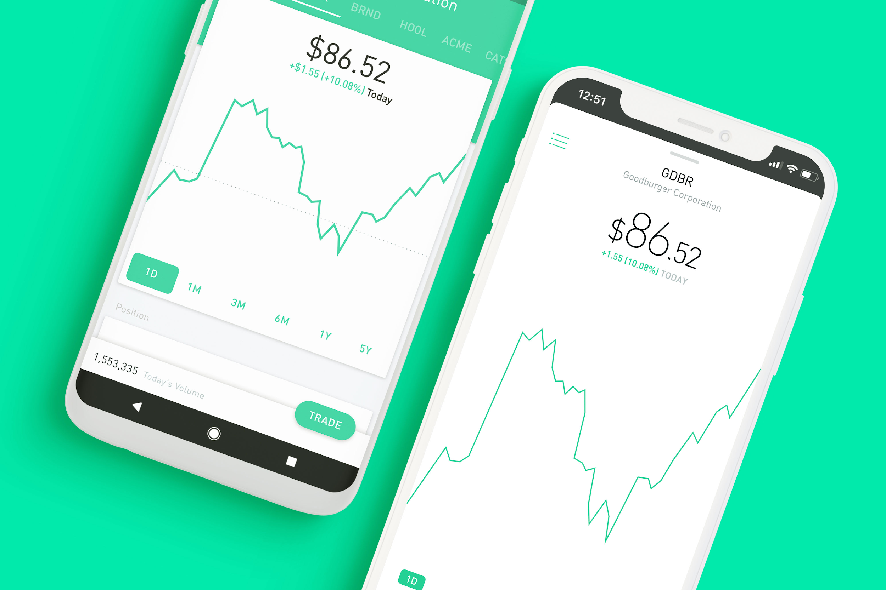
popular fintech apps
Cryptocurrency
Coinbase
Investment
Robinhood

Slide 15
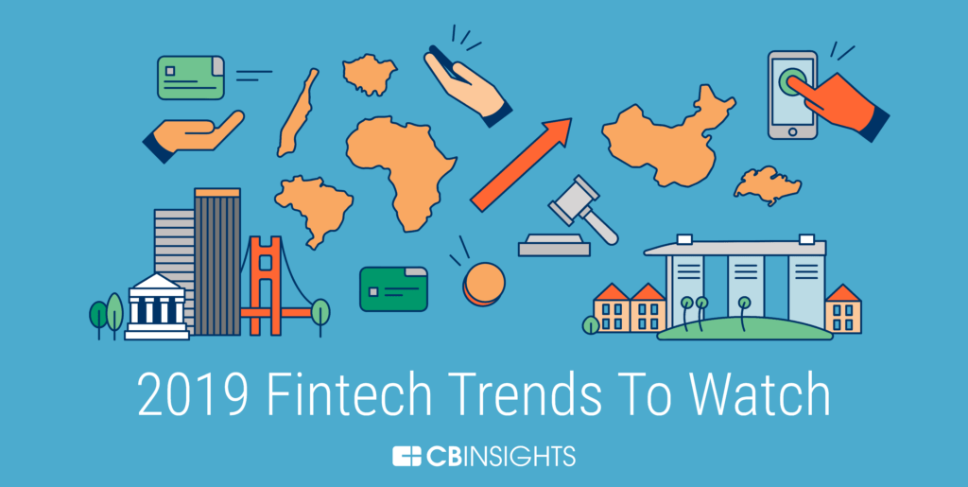
trends in fintech
Robo Advising for Financial Advisors
Security Token Offerings
Blockchain in Lending and Investing
Increase in Mobile Wallet Transactions
Global Fintech Regulation
Notes:
https://online.wharton.upenn.edu/uncategorized/5-fintech-trends-to-watch-in-2019/

Slide 17
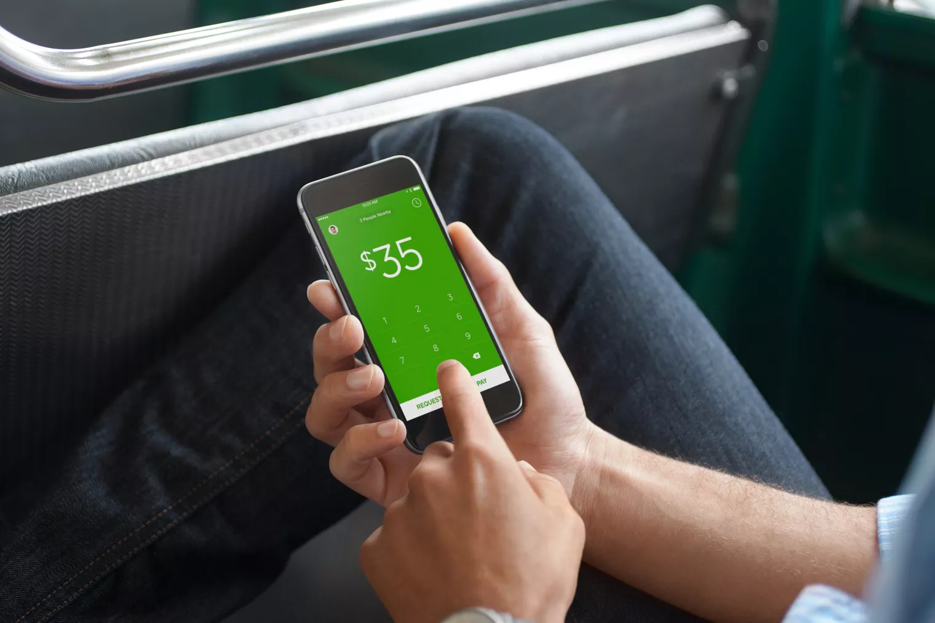
Mastercard and R3 partnership
Cryptocurrency
Coinbase

