Slide 1
Notes:
Explain what gatortech is.

Slide 2
Check-in on gatortechuf.com
Coordinator meeting 11/19 * correction from last week
Right after GBM!
Video game social - 12/3
Notes:
Go to mentimeter for the polls.
Hackathons: https://mlh.io/seasons/na-2019/events
ShellHacks: https://shellhacks.net/
HackGSU: http://hackgsu.com/
HackGT: https://2018.hack.gt/
HackFSU: https://hackfsu.com/
SwampHacks: https://2019.swamphacks.com/
MangoHacks: https://mangohacks.com/
KnightHacks: https://knighthacks.org/

Slide 3
Rock, Paper, Scissor

Slide 4
Word and Songs
Get into groups of 4-5
Come up with as many songs as you can with the word “baby” in it
After the time is up, we are going to go around the room and sing part of the lyric that has the word “baby” in it
Songs cannot repeat

Slide 5
game
design

Slide 6
game design
Game design refers to the idea behind a game, including:
Theme
Plot
Rules and mechanics
Goals
Different from development
Notes:
Game-design is concept creation, while game-development is the execution of this creative vision.
Game-designers are creative and can see the big picture, they normally know what gamers want in a game and what makes the game fun, challenging, and unique.

Slide 7
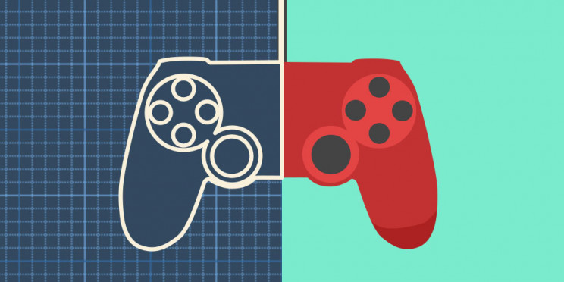
game design document
The blueprint for your game.
Outlines:
Genre and Theme
Pillars
Target Audience and Platform
Gameplay and Mechanics
Should be capable of changing.
Notes:
Describes the vision of your game and outlines the details.
Pillars: defining features that should be focused on. What makes the game unique
Gameplay: the systems, how the game is gonna work, the structure and goals, components
GDD shouldn’t be super strict so that it doesn’t limit and hinder development when something doesn’t work as planned

Slide 8
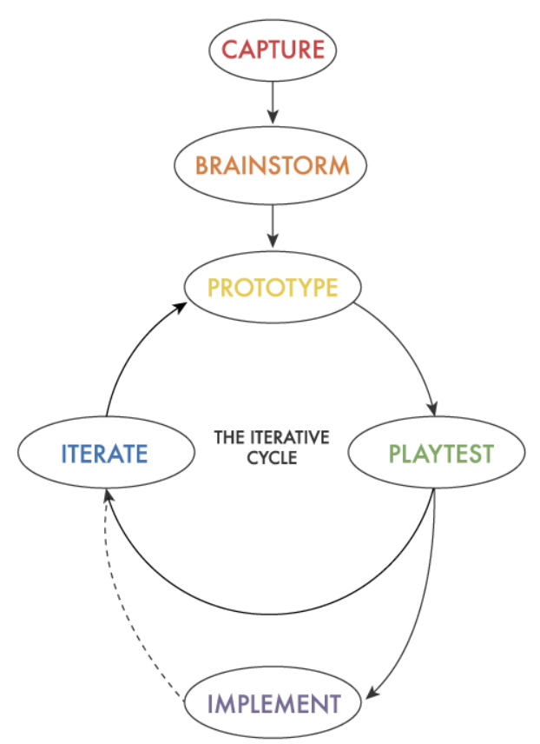
stages of game design
capture: do research and find inspiration for designs
brainstorm: toss around different concepts and ideas
prototype: give ideas form
playtest: see how it fits into the current environment and storyboard
iterate: make necessary adjustments
implement: put into the product but be on the lookout for future improvements
Notes:
https://www.gamecareerguide.com/features/1415/the_game_design_process.php

Slide 9
software
Maya (3D Models)
Illustrator (2D Art)
Photoshop (UI, Level Maps, Assets)
Unity / Unreal / Gamemaker (Prototypes)
Notes:
Character and component concept creation is important for game design, this is usually done in Maya for 3D models and Adobe Illustrator for 2D art. Placeholders can be made prior to the final models so that the game can be tested without committing too many resources.
Photoshop is normally used for designing levels and making assets (such as sprites).
Unity / Unreal / Gamemaker, which we talked about last week, can be used to create prototypes of games before achieving the final product.

Slide 10
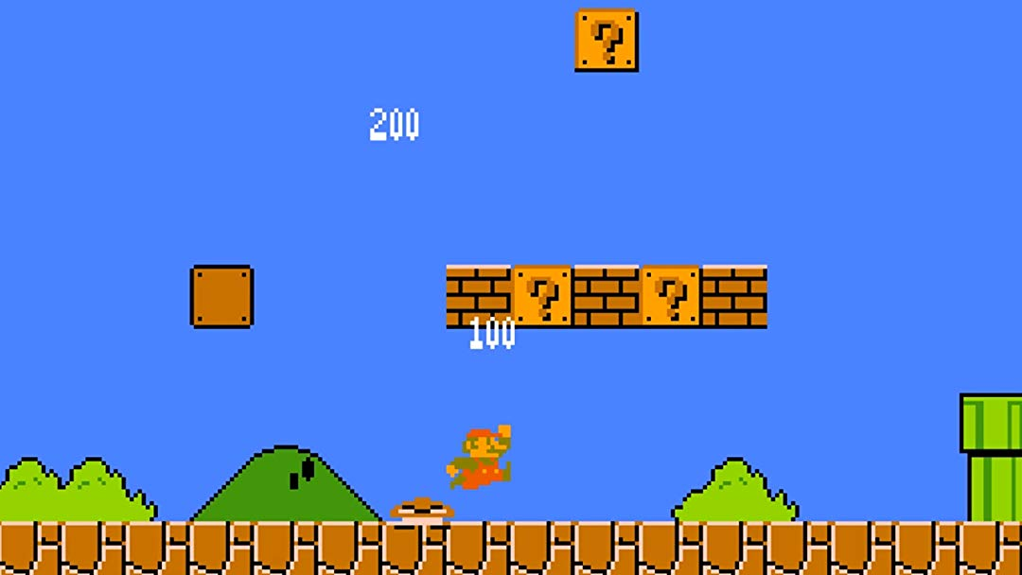
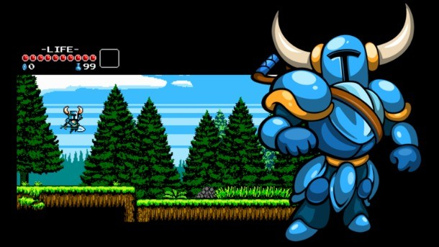
how to start
Hook: What makes your game so interesting? Is it the story, the gameplay, or art?
Mechanics: What does the player do and why?
Story: What gives the game purpose and emotions
Ambiance: What impressions will the game give off?
Notes:
Both Mario and Shovel knights are platformers and share many similarities
They both have the same quest to rescue someone precious to them
But we can see how different their aesthetic are
Mario is much more brighter and jovial while Shovel Knight is a more grim and darker theme

Slide 11
storyboarding
The crux of game design
Sketches of characters and areas
Important plot point and direction
Establishes flow of events
Helps identify lacking areas
Area objectives
May include
Puzzles
Skills and gear upgrades
Concept Art
Establishes tone and atmosphere of characters and scenes
Helps guide storyboarding and animation

Slide 12
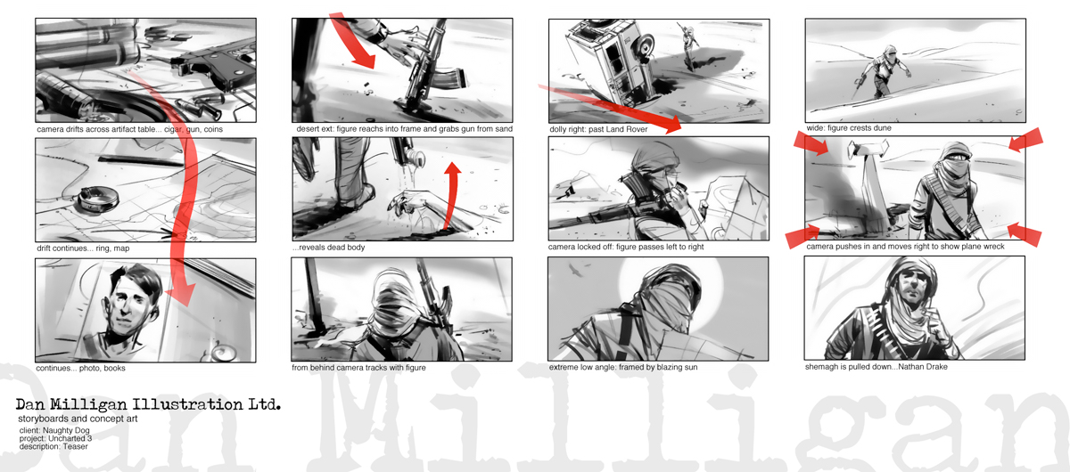
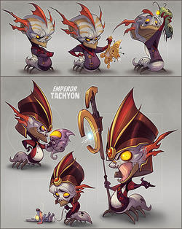
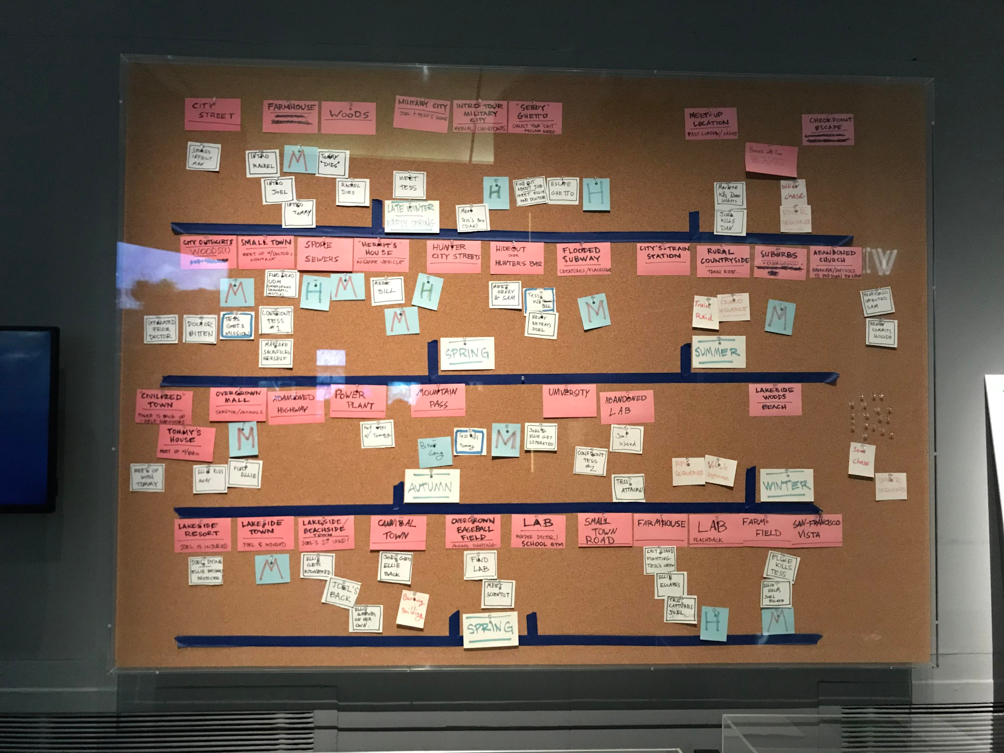
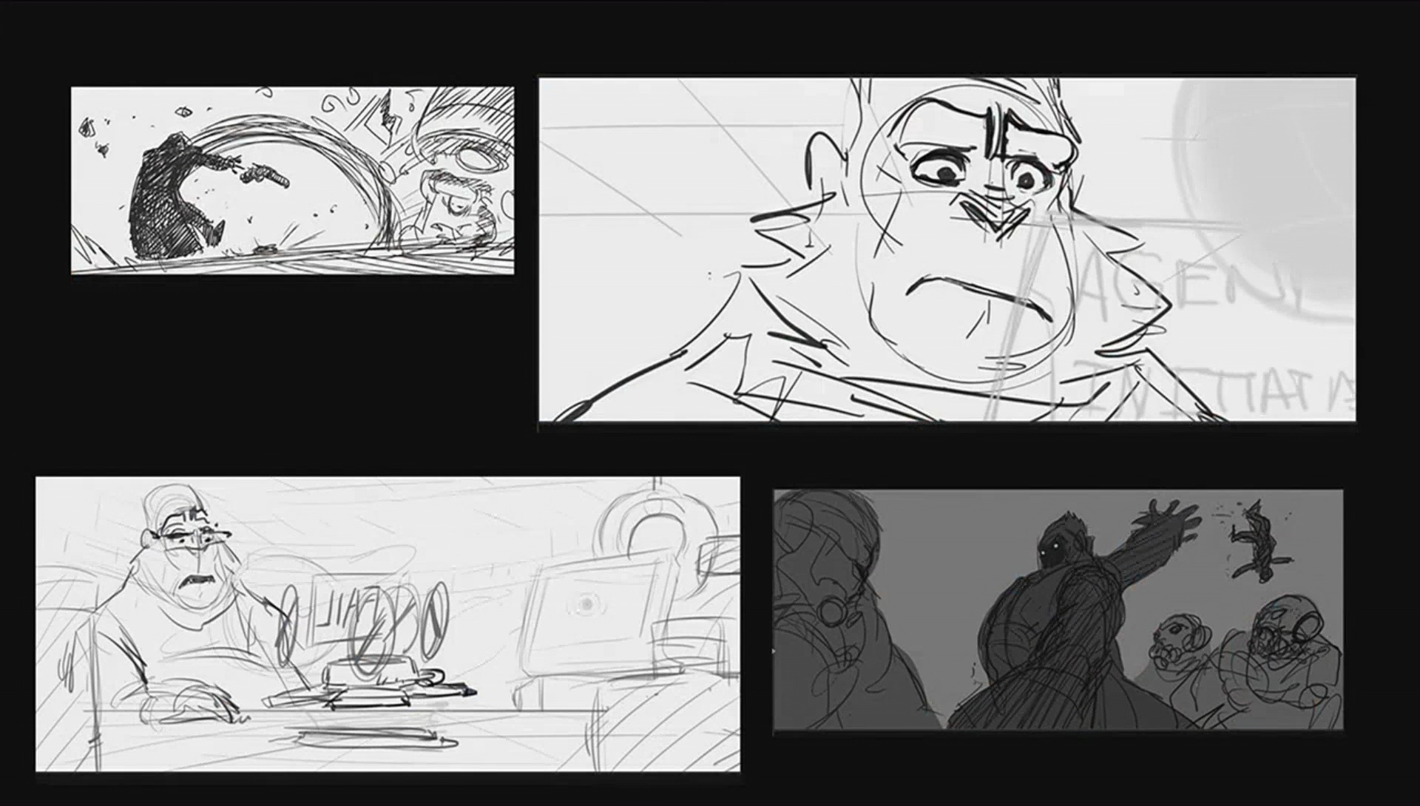
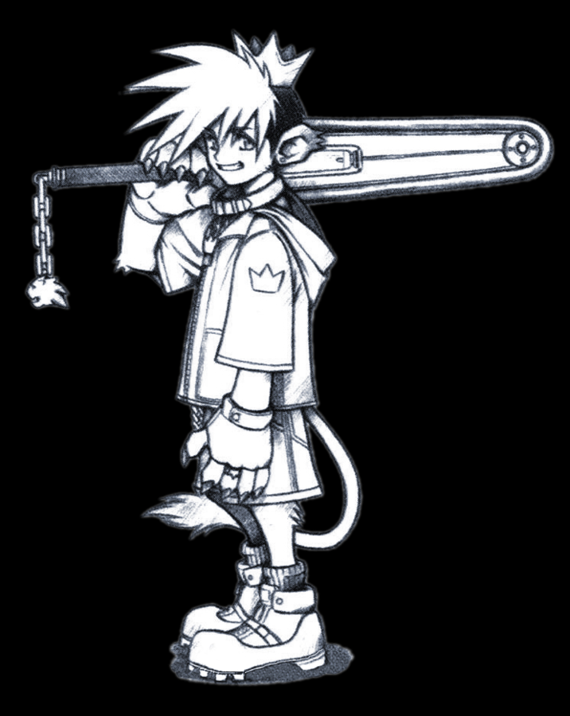

Slide 13
animation
Modeling
Creation of the base model for characters, items and location
Textures and and animation added afterwards
Requires research and references
2D Art
Character sheets
Multiple poses strung together for animation
Different expressions
Texture
Texture map contains the image and color details for the model
Animation
Making models move, interact, and emote
Controls how models react to certain stimuli
Notes:
Mesh: a form of modeling that stores information about vertices, edges, and faces to construct model
https://youtu.be/M4xJaXLE_98?t=184

Slide 14
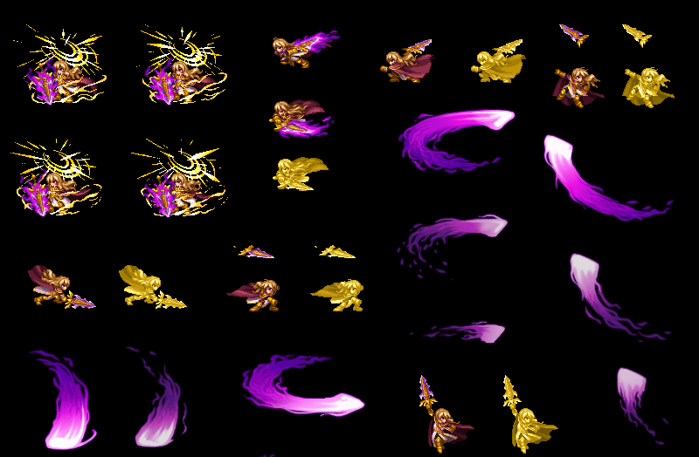
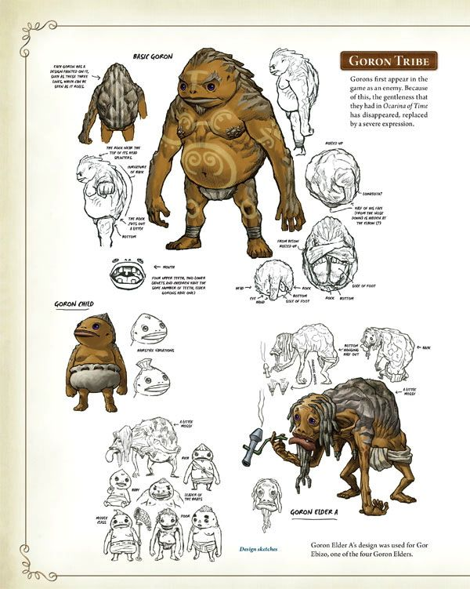
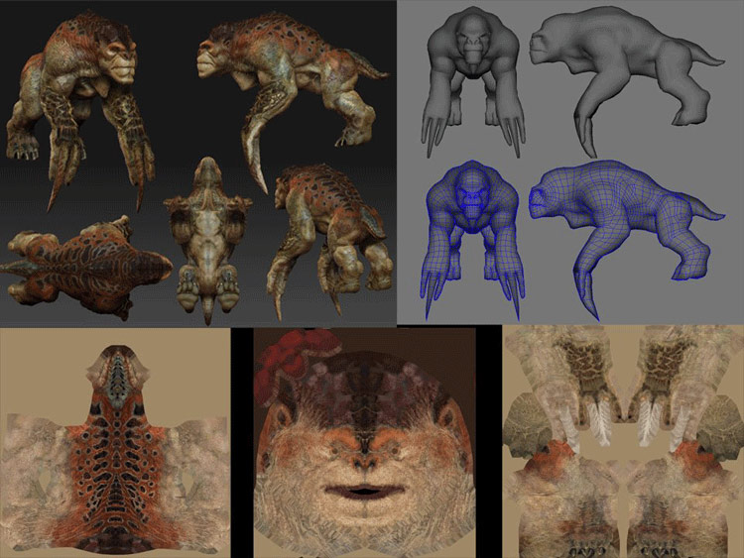

Slide 15
level design
Providing players with a goal and providing players with an enjoyable play experience.
Levels are generally constructed with a control of the flow in mind, directing players to certain objectives and preventing idleness and confusion.
Some examples of level design elements:
Set ground rules such as scoring system, win and loss conditions, movement
Location of scripted events, non scripted events, player character, and enemies
Level textures, sounds, and animations

Slide 16
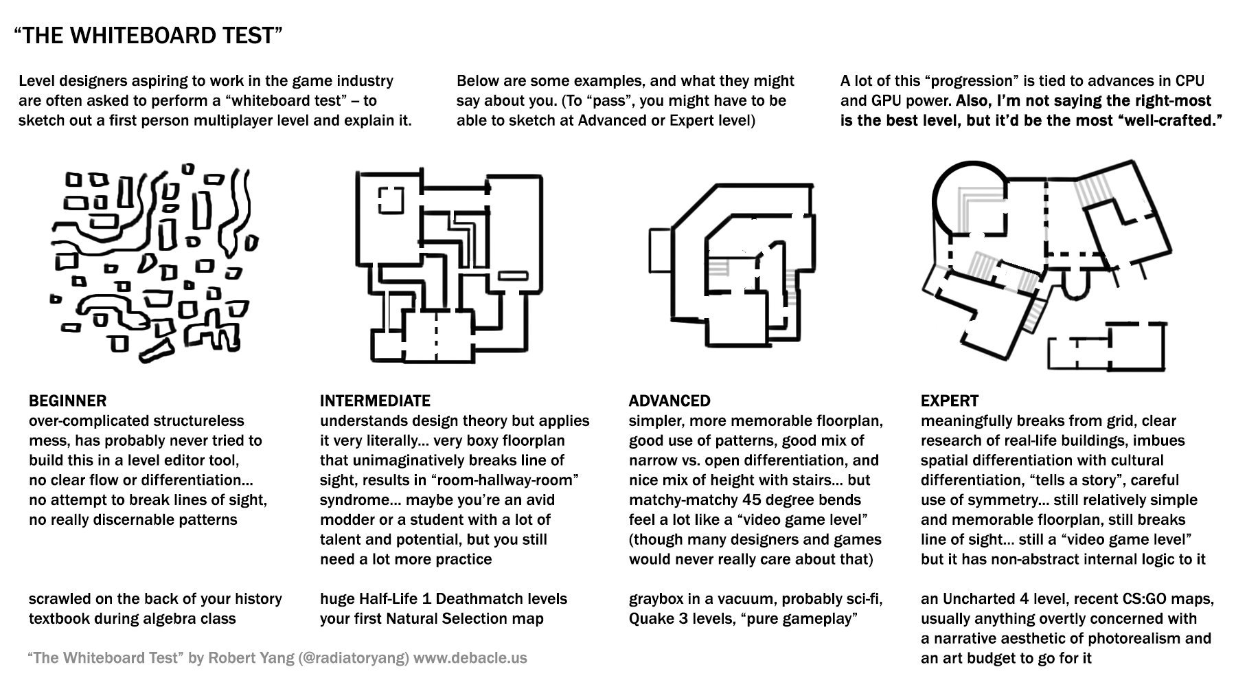

Slide 17
activity
Design an area, character, or basic model that will be a part of the game idea you came up with last week.
Notes:
Next week design an area/character, and then basic modeling/hud

Slide 19
Porsche and Boeing’s ambitious partnership.
Portland’s Renewable Wave Machine

Slide 20
this week in tech:
Facebook’s News Chief Conflict-of-Interest?
Google’s Collection of Health Data

Slide 21
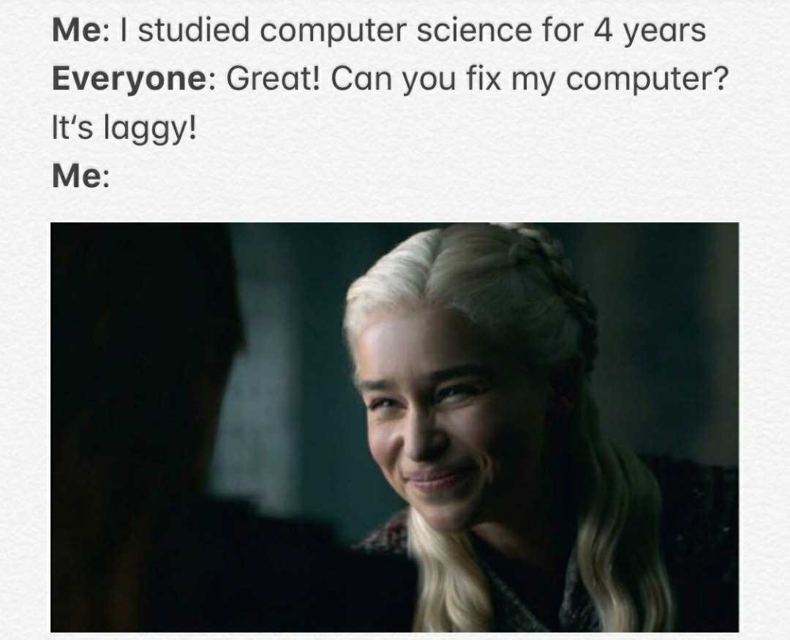
Tech Meme(s) of the Week

