Slide 1
blockchain

Slide 2
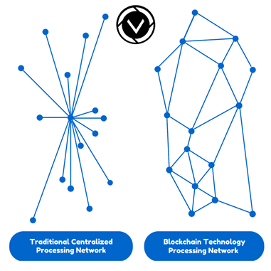
what is blockchain
Digital, distributed ledger
Peer to peer network
vs. client/server
vs. central point of failure
Notes:
Ledger - book for recording

Slide 3
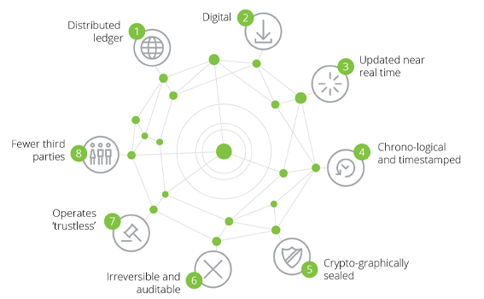
making blockchain
Distributed
Consensus protocol
Cryptographically secured
Timestamped history

Slide 4
how does blockchain work?
Linked list
Each block has a timestamp and a link to previous block
Managed autonomously through peer to peer network

Slide 5
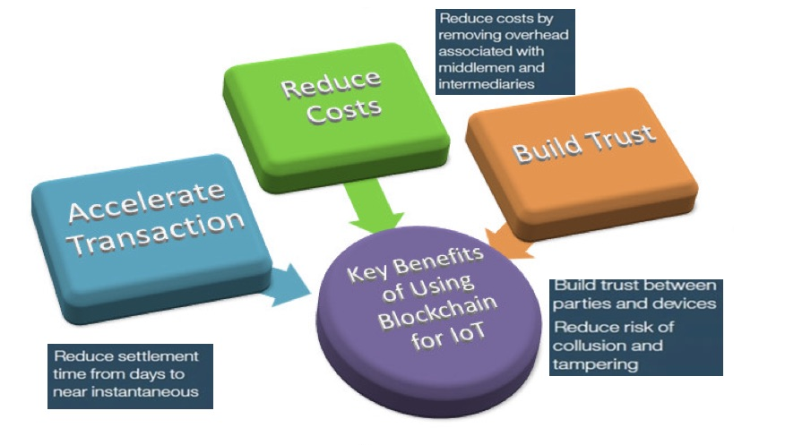
blockchain benefits
Trustless / no middle-man
Decentralized
Transparency
Immutability
Speed
Reduced fees *

Slide 6
blockchain challenges
Nascent
Legal & regulatory status
Permissions & privacy
Culture / adoption challenges
Scaling

Slide 7
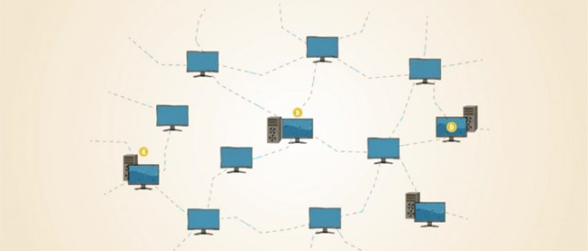
bitcoin
Digital currency
secured by blockchain
Payment processor
Global trust network
Benefits
Solves double-spend problem
Low fees
Quick processing

Slide 8
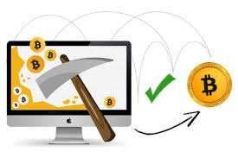
mining
Approving transaction records to the ledger
Batch becomes a block added to the chain!
Solve math problem (proof of work)
Incentive: new bitcoins
Currently ~16 million bitcoins
1mil + lost
Cap of 21 million - 2140
Notes:
Limited # mined - like gold. Thats why it has value

Slide 9
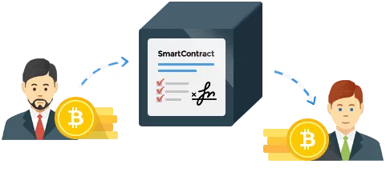
smart contracts
Code that allows for the exchange of assets in a transparent, conflict-free way
Avoids the need for a middle man
Operate on a “if this-then that” logic
Example: fantasy football

Slide 10
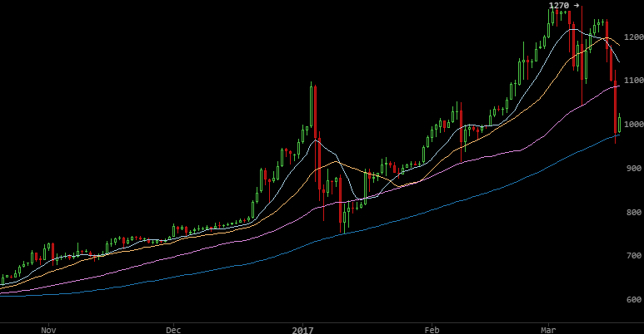
initial coin offerings/invest
ICOs > Venture Capital
Speculative & volatile
New way to store value
Greece, Venezuela, etc.

Slide 11
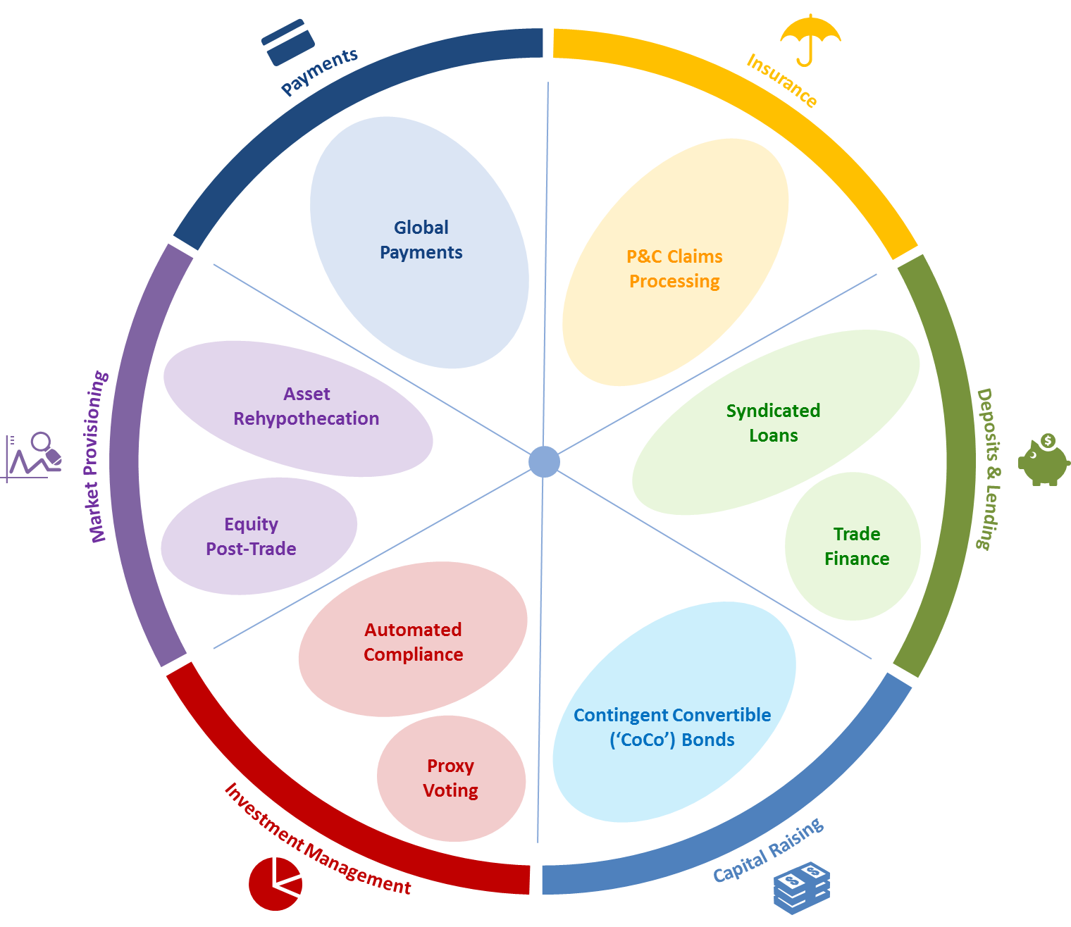
use cases
Finance/Currency
Remittances
Supply Chain
Energy Sector
Healthcare
Governments - Voting
Legal
Smart contracts / property deeds
Other Tech - self driving cars

Slide 12
resources
Blockchain Overview (written by Denes Magyar and Sam Neely) https://github.build.ge.com/EntArch/OtherDocs/tree/master/Blockchains
Playground- Test it yourself online, no setup required https://composer-playground.mybluemix.net/
Install hyperledger instance locally https://hyperledger.github.io/composer/installing/installing-index.html
Tutorials https://hyperledger.github.io/composer/tutorials/tutorials.html
Video Overview/Demo: https://www.youtube.com/watch?v=fdFUsrsv5iw
Support chat https://chat.hyperledger.org
Bitcoin https://bitcoin.org

