Slide 1
user experience

Slide 2
the basics

Slide 3
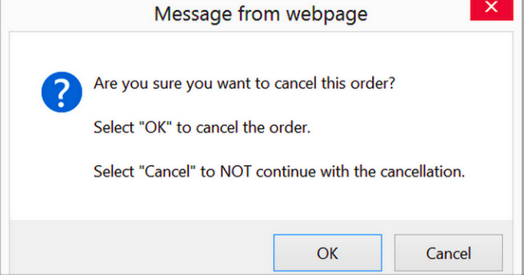
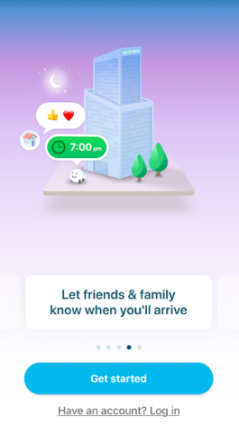
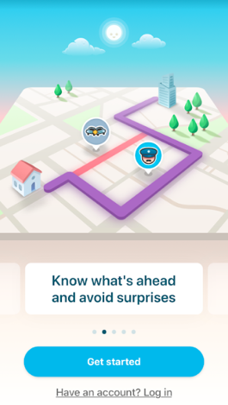
UX vs. UI
User Experience
User Interface
“Interaction Design”
Enhancing user satisfaction through better usability of a product
“Visual Design”
the visual elements of a product or experience that a user interacts with

Slide 4
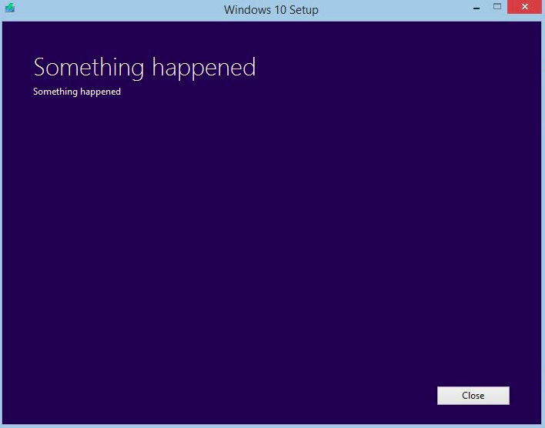
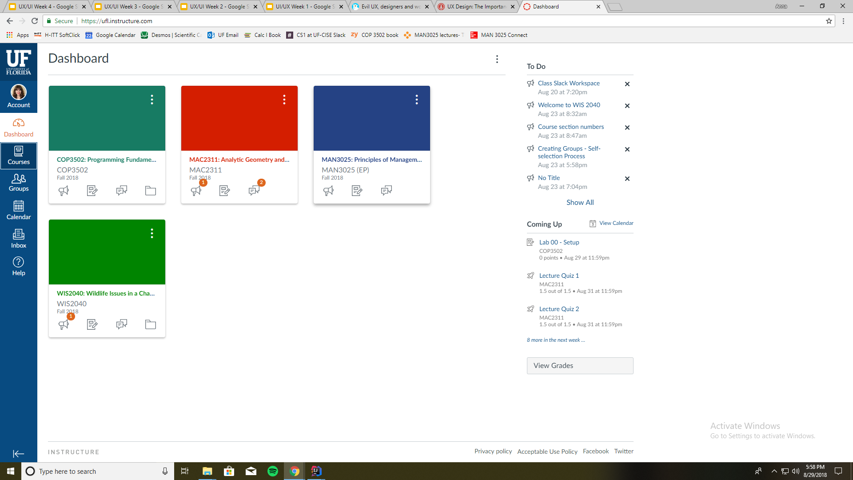
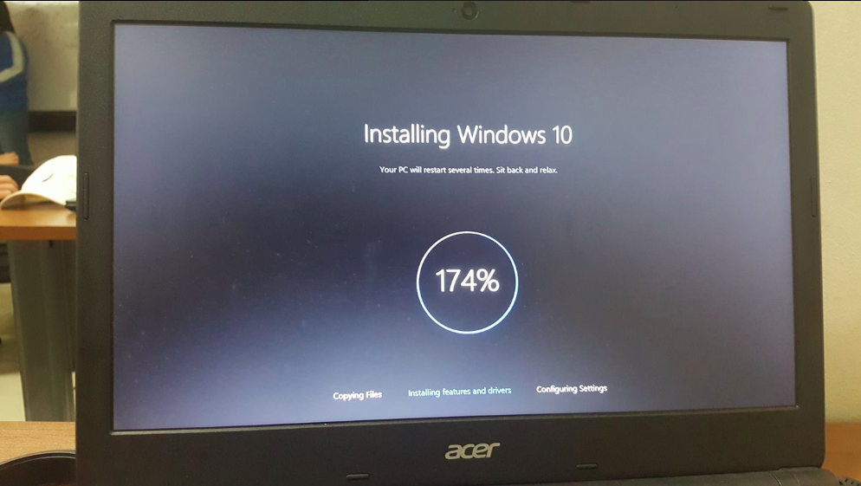
more bad ux, bc why not
canvas, doesn’t have bad ux i just have a bad experience every time i log on
Notes:
With bad ux you cant find things where you think they should be (probably due to poor planning/thinking on design side)
Too many clicks, not easy, not enjoyable

Slide 5
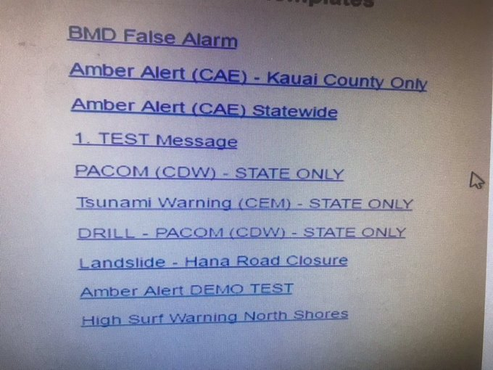
why is this important?
Example:
Hawaii Missile Alert
The operator clicked the PACOM (CDW) State Only link. The drill link is the one that was supposed to be clicked.

Slide 6
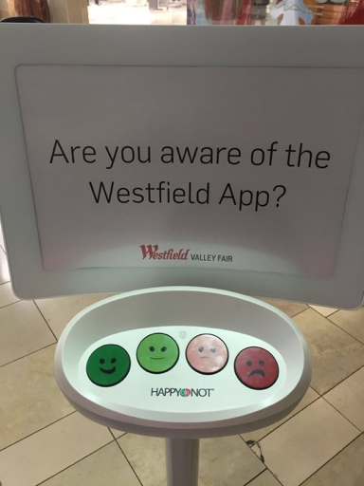
discussion
Get in a group of 3-4 and discuss:
What bad user experience or interface have you come across (whether on a website, app, or in real life)? What made it unenjoyable?
Snapchat redesign circa 2018
Poor UX irl

Slide 7
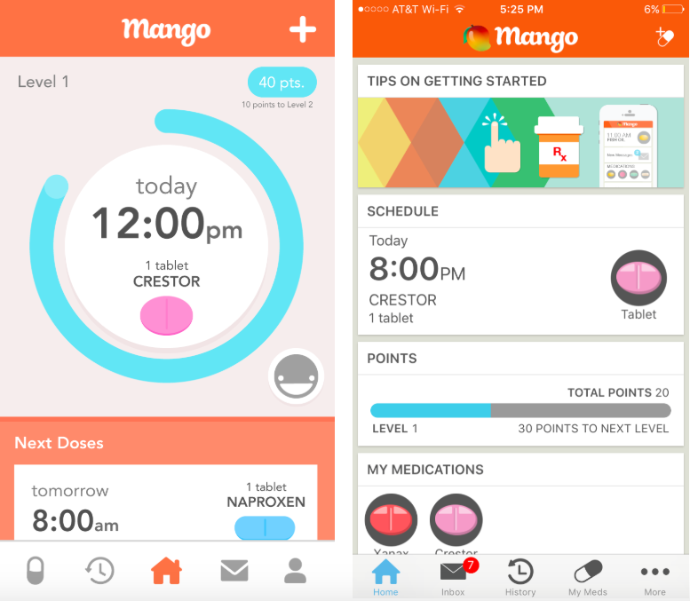
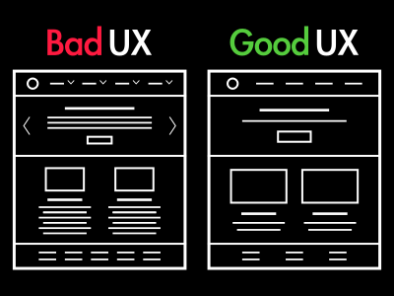
roles of UX designers
Strategy & Content:
How content is applied and received/interacted with best by the user
Customer + competitor analysis
Wireframing & Prototyping:
Wireframing = skeletal framework of a page
Prototyping = creation and testing of a prototype
Digital Prototype- software like PowerPoint
Paper Prototype- paper sketch
HTML Prototype- basic website framework
Knowing your audience: the elderly
Notes:
For the interacted link, scroll to near the bottom where apple has a scrollbar for the app page

Slide 8
topics within UX
Visual Design
Interaction Design
Design Thinking
Usability Testing
UX Research

Slide 9
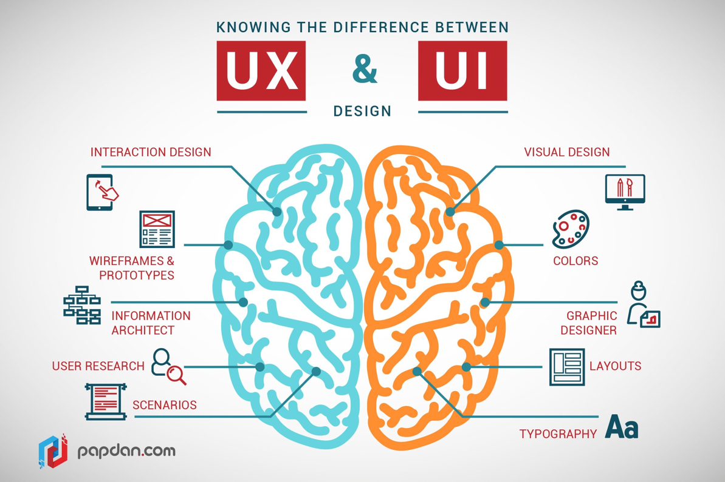
roles of UI designers
Look & Feel:
Looking at target market and designing accordingly
Visual Design:
Colors, typography, etc.
Also Interaction Design
Animation, interactive charts, etc.
Work with development to ensure vision is accurate
Notes:
Interaction Design can fall under UI or UX because interaction needs designing? If that makes sense

Slide 10
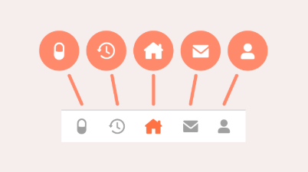
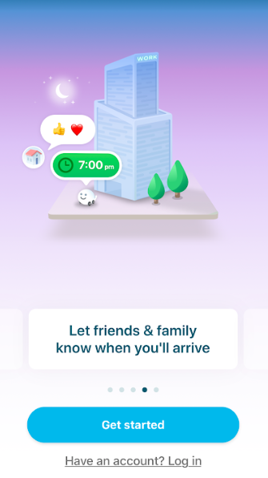
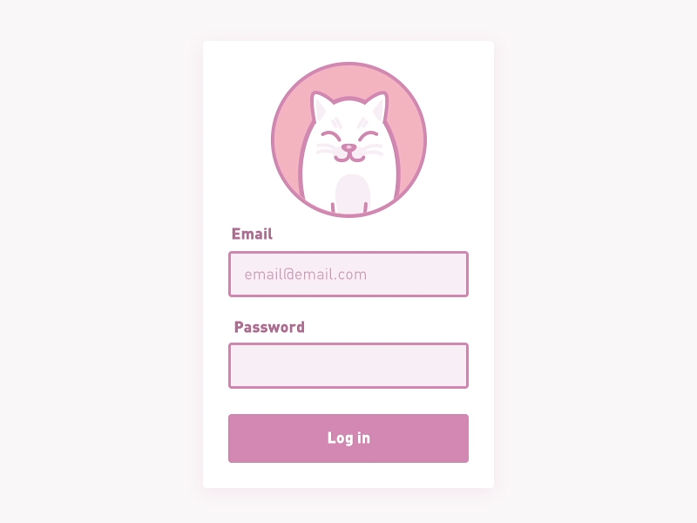
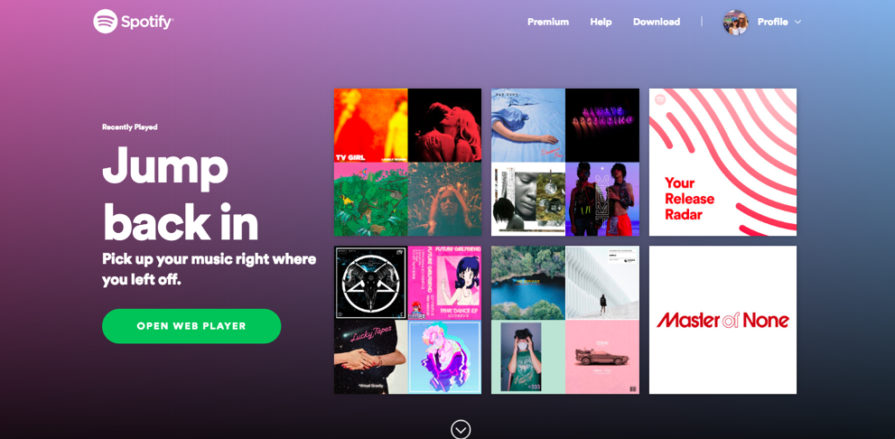
2018 UI trends
1. Color Gradient
2. Seamless Interface- all content on a single page
3. Quiet/Comfort Colors
4. Children’s book-esque characters/icons
5. Animations

Slide 11
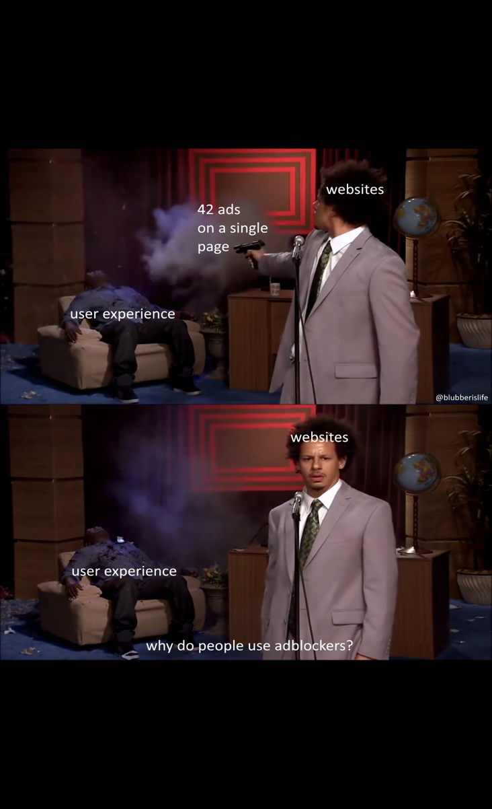
prototyping tools
Moqups.com
Marvelapp.com
Justinmind.com
Invisionapp.com
pen and paper

Slide 12
UX activity
Pick a target demographic
Using Google slides, redesign an app of your choice to be more suitable for them
Ex: redesigning twitter for 3 year olds or 80 year olds
Example

Slide 13
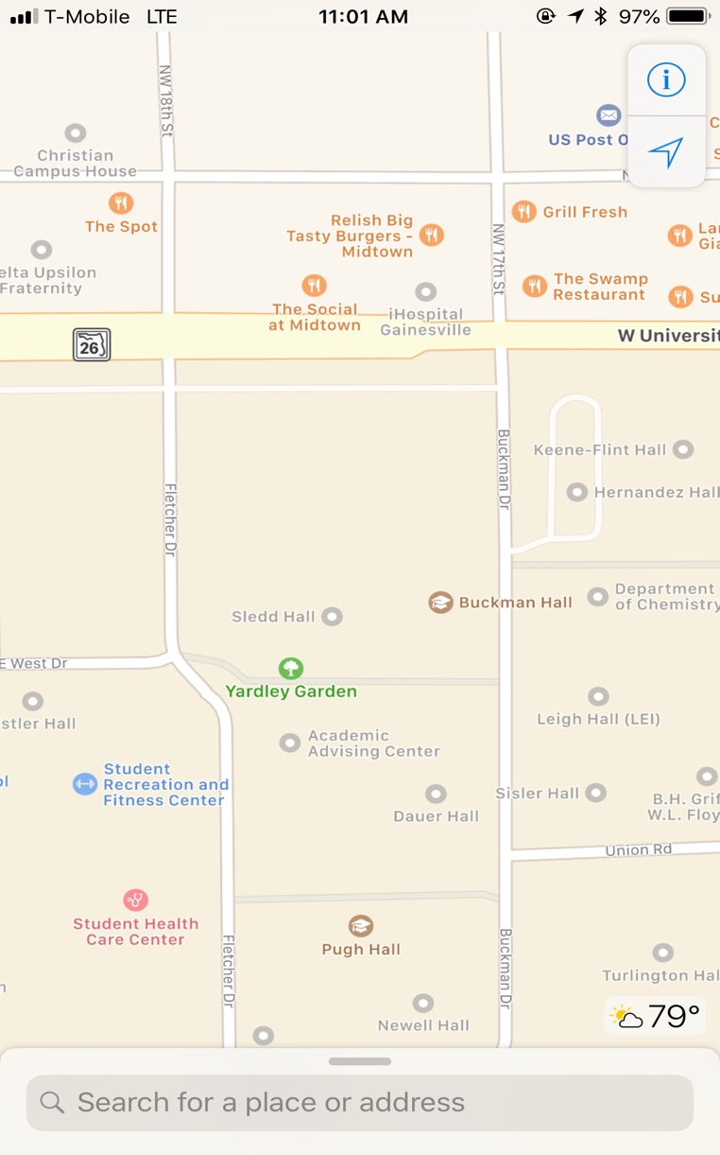
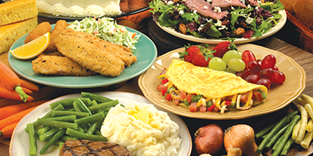
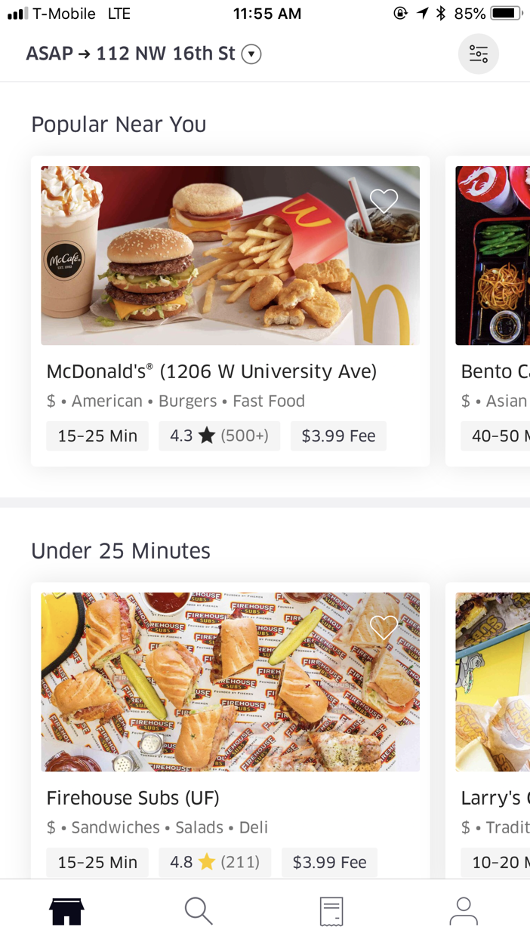
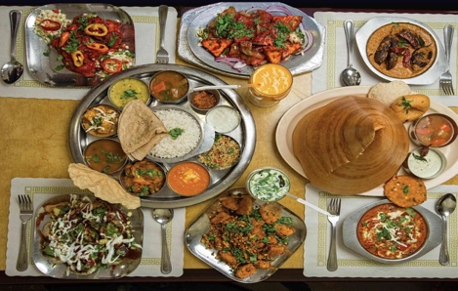
Take out the popular near you and instead put suggested for you (if my nana saw acai bowls, she’d dip)
Delivering → Social 28
Suggested for you
Where are we delivering to?
Current Location
Custom Address
Golden Corral Est. Time: 10 mins
Near you
Andaz Indian Restaurant (University)
$$ - Indian
30-35 mins - 4.6

Slide 14
design thinking

Slide 15
design thinking
“Thinking about problems in a user-centric way and bringing together skilled teams to approach those user problems” -u/Ezilli, obscure reddit user, 2018

Slide 16
design thinking process
Empathize
Understand your users through research
Define
Combine research to define where problems exist
Ideate
Create a range of ideas/solutions
step 7: profit
Implement
Test
Solicit feedback for prototype(s)
Prototype
Build representations for your ideas
Notes:
Identifying new solutions
https://dschool-old.stanford.edu/sandbox/groups/designresources/wiki/36873/attachments/74b3d/ModeGuideBOOTCAMP2010L.pdf
Empathize: effort to understand the way they do things and why, their physical and emotional needs, how they think about world, and what is meaningful to them
Define: define the challenge you are taking on, based on what you have learned about your user and about the context
Ideate: Ideation is your chance to combine the understanding you have of the problem space and people you are designing for with your imagination to generate solution concepts
Prototype: anything that a user can interact with

Slide 17
case example
“redesigning the uber pickup experience”
Background on Uber:
Designed in 2012
Struggled to scale alongside hyper-growth of the company
Fundamental usability was challenged
Main Goals of Redesign:
Make usage faster and easier for everyone, everywhere (was not global yet)
Give riders more control over their time and money
Notes:
http://simonpan.com/work/uber/

Slide 18
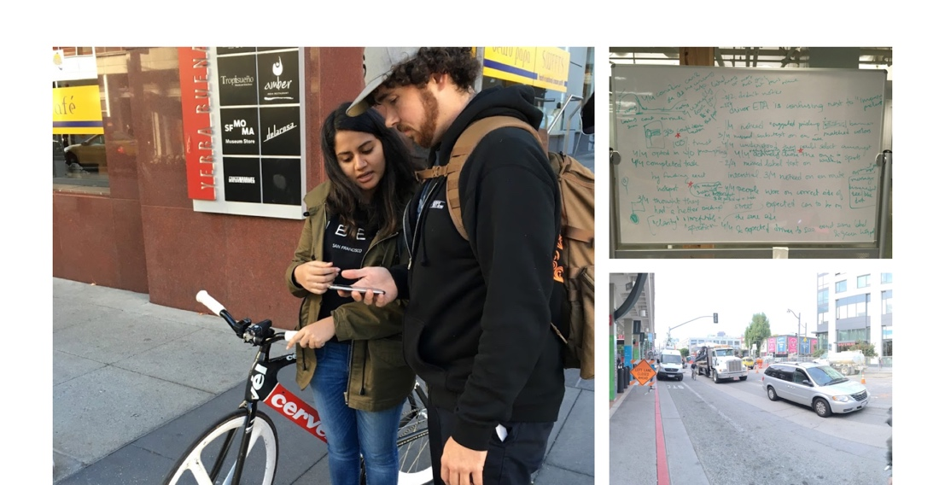
uber redesign
Empathize
understand your users through research
Tested existing Uber app
Used 8 participants in San Francisco
Found that the expectations of riders (entitled millennials smh) were high- they wanted to use the app with minimal effort

Slide 19
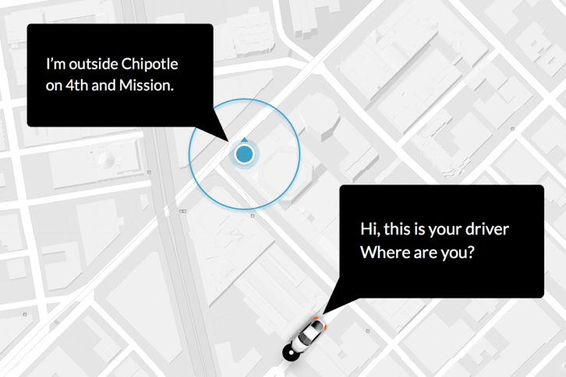
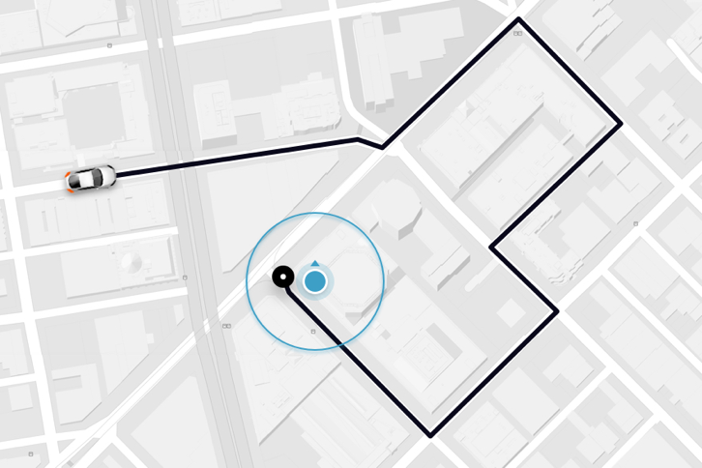
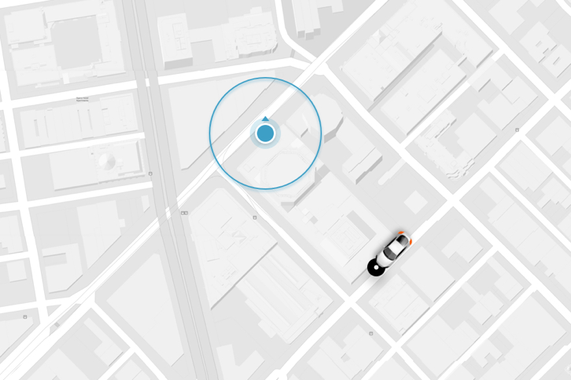
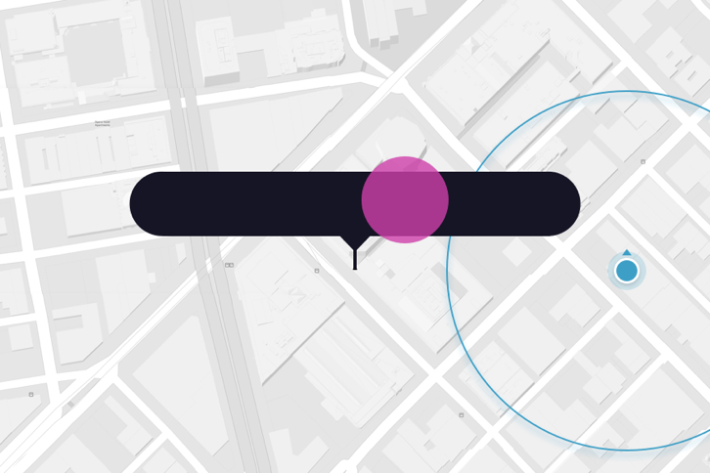
uber redesign
Define
combine research to define where problems exist
Tested existing Uber app with 8 participants to find problems:
Problem 1: Frequent Contact to Confirm or Coordinate Location
Problem 2: Suboptimal Routes Given to Driver
Problem 3: Unexpected Arrival Location
Problem 4: No Pickup Location Specified
Notes:
Problem 3: The driver would arrive in an inconvenient spot (across the road, etc.)
Problem 4: Riders wouldn’t set an explicit location- they would rely on the app’s location, and half of the sessions were at least 100 meters inaccurate
Ex: if someone requests a pickup from inside a building, the actual pickup location would differ depending on the Operating System (Android or iOS) the drive has
A major reason problematic pickups occurred were because getting an Uber relied heavily on the Rider explicitly setting a precise pickup location to meet. Not doing so, causes the Driver to be sent to the default device location, which half the time is wildly inaccurate.

Slide 20
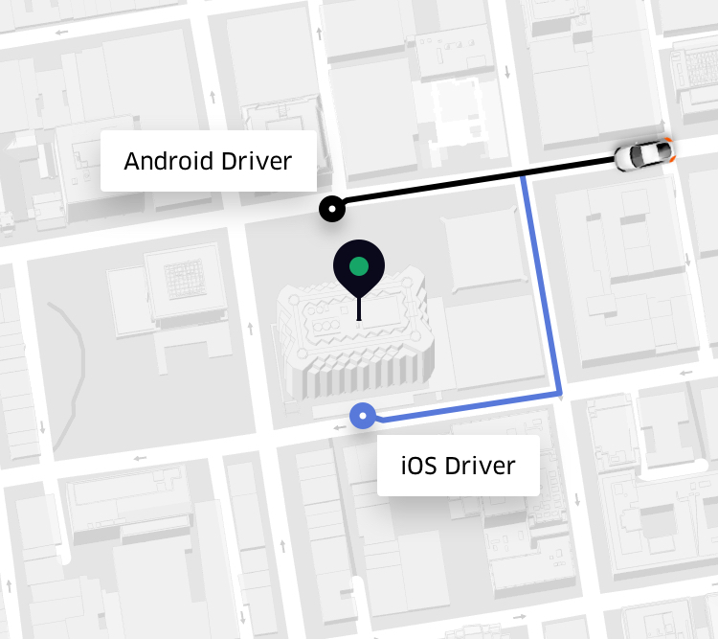
uber redesign
Define
combine research to define where problems exist
Notes:
Depicting the difference in operating systems

Slide 21
uber redesign
the question boiled down to “How might we help Riders and Drivers form a better pickup plan?”:
How do you design for everyone, everywhere?
What contexts need to be considered?
What’s the perfect pickup?

Slide 22
uber redesign
Ideate
create a range of ideas/solution
“Rendezvous” - pickup plan designed on behalf of riders and drivers
Two key features:
Destination First - ask “Where to?” upon launch
Live Locations - do they need to default to one location?
implemented these via “adaptation,” or programming a system flexible enough to know when to do the work for a user, and when to ask for help - did this based on a confidence score
Notes:
Destination First method matches the driver’s mentality AND gives the GPS time to warm up, thus allowing for more accurate locations
Live Locations - originally the uber app would lock a rider’s location upon the app launching, but with this feature the rider’s location would continue to update as the GPS updated

Slide 23
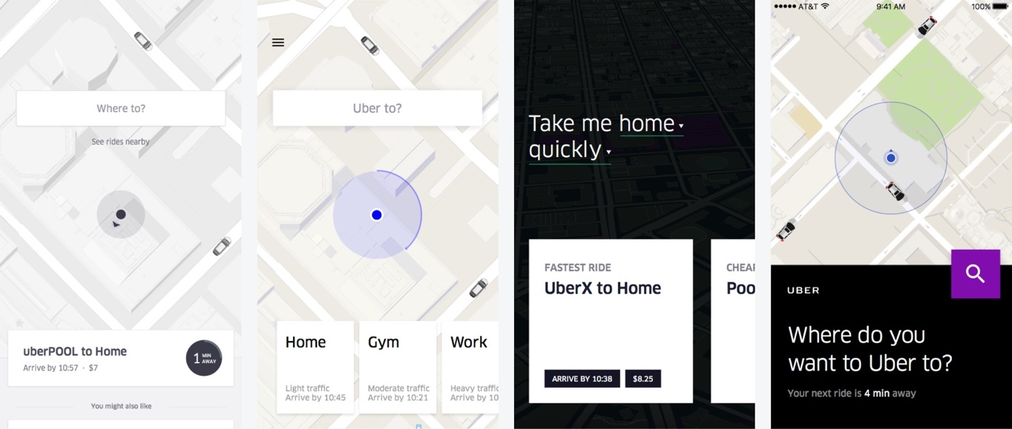
uber redesign
Prototype
build representations for your ideas
Test
solicit feedback for these prototypes
tested this in Bangalore, Delhi, Ahmedabad, Guangzhou and Shanghai
Destination First - ask “Where to?” upon launch

Slide 24
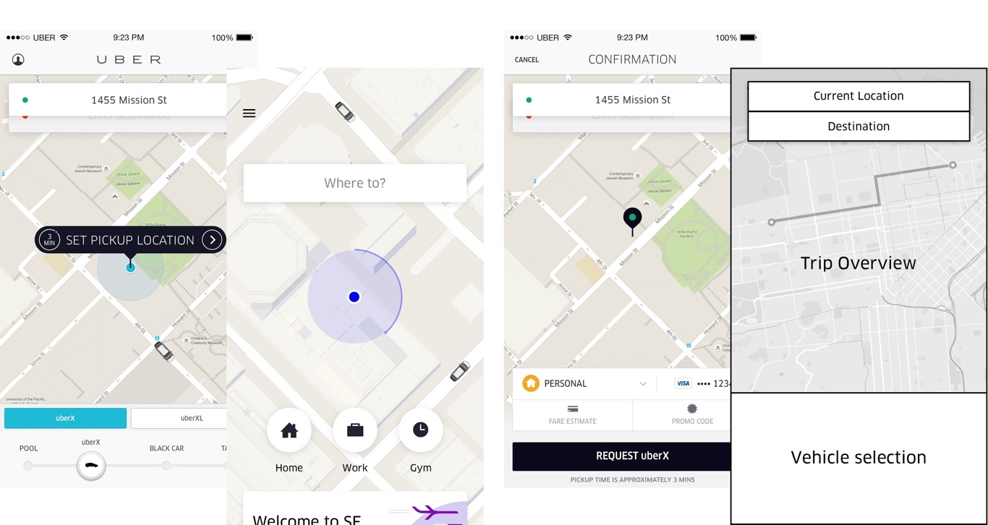
uber redesign
Prototype
build representations for your ideas
Test
solicit feedback for these prototypes
tested this in Bangalore, Delhi, Ahmedabad, Guangzhou and Shanghai
Live Locations - do they need to default to one location?

Slide 25
uber redesign
Implement
The error distance between requested pickup location and actual pickup location decreased by 34%
Driver wait-time decreased by 20%
High-precision pickup rates increased by 17%
Multi-contact rate decreased by 3%

Slide 26
activity
Redesign the Grill Fresh logo either on your computer or on paper

Slide 27
ux research

Slide 28
topics within UX
Visual Design
Interaction Design
Design Thinking
Usability Testing
UX Research

Slide 29
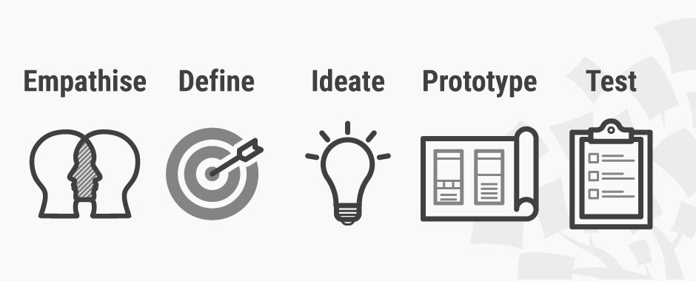
ux research
systematic investigation of users and their requirements
use cases:
design new products
redesign existing products
why?
ux research helps us understand how people go about performing tasks
ux research is part of the design thinking process: empathizing with the user
Notes:
segue the why into the next slide, explaining how some designs aren’t intuitive

Slide 30
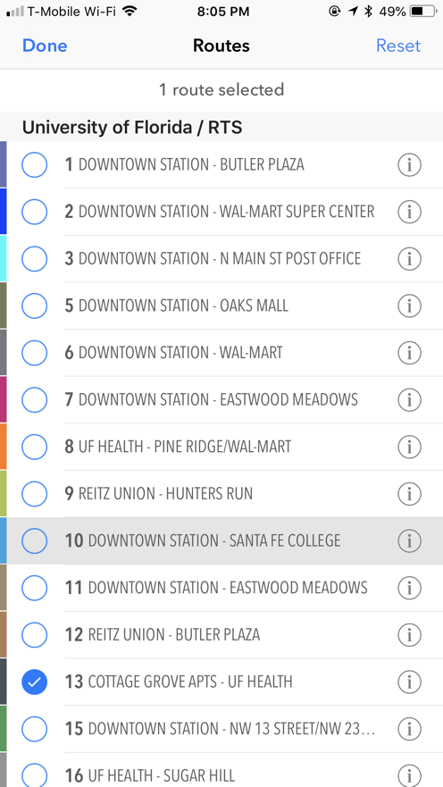
ux research
systematic investigation of users and their requirements

Slide 31
ux research spectrum
Behavioral
-provides information on what the user does
-tells what is happening
ex: eye tracking
Qualitative
Quantitative
-provides in-depth, contextual understanding of trends
-ex: usability tests
-provides trends + conclusions
-ex: survey
Attitudinal
-provides insight into a user’s attitude
-tells why a behavior is happening
ex: focus groups/interviews

Slide 32
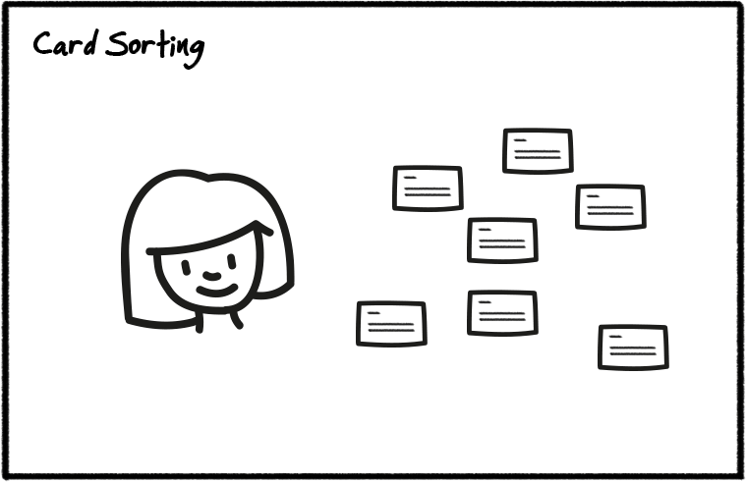
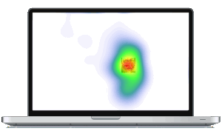
ux research methods
systematic investigation of users and their requirements
user testing
user complete activities using a design or interface
UserTesting.com - $
screen-recording
competitor studies
have participant interact with your product and the competitor’s
card sorting
users sort cards into categories
helps designer make site more intuitive
ex: sorting categories for a clothing app
focus groups or 1:1 user interviews
moderator asks a group of people or about behaviors, preferences, etc.
allows for brainstorming
surveys
measures user engagement, perception, and market needs
eyetracking
measures movement and dilation of a person’s pupils as they look at screen

Slide 33
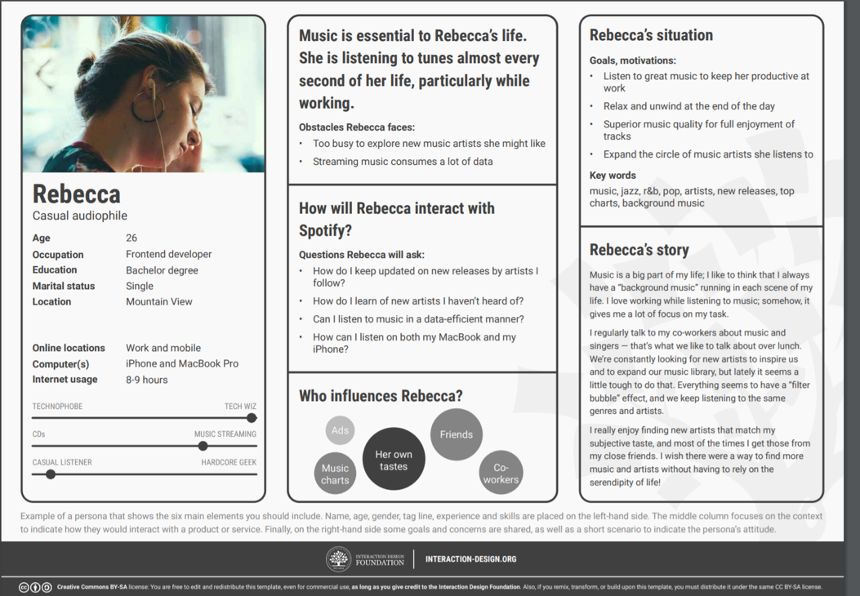
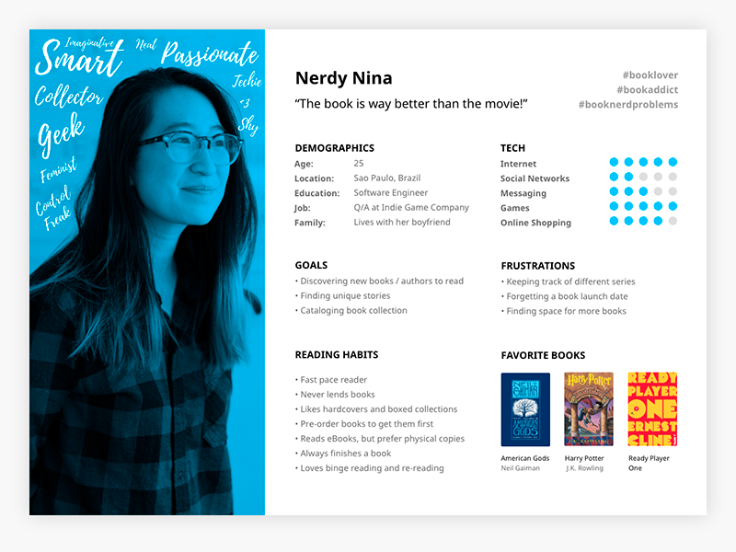
ux research methods cont’d
systematic investigation of users and their requirements
user personas
“fictional, yet realistic, description of a typical or target user of the product”
conduct user research (interviews, surveys, etc.) to define characteristics of typical users in your target market
create individual personas based on your user research
base your design off what may appeal to this persona

Slide 34
user personas
Name, age, gender, and a photo
Tagline describing what they do in “real life”
Experience level in the area of your product or service
Context for how they would interact with your product: Through choice or required by their job? How often would they use it? Do they typically use a desktop computer to access it, or their phone or other device?
Goals and concerns when they perform relevant tasks: speed, accuracy, thoroughness, or any other needs that may factor into their usage
Quotes to sum up the persona’s attitude

Slide 35
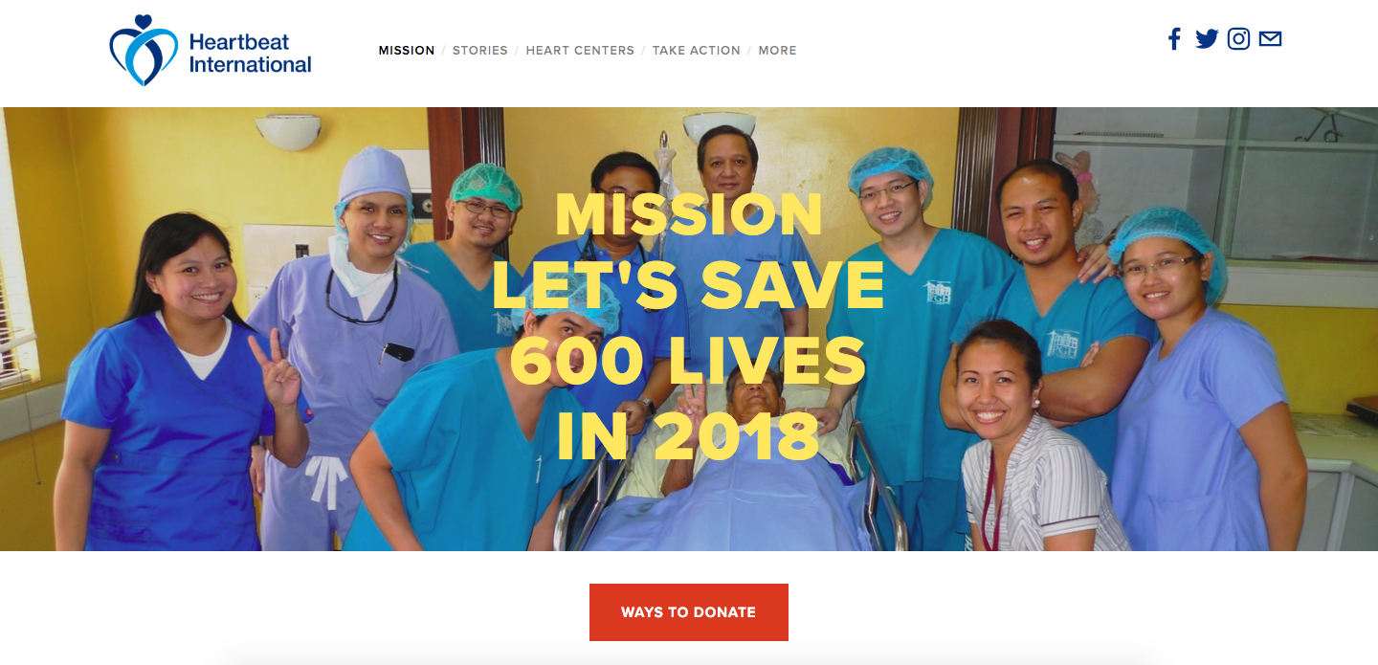
shreya!
Heartbeat International
redesign
color psychology
graphics
element placement
Notes:
Color psychology

Slide 36
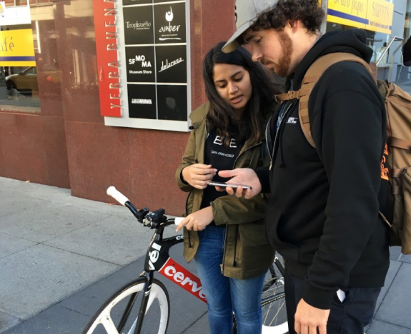
ux research example
redesigning the uber app
struggled with scalability
without a clear mission, they used user interviews to set goals
tested app with 8 participants in problematic San Francisco areas
found different problems (frequent driver-rider contact to confirm location, suboptimal routes being given on gps, etc.)
overall, they discovered what riders expected and were therefore able to design a more easy-to-use app
Notes:
Skip over this if not enough time

Slide 37
user persona activity
10 minute activity:
Get in groups of 4
Pick an existing app or an app you want to build
or the app you made 2 weeks ago:
https://docs.google.com/presentation/d/1v_4nKdnifoCfdh2QnmEma5JgiN4WFC1T_26vtwgxRhU/edit#slide=id.p
Create detailed user personas for the application you choose
Create them here:
https://docs.google.com/presentation/d/1f8LaUpFsrpxOX6j5TtqI2UFBUnYEUudcLFhh1-sEoOA/edit?usp=sharing

Slide 38
ux review & tools

