Slide 1
web dev

Slide 2
html

Slide 3
module agenda
HTML
defines structure of a webpage
CSS
defines the style of a webpage
JavaScript
provides dynamism to a webpage

Slide 4
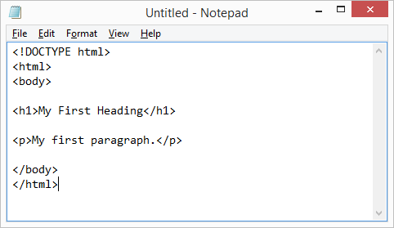
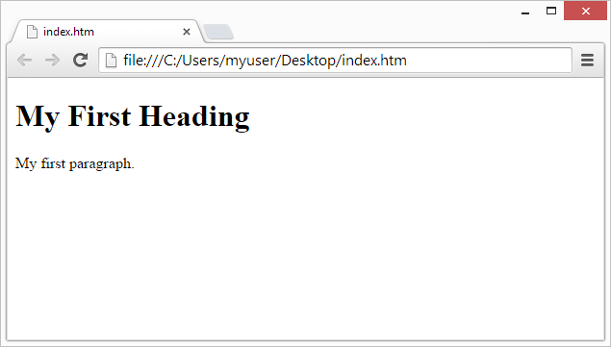
<HTML: what is it?/>
im glad u asked
Hypertext Markup Language
markup language- uses tags (</>) to specify how something should be displayed
describes the structure of web pages
different tags accomplish different things

Slide 5
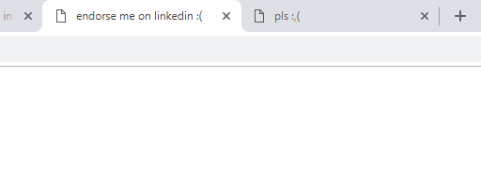
HTML: what is a tag?
element names surrounded by angle brackets
<elementname>content goes here...</elementname>
element
normally come in pairs
comprised of an open/start tag <> and a closed/end tag </>
ex: <title></title> tags define the title displayed in the browser’s tab
Notes:
Whole thing is an element

Slide 6
writing an HTML doc
Important Components
<!DOCTYPE html>
helps browser display the webpage correctly
<html></html>
html tags define where the document begins
<head></head>
contains the title (text displayed in browser tab)
<title>content</title>
<body></body>
what is visible on the page
<!DOCTYPE html>
<html>
<head>
<title>GatorTech</title>
</head>
<body>
...
</body>
</html>
Notes:
Copy and paste this into brackets and run

Slide 7
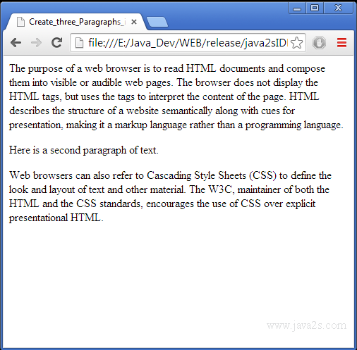
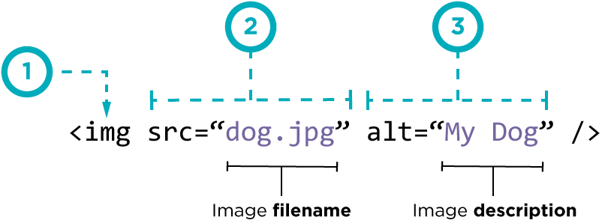
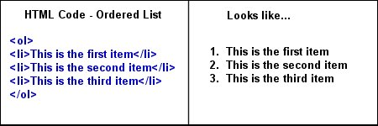
body tags
element names surrounded by angle brackets
headings
paragraphs
links
images
lists
defined with the <h1> to <h6> tags
defined with the <p> tag
defined with the <a> tag
-contains href attribute
defined with the <img> tag
-src, alt, width, height
<ul> - unordered
<ol> - ordered
followed by <li>
“empty” tag - has no contents or closing tag, only attributes (ex: <br>)

Slide 8
exercise 1
Open JSFiddle.net or text editor on your computer
Code a simple page with a title, heading, and a list
<!DOCTYPE html>
<html>
<head>
<title>...</title>
</head>
<body>
...
</body>
</html>
headings
lists
defined with the <h1> to <h6> tags
<ul> - unordered
<ol> - ordered
followed by <li>
Notes:
Show Exercise1.html in brackets
~5 mins

Slide 9
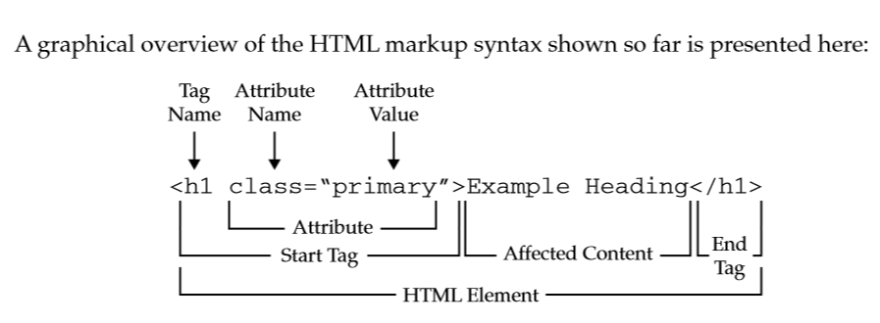
attributes
provide additional information about an element; in the start tag
Examples:
href - specifies a link in an <a> tag
src - specifies the filename of the image source for an <img> tag
width / height - specifies the size of a src image for an <img> tag
alt - specifies an alternative text to be used when an image cannot be displayed for an <img> tag
style - specify the styling of an element, like color, font, size etc.

Slide 10
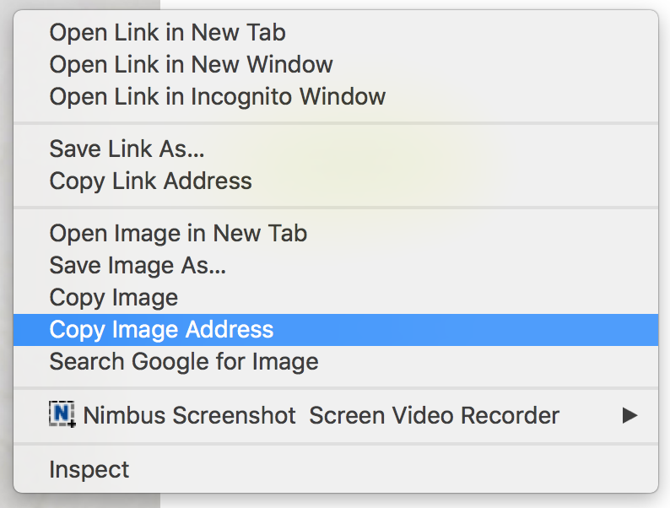
exercise 2
Open JSFiddle.net or text editor on your computer
Code a simple page with a:
title
heading with style attributes
img tag containing an src link to an image, width and height attributes
tip: make sure to copy the image address, not just the link
<!DOCTYPE html>
<html>
<head>
<title>...</title>
</head>
<body>
...
</body>
</html>
Notes:
Show Exercise2.html in brackets

Slide 11
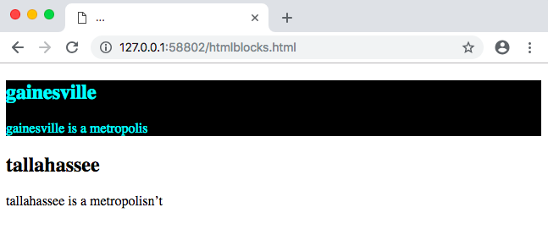
HTML blocks
grouping various tags together
<div>
<!DOCTYPE html>
<html>
<head>
<title>...</title>
</head>
<body>
<div style=”background-color: black; color: aqua”>
<h2>gainesville</h2>
<p>gainesville is a metropolis</p>
<div>
<h2>tallahassee</h2>
<p>tallahassee is a metropolisn’t</p>
</body>
</html>
used as a container for other HTML elements
Notes:
DivTags.html

Slide 12
css

Slide 13
CSS: what is it?
Cascading Style Sheets
describes how HTML elements are to be displayed on screen, paper, or in other media
can be added 3 ways:
inline
<h1 style=”background-color:pink”></h1>
-inline CSS uses the style attribute of an HTML element
-what we used last week
-used less bc mixes languages
internal
-uses <style> tags in the html doc to define style
external
-uses an external sheet (not in the html doc)

Slide 14
CSS: internal
uses <style> tags in the html doc to define style
<!DOCTYPE html>
<html>
<head>
<style>
body {
background-color: powderblue;
}
h1 {
color: blue;
}
p {
color: red;
}
</style>
</head>
<body>
<h1>This is a heading</h1>
<p>This is a paragraph.</p>
</body>
</html>
defined in the <head> section of html doc, within <style> element:
Notes:
Do demonstration here

Slide 15
exercise 3
Open JSFiddle.net or text editor on your computer
Use internal CSS to create a simple page
Style whatever elements you prefer (<p>, <h1>-<h6>, <ul> or <ol>, etc.)
some other CSS properties:
background-image: url(insert image url here)
background-color: color
font-family: font or font-family
font-style: normal, italic, oblique
text-align: left, right, center, justify
padding: 10px
<!DOCTYPE html>
<html>
<head>
<style>
body {
...
}
</style>
</head>
<body>
...
</body>
</html>
Notes:
Show Exercise3.html

Slide 16
CSS: external
uses an external sheet (not in the html doc)
internal css
index.html
external css
<!DOCTYPE html>
<html>
<head>
<style>
body {
background-color: powderblue;
}
h1 {
color: blue;
}
p {
color: red;
}
</style>
</head>
<body>
<h1>This is a heading</h1>
<p>This is a paragraph.</p>
</body>
</html>
index.html
styles.css
<!DOCTYPE html>
<html>
<head>
<link rel=”stylesheet” href=”styles.css”>
</head>
<body>
<h1>This is a heading</h1>
<p>This is a paragraph.</p>
</body>
</html>
body {
background-color: powderblue;
}
h1 {
color: blue;
}
p {
color: red;
}
use the <link> element to link the css doc to the html doc
rel attribute describes the relationship of the doc to html doc
href tag provides file name

Slide 17
id and class attributes
id
class
used to define a specific style for one special element
-id name can only be used once
-selected with #
used to define a specific style for special types of elements
-class name can be used multiple times
-selected with .
<p id=”id_name”>This is an id.</p>
<p class=”class_name”>This is a class.</p>
-these are useful for when you have multiples of one tag and need a unique way of identifying them
-ids are prioritized above a class
Notes:
Show IdAndClass.html

Slide 18
id and class attributes
how to access them
id
class
similar to before, but
access with # and the id name
similar to before, but
access with . and the class name
<!DOCTYPE html>
<html>
<head>
<style>
#id_name {
color: red;
}
</style>
</head>
<body>
<p id=”id_name”>This is an id.</p>
</body>
</html>
<!DOCTYPE html>
<html>
<head>
<style>
.class_name {
color: red;
}
</style>
</head>
<body>
<p class=”class_name”>This is a class.</p>
</body>
</html>
Notes:
The syntax for the style tags is similar in that before we would have just had “body” or some other tag written instead of #id_name or .class_name

Slide 19
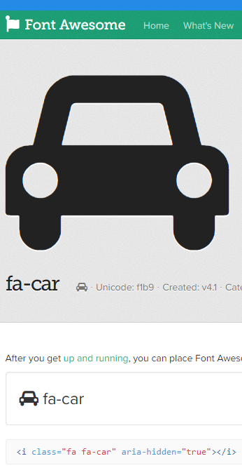
icons
you can also insert icons into your webpage with font awesome
insert the link tag in the example in your head tags
in whichever tag you use, create a class attribute with the prefix fa followed by the icon’s name
you can edit this icon through css by using what we used prior:
<html>
<head>
<title>Font Awesome</title>
<link rel="stylesheet" href="https://cdnjs.cloudflare.com/ajax/libs/font-awesome/4.7.0/css/font-awesome.min.css">
</head>
<body>
<p class=”fa fa-car”></p>
</body>
</html>
Notes:
https://www.w3schools.com/icons/fontawesome_icons_intro.asp

Slide 20
exercise 4
Open JSFiddle.net or text editor on your computer
Use internal CSS to create a simple page that utilizes the class and id attributes
some other CSS properties:
background-image: url(insert image url here)
background-color: color
font-family: font or font-family
font-style: normal, italic, oblique
text-align: left, right, center, justify
padding: 10px
<!DOCTYPE html>
<html>
<head>
<style>
.class_name {
color: red;
}
</style>
</head>
<body>
<p class=”class_name”>This is a class.</p>
</body>
</html>
<!DOCTYPE html>
<html>
<head>
<style>
#id_name {
color: red;
}
</style>
</head>
<body>
<p id=”id_name”>This is an id.</p>
</body>
</html>
from previous slide

Slide 21
javascript

Slide 22
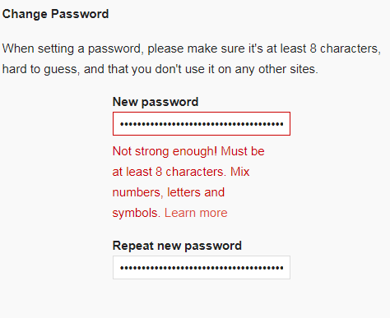
JavaScript: what is it?
programming language used to dictate the behavior of web pages
provides dynamism
runs code inside a user’s browser that constantly checks if the server has sent more data
does this through functions performed on html and css code

Slide 23
what can it do?
JavaScript can change HTML content
JavaScript can change HTML attributes
JavaScript can change CSS style
JavaScript can hide HTML elements
JavaScript can show hidden HTML elements

Slide 24
inserting JS
external
internal
<script src="myScript1.js"></script>
<script>[insert code here]</script>
link your html to a javascript file
write the code in script tags

Slide 25
functions + events
function:
a block of JavaScript code that can be executed when "called" for
can be called when an event occurs (like when the user clicks a button)

Slide 26
functions + events
onclick
onmouseover
onmouseout
onsubmit
occurs when user clicks on html
occurs when user mouses over html
occurs when user mouses off html
occurs when user clicks on submit button
<button id="Button" onmouseout="normal()" onmouseover="clickMe()">Click Me</button>

Slide 27
calling functions
we can call a function a couple of ways:
through an HTML attribute
in <script> tags by accessing the tag’s id attribute
<button id="button" onclick=”functionName()”>Click Me</button>
<script>
variableName.onclick = functionName {
// function carries out here
};
</script>
technically better coding practice bc doesn’t mix languages can i getta h*ck yeah :,(

Slide 28
actually doing stuff in a function
some relevant things:
“document” - a global variable in javascript used to access any HTML element on the page
“var” - how you declare any variable in JS
getElementById(id) - access any id in your HTML
there are also ones for accessing tag names and classes

Slide 29
displaying data
innerHTML
alert()
document.write()
-used for writing into an HTML element
-used for writing into an alert box
-used for writing into the HTML output
Notes:
<!DOCTYPE html>
<html>
<body>
<button id="Button" onmouseout="normal()" onmouseover="clickMe()">Click Me</button>
<script>
function clickMe() {
var clicker = document.getElementById('Button');
clicker.innerHTML = "You clicked!";
}
function normal() {
var clicker = document.getElementById('Button');
clicker.innerHTML = 'Click Me';
}
</script>
</body>
</html>

Slide 30
exercise 1
Get in pairs and write a simple HTML webpage that includes a Javascript function
utilize one of the top three and one of the bottom 4 events:
innerHTML
alert()
document.write()
-used for writing into an HTML element
-used for writing into an alert box
-used for writing into the HTML output
onclick
onmouseover
onmouseout
onsubmit
occurs when user clicks on html
occurs when user mouses over html
occurs when user mouses off html
occurs when user clicks on submit button

Slide 31
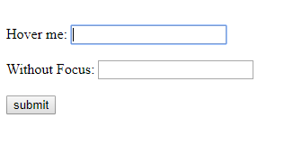
JS function cont’d
value - contains the value a user types in
length - gets the length of a string
style - accesses the CSS/style of a tag
focus - focuses on a box
prompt() - method that displays a dialog box that prompts for user input
prompt(“sometext”, “defaulttext”);
if user clicks OK, it returns the input; else null

Slide 32
forms
<form></form> - used to create an HTML form for user input
<input>
<button>
<select>
<option>
-specifies an input field where a user can enter data
-empty
-defines a clickable button
-used to create a drop-down menu
-uses <option>
-used in <select> to create names + values for options
attributes:
-type: specifies input type (button, submit, search, checkbox)
-name: specifies the name of input
-placeholder: short hint that describes expected value
attributes:
-type: specifies type of button (reset, button, submit)
-name: specifies the name of the button
attributes:
-name: specifies the name of the menu
attributes:
-value: specifies the value to be sent to a server
-selected: option should be pre-selected when the page loads; just input “selected”
Notes:
See Forms.html

Slide 33
exercise 2
get in groups/pairs
use a the <button></button> tags to create a button
also create a prompt box to ask for some information from the user
validate that information using javascript

Slide 34
http requests and responses

Slide 35
the world wide web
HTML/HTTP
Internet
HTTP
Your computer + browser
Servers
Notes:
Looking back again at this document
HTTP was made to fetch HTML documents and send them to the client, HTTP is what communicates between the internet and the server to fetch you website, content, etc. SUPER important.

Slide 36
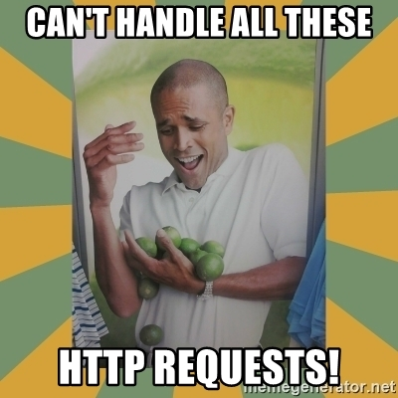
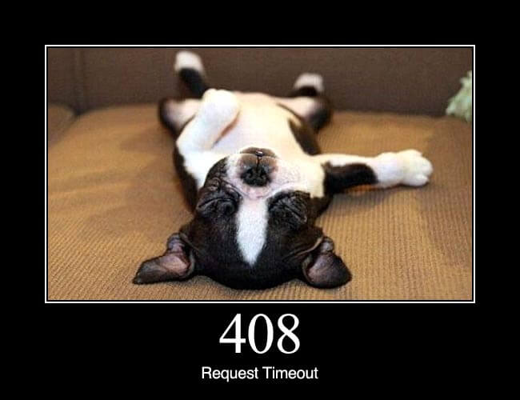
HTTP introduction
Hypertext Transfer protocol allows web-based applications to communicate and exchange data, the “messenger of the web” to deliver images, video, audio, docs, etc.
Notes:
HTTP is composed of requests and responses, shown below.
Connectionless: after making a request to the server, the client disconnects until the response in ready and then the server re-establishes the connection to deliver a response (every connection is acted as if a new connection between computers)
TCP/IP based protocol: Transmission Control Protocol/Internet Protocol is a widely adopted networking standard, a set of networking protocols that allows computers to communicate. (a language computers use to access the internet)

Slide 37
HTTP requests & responses
Method path/to/file.ext http/version
http/version status code
Start line
Name1: value1
Name2: value2
Name3: value3
Name1: value1
Name2: value2
Name3: value3
Headers
Body
File requested
Internet
Notes:
The information in these boxes varies depending on the http message and whether it’s a request or response…
This is how your browser sends a request to get a website and the response is either getting the site or getting an error of some sort.

Slide 38
HTTP Requests
Method path/to/file.ext http/version
Start line
GET /products/myproduct.html HTTP/1.1
Name1: value1
Name2: value2
Name3: value3
Host: www.mywebsite.com
Accept-language: en-us
Accept: text/html
Headers
fileType/ext - Tells what the type of file is i.e. image/gif text/html
The method is a command that tells the server what to do
Internet
Notes:
The information in these boxes varies depending on the http message and whether it’s a request or response…
This is how your browser sends a request to get a website and the response is either getting the site or getting an error of some sort.

Slide 39
Types of methods for HTTP requests
GET
is used for fetching documents/html and is requested from a specified source
Most often used for requesting a doc/retrieving data from the server
Not to be used when dealing with sensitive data
POST
is used for updating/submitting data to be processed to a specified resource
Reloading page/form sends new data to server to be stored
Notes:
HTTP Verb Definitions: GET: Retrieves information based on given parameters PUT: Stores/updates information in a specific location POST: Send information in to be stored DELETE: Deletes a given piece of information

Slide 40
HTTP Responses
http/version status code
Start line
HTTP/1.1 200: OK
Name1: value1
Name2: value2
Name3: value3
Host: www.mywebsite.com
Accept-language: en-us
Accept: text/html
Headers
File requested
Body
products/myproduct.html
Tells client if request succeeded or failed. 200: ok, 404: file not found
Internet
Notes:
This is what an HTTP response would look like for a website

Slide 41
Questions
If I wanted to create an HTTP request to my LinkedIn profile, what would I say?
Method path/to/file.ext http/version
Host:
Accept-language:
Accept:
Methods: GET, POST, PUT, DELETE
Notes:
Answer: GET /in/madisonross HTTP/1.1
Host: linkedin.com
Accept-language: en-us
Accept: text/html
And that is the end of the second part of web development! Keep going for the third.

Slide 42
api’s

Slide 43
the world wide web
HTML/HTTP
Internet
HTTP
Your computer + browser
Servers
Notes:
Final meeting on web development

Slide 44
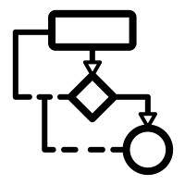
application programming interface
APIs are protocols and tools for building application software that allows two different softwares to communicate with each other by using JSON.
API
Database
Notes:
Has access/connects to your important database, caching service, and priceless algorithm Build a web application that has a server Malicious user can backwards engineer sensitive data APIs sit between the web application and the server to prevent them from seeing… (authentication) look up and making sure you’re going where you’re supposed to, can access only certain resources on the server Encapsulation: only let the user know what they need to know and do what they need to do

Slide 45
RESTful APIs
Representational State Transfer APIs are a way to share info. between programs. REST APIs use HTTP URLs, GET, PUT, POST, and DELETE to request/send info and handle business logic: signing in users, status updates.
desktop apps
mobile apps
web apps
Notes:
Why is this important for your own website? An example would be GET http://api.example.com/weather/32611. The request would retrieve the weather information on Gainesville. The GET portion is the HTTP verb, and the http://api.example.com/weather/32611 is the API endpoint, or URL.
REST (Representational State Transfer) APIs are a common way to share information between programs. REST APIs use regular HTTP URLs such as http://google.com and the HTTP verbs (GET, PUT, POST, DELETE) to request and send information. There are two kinds of APIs, public and private. The REST API handles all of your business logic: signing in users, status updates. Anything connected to the internet can use your API: mobile apps, web apps, desktop programs.

Slide 46
API walkthrough
REST API video:
www.youtube.com/watch?v=7YcW25PHnAA
Part 2 of REST API video - how to make your own site using Instagrams and Google Maps API:
www.youtube.com/watch?v=RTjd1nwvlj4

Slide 47
web dev workshop: how the internet works

Slide 48
The Role of Browsers
Client
Interface for displaying web pages
HTML pages (HTML and CSS)
Other types of web resources
Utilize HTTP Protocol
Get and Post
Rendering Engine - Parses HTML and CSS to display
Cache & Cookies

Slide 49
Web Address/URL
URL - Uniform Resource Locator
Components of a web address:
Scheme - Identifies protocol
Host - Where the resource is found
Path - Identifies the desired resource
Query String - Information for the resource to use (Google)
https://www.gatortechuf.com/media/membership/ryan.jpg
Notes:
URL is a type of URI

Slide 50
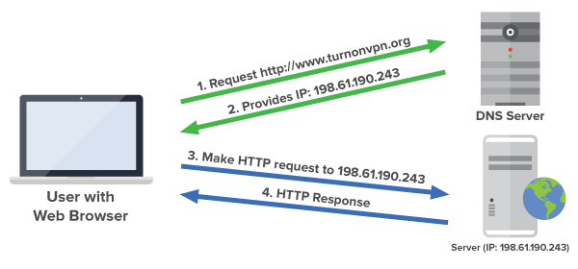
Domain Name System
DNS
Converts (Resolves) domain name into an IP address
www.gatortechuf.com 52.45.149.226
Utilizes a distributed database structure
Tiered structure starting with root servers
Managed by multiple companies/organizations
Verisign manages the .com top level domain
330.6 million domain names (Q1 2017)

Slide 51
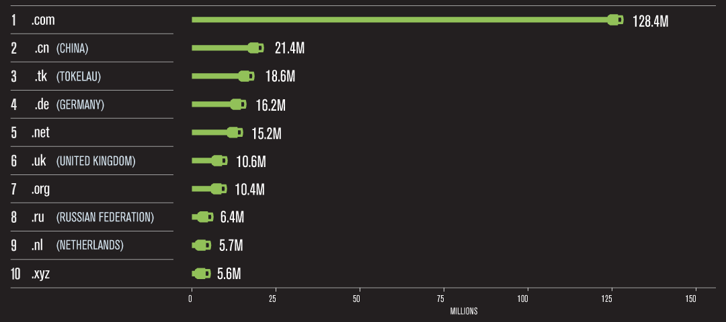
TLD Breakdown
⅙ of Tokelau’s economy comes from of .tk web addresses

Slide 52
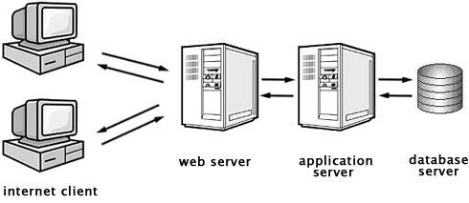
Servers
Three-Tier Architecture

Slide 53
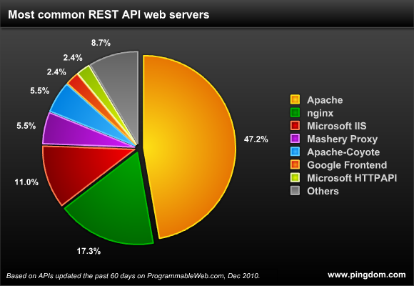
Web Servers
Server that understands HTTP requests
Hosts all of a website’s files
Increases reliability and security
Easily handles static content (HTML pages, .pdf, .zip, etc.)
Cannot handle logic
Acts an intermediary for dynamic content
Client Web Server Application Server

Slide 54
Application Servers
Three-Tier Architecture

Slide 55
Application Servers
A server that understands HTTP and more...
Hosts and allows access to business logic
Code is deployed onto onto an application server
Provides reliability and security
Usually accessed through an API
Web Server App Server Database Server

Slide 56
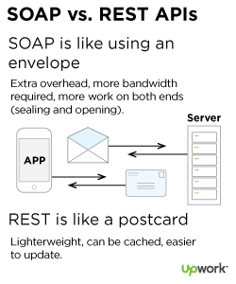
APIs
Application Programming Interface
Most websites currently use RESTful APIs
SOAP
HTTP query string json
json is parsed and put into variable in the backend
Can respond with HTML page or json data
json data is then converted into HTML and displayed
Javascript

Slide 57
Database Servers
Three-Tier Architecture

Slide 58
Database Servers
Computer that hosts database software
SQL Server, MySQL, Oracle RDBMS, IDM DB2
Connection established with app server
Queries passed to database with correct variable values
Responses are parsed in the application server

