Slide 2
Feedback form - http://bit.ly/GTFeedback2020
Coordinator meeting tonight after GBM
Tuesday, March 17th - ISOM Info Session during normal GBM time and place
Coordinators - headshot and bio due tomorrow at 11:59 pm
Notes:
Go to mentimeter for the polls.
Hackathons: https://mlh.io/seasons/na-2019/events
ShellHacks: https://shellhacks.net/
HackGSU: http://hackgsu.com/
HackGT: https://2018.hack.gt/
HackFSU: https://hackfsu.com/
SwampHacks: https://2019.swamphacks.com/
MangoHacks: https://mangohacks.com/
KnightHacks: https://knighthacks.org/

Slide 3
Three P’s

Slide 4
Three P’s
-Get into groups of 2-3 people
-Share three facts about yourselves:
-Something personal, something professional, and something peculiar
*Have fun and don’t share details that are too personal

Slide 5
mobile software and hardware security

Slide 6
your device matters, too
Built-in protections from software and hardware working together
Locking-down locally stored data and protecting it from:
Bad actors
Former employees
Unauthorized physical access
Notes:
I.e to protect company property and prevent it leaking out
https://www.thebalance.com/keeping-mobile-devices-safe-from-cyber-threats-4122471

Slide 7
in practice
Remote wipe - removes encryption keys from low-level storage, rendering data inaccessible
“Find My”
Mobile Device Management (MDM), including containers to separate personal and corporate data.
iOS’s Secure Enclave / Trusted Platform Module (TPM) / T2 Chip on macOS

Slide 8
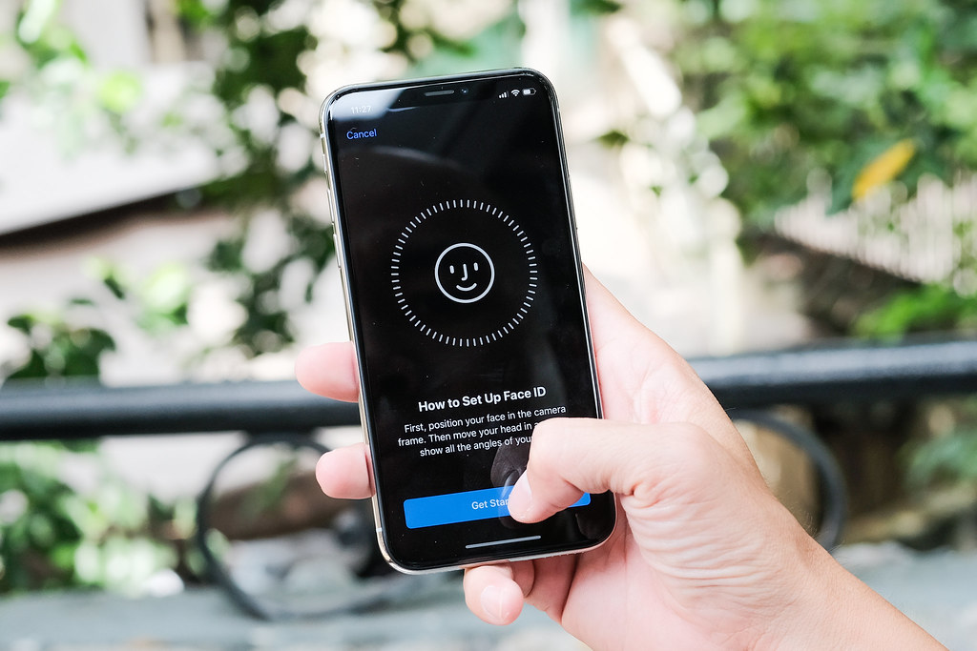
secure enclave
completely separate processor to handle biometric information
Touch ID, Face ID
boots separately from the rest of device, inaccessible by OS
stores 256-bit elliptic curve private keys
unique to device
never synced to cloud or seen by primary OS
Notes:
https://www.howtogeek.com/339705/what-is-apples-secure-enclave-and-how-does-it-protect-my-iphone-or-mac/
"_DSF0297" by Tinh Te Photos is licensed under CC0 1.0

Slide 9
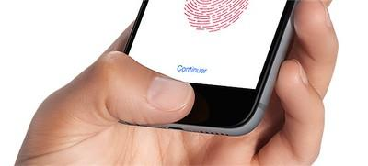
secure enclave
Incredibly difficult to decrypt sensitive info without physical access
Enclave stores encryption keys to lock down a mathematical representation of biometric data
Apps and OS must make requests for Secure Enclave to encrypt/decrypt data, cannot read keys directly.
Can’t import keys from other devices
Exclusively creates and uses keys locally
Notes:
https://www.howtogeek.com/339705/what-is-apples-secure-enclave-and-how-does-it-protect-my-iphone-or-mac/
“iOS83-fonction TouchID achats app store” by downloadsource.fr is licensed under CC BY 2.0.

Slide 10
recent & sweeping privacy regulations

Slide 11
general data protection regulation (EU)
GDPR - May 2018
Allows consumers in the EU the right to view the information a company has on them and request deletion.
American companies that store data in Europe or store data of European consumers in the United States have struggled with the issue of data governance.
Scope of collection must be relevant to business purpose only.
Notes:
https://www.secureworks.com/blog/privacy-vs-security

Slide 12
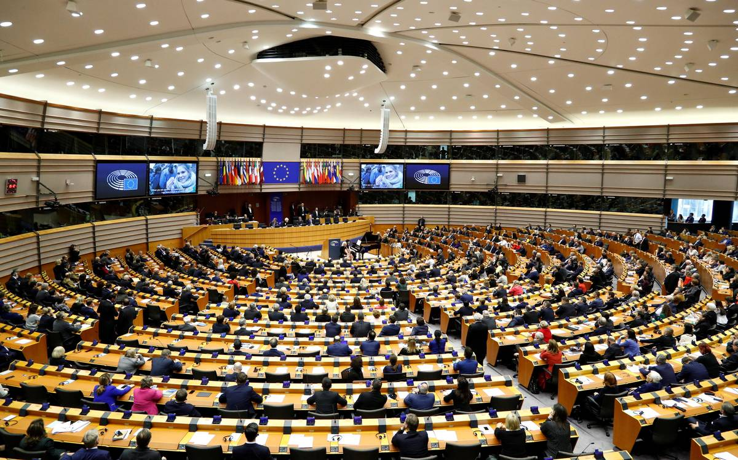
GDPR vs. the american standard
Adapted from PricewaterhouseCoopers’ “Data breach notification: 10 ways GDPR differs from the US privacy model”
Defining requirements -
much broader definition of ‘personal data’ (anything that can be tied back to a living person, including IP addresses)
Risk of Harm -
mandatory reporting for any general risk of harm to personal freedoms and rights
Timing, recipients, content of notifications -
72hrs to report, fewer parties to notify in EU
Notes:
https://www.pwc.com/us/en/services/consulting/cybersecurity/library/broader-perspectives/gdpr-differences.html

Slide 13
GDPR vs. the american standard
Adapted from PricewaterhouseCoopers’ “Data breach notification: 10 ways GDPR differs from the US privacy model”
4) Credit monitoring remedy less common -
not technically required in either the US or EU, certainly not expected in EU
5) No public breach reporting requirement
public impact assessments only
6) Documentation after-the-fact
GDPR requires companies affected by breaches to document details of a breach and steps taken to reduce the likelihood of recurrence
Fines: up to €20 million, or up to 4% of the annual worldwide turnover of the preceding financial year, whichever is greater.
Notes:
https://www.pwc.com/us/en/services/consulting/cybersecurity/library/broader-perspectives/gdpr-differences.html

Slide 14
Q&A w/Mads

Slide 16
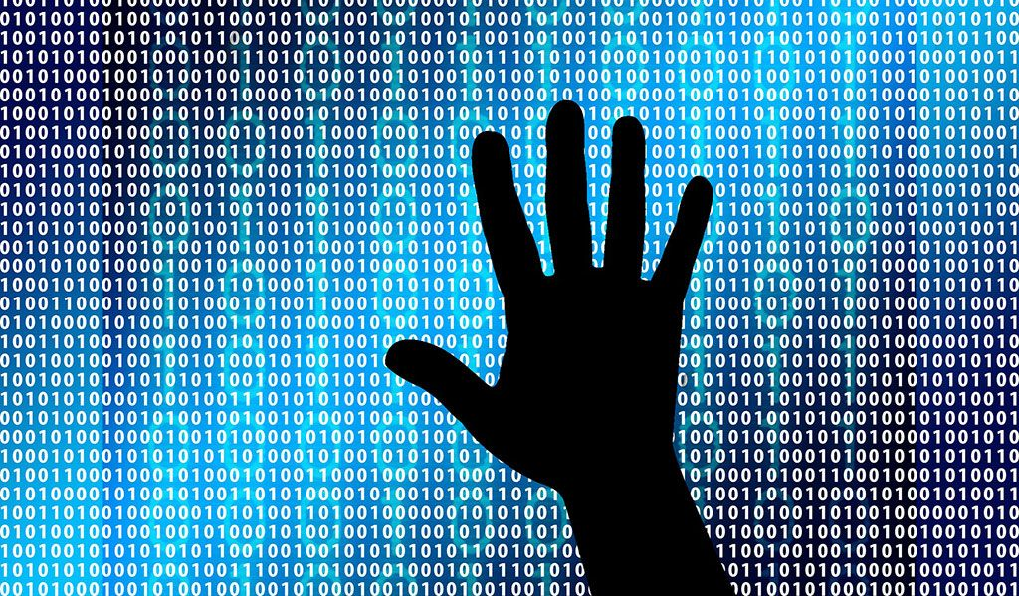
this week in tech:
Jeff Bezos’ Earth Fund
Mac Malware Threats Reassessed
Notes:
Hi matt

