Slide 1
Notes:
Explain what gatortech is.

Slide 2
ISOM Info Session - 3/17 during normal GBM time and place
CGS2531 paid tutor needed! Contact Dr.M or msg @liana on Slack
Coordinator meeting - 2/18 after GBM
Coordinators - send me a headshot and bio
https://gatortechuf.com
Reference to all our slides, calendar, and more
Notes:
Go to mentimeter for the polls.
Hackathons: https://mlh.io/seasons/na-2019/events
ShellHacks: https://shellhacks.net/
HackGSU: http://hackgsu.com/
HackGT: https://2018.hack.gt/
HackFSU: https://hackfsu.com/
SwampHacks: https://2019.swamphacks.com/
MangoHacks: https://mangohacks.com/
KnightHacks: https://knighthacks.org/

Slide 3
Personality Quizzes

Slide 4
Personality Quizzes
Access the quizzes on Slack and join our Slack channel!
https://www.buzzfeed.com/sarahaspler/eat-like-a-college-student-for-a-day-and-well-rev?origin=btm-fd
https://www.buzzfeed.com/katangus/choose-some-dogs-and-some-snacks-and-well-reveal?origin=btm-fd
Share with people around you! Looks like I am a reliable Media and Communications Major… - Sarah

Slide 5
cybersecurity

Slide 6
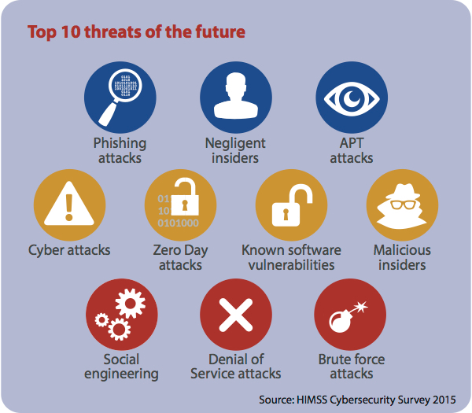
threats
phishing
sending emails purporting to be legit company in order to induce individual to reveal personal information.
interception
intercept the data that being send out. stored / change form of the data .
DDoS
botnet directs a flood to a single website server with rapid fire page causing it to slow down / crash.
Notes:
Talk about the different types of threats, have like 3 per slide
Phishing
Interception
The data or message which is sent by the sender is intercepted by an unauthorized individual where the message will be changed to the different form or it will be used by the individual for his malicious process. So the confidentiality of the message is lost in this type of attack.
To understand how the message being intercepted, we have to first understand how the data is being transmit.
Data is transfer through optical fiber cable. It could get intercepted.
The hackers can alter ip address and have the data send to them / installed malware at data center to collect data the from specific ip address.
How does internet work.
https://www.youtube.com/watch?v=x3c1ih2NJEg&t=29s
DDoS
Computers compromised by malware can be formed into botnet to attack other computers / serve.
DDoS : botnet directs a flood to a single website server with rapid- fire page requests, causing it to slow down or crash.
Prevent web crushing. Limit the request each ip address can sent. Block data center ip address request.

Slide 7
threats
data breach
intentional or unintentional released confidential data.
malware
install malicious software in one’s device without the person knowledge.
social engineering
similar to phishing, but employ social media, instant message, social media and more. it involved psychological method to manipulate human’s emotion.
Notes:
Talk about the different types of threats, have like 3 per slide
https://en.wikipedia.org/wiki/Data_breach
Data breach
Intentional / unintentional released data / Confidential information that are being transmit, copied, viewed or stolen by unauthorized individuals/ groups.
Identity theft. Someone using your SSN to open a bank account/ take out loans.
Malware
https://us.norton.com/internetsecurity-malware-malware-101-how-do-i-get-malware-complex-attacks.html
Type of attack.
1, Exploit kit attack
A kind of malicious software use to search system’s vulnerability on a target device.When the vulnerability is found, inject malware into the system’s through security flaws.
2, Malicious website and drive by download
Visit site that hosts exploit kit search for browser vulnerability and inject malware via security holes. There is no interaction needed from use.
3, Man in the middle attack
A man-in-the-middle attack employs the use of an unsecured, or poorly secured, usually public Wi-Fi router. The hacker will then scan the router using special code looking for certain weaknesses such as default or poor password use.
Social engineering
https://www.secureworldexpo.com/industry-news/5-emotions-hackers-use-social-engineering-attacks
5 ways hacker use to manipulated human emotions.

Slide 8
encryption
the process of converting information or data into a code to prevent unauthorized access
encrypting data allows for a safe transfer of information across the internet
4 types:
symmetric
Asymmetric
hashing
salting
Notes:
Talk about encryption/decryption, public keys, private keys
https://www.cloudflare.com/learning/ssl/how-does-public-key-encryption-work/
“Linux password file” by Christiaan Colen is licensed under CC BY-SA 2.0.

Slide 9
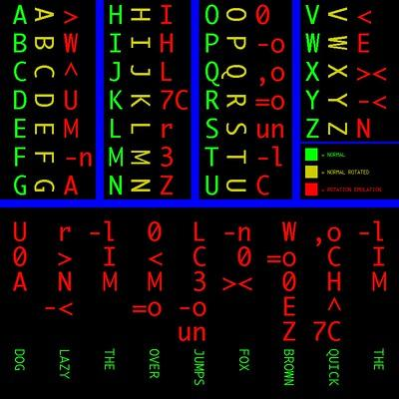
symmetric encryption
oldest and best-known type of encryption
secret key
the sender and recipient must know the secret key for this encryption
Notes:
Talk about encryption/decryption, public keys, private keys
https://support.microsoft.com/en-us/help/246071/description-of-symmetric-and-asymmetric-encryption
“encryption 90 degrees clockwise” by Chris Dlugosz is licensed under CC by 2.0.

Slide 10
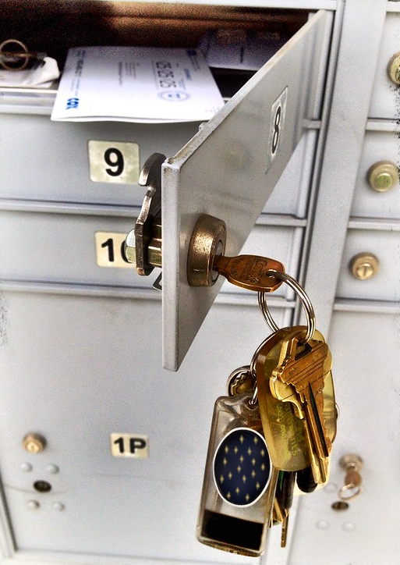
asymmetric encryption
encrypt data with two keys
private key - use this key to encrypt your data/information
public key - used to send/receive the information
examples:
mailbox example
HTTPS and Bitcoin
Notes:
Talk about encryption/decryption, public keys, private keys
https://www.cloudflare.com/learning/ssl/how-does-public-key-encryption-work/
"Mail's in" by Damian Gadal is licensed under CC BY 2.0
Cropped the image
Photoshopped out the ugly keychain

Slide 11
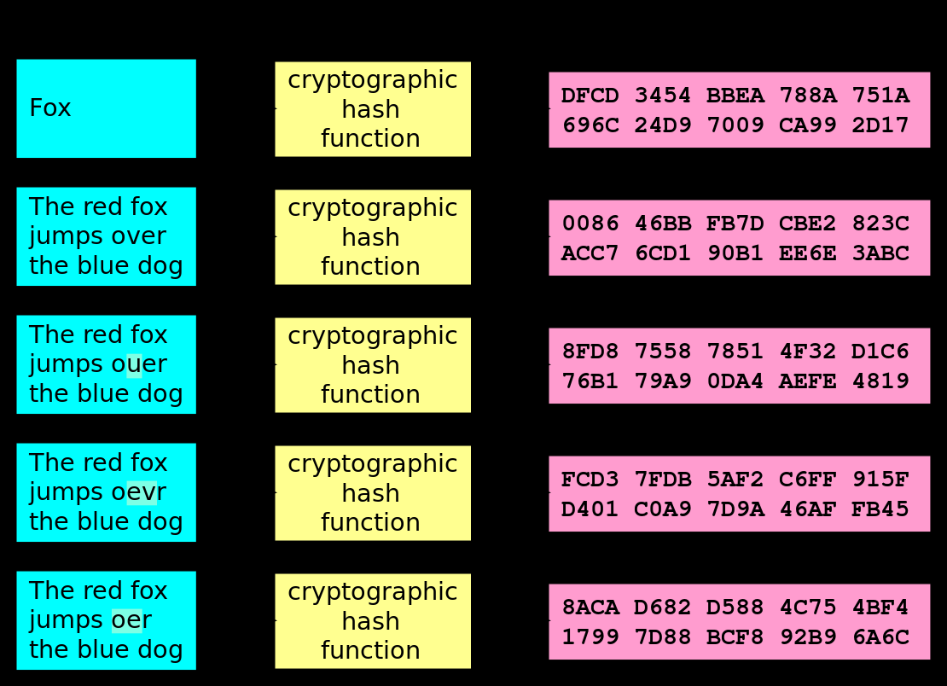
hashing
converting an input of any length into a fixed size string of text using a mathematical function
any message can be converted to an array of numbers and letters
message = input, algorithm used to convert the input = hash function, output = hash value
Notes:
Talk about encryption/decryption, public keys, private keys
https://www.cloudflare.com/learning/ssl/how-does-public-key-encryption-work/
https://www.youtube.com/watch?v=2BldESGZKB8
https://commons.wikimedia.org/wiki/File:Hash_function_long.svg

Slide 12
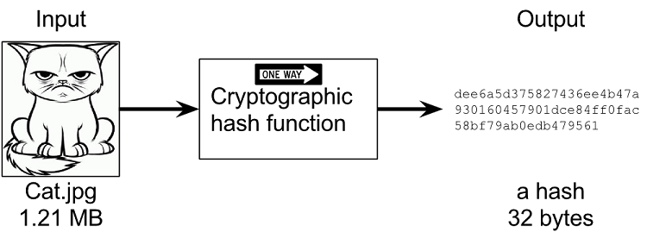
hashing qualities
unique hash value for every output, no repeats
impossible to generate same hash value using different inputs
hashing speed: hash function should be quick to produce a hash value
secure hash: hash function needs to be secure
extremely difficult to determine the input based on the hash value
one wrong value = completely different hash
Notes:
Talk about encryption/decryption, public keys, private keys
https://www.cloudflare.com/learning/ssl/how-does-public-key-encryption-work/
https://www.youtube.com/watch?v=2BldESGZKB8
Photo: https://theccpress.com/all-about-hashing-algorithms-and-how-they-work/

Slide 13
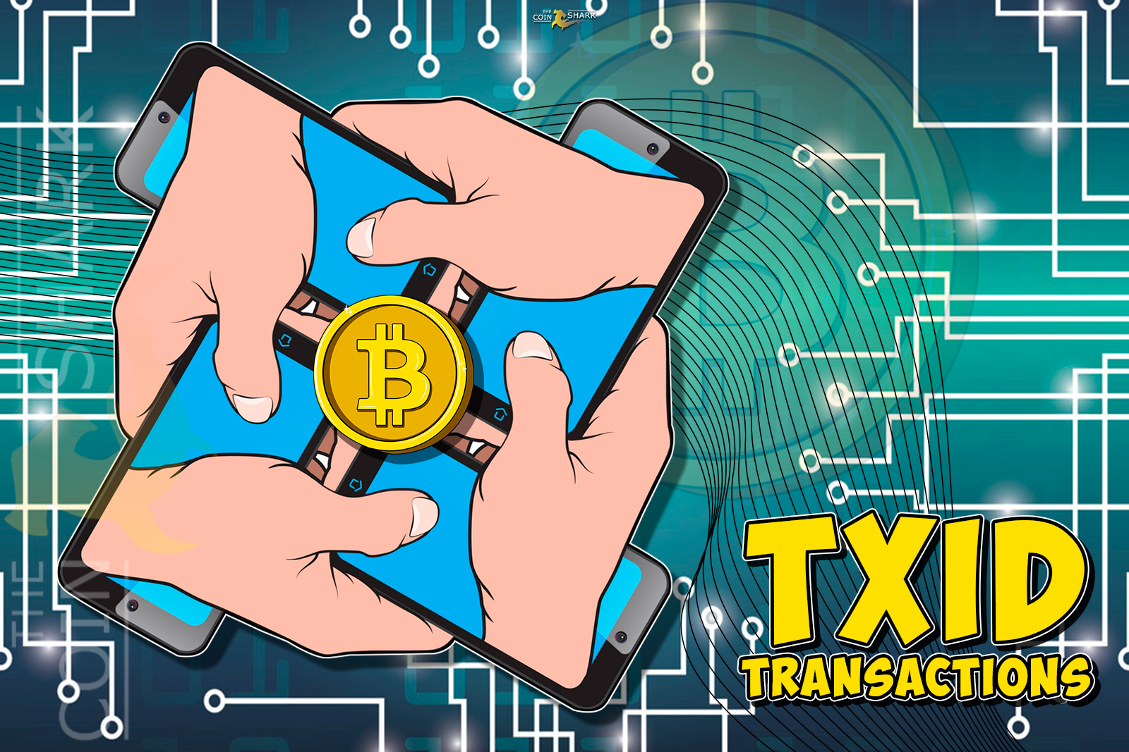
hashing examples
transaction IDs: use hashing to create a secure way of sending money across the internet and identify and confirm a transaction happened
block chain: keeps track of current state of a block chain and ensure immutability
first block (Genesis Block):
contains transactions that when combined, produce a unique hash
continued for more blocks to create a blockchain
highly secure, immutable, transparent network
Notes:
Talk about encryption/decryption, public keys, private keys
https://www.cloudflare.com/learning/ssl/how-does-public-key-encryption-work/
https://www.youtube.com/watch?v=2BldESGZKB8
https://thecoinshark.net/en/what-is-txid-or-how-to-find-a-transaction-in-the-blockchain-ocean/
transaction IDs: use hashing to create a secure way of sending money across the internet and identify and confirm a transaction happened
amount being sent
sending/receiving addresses
time stamp

Slide 14
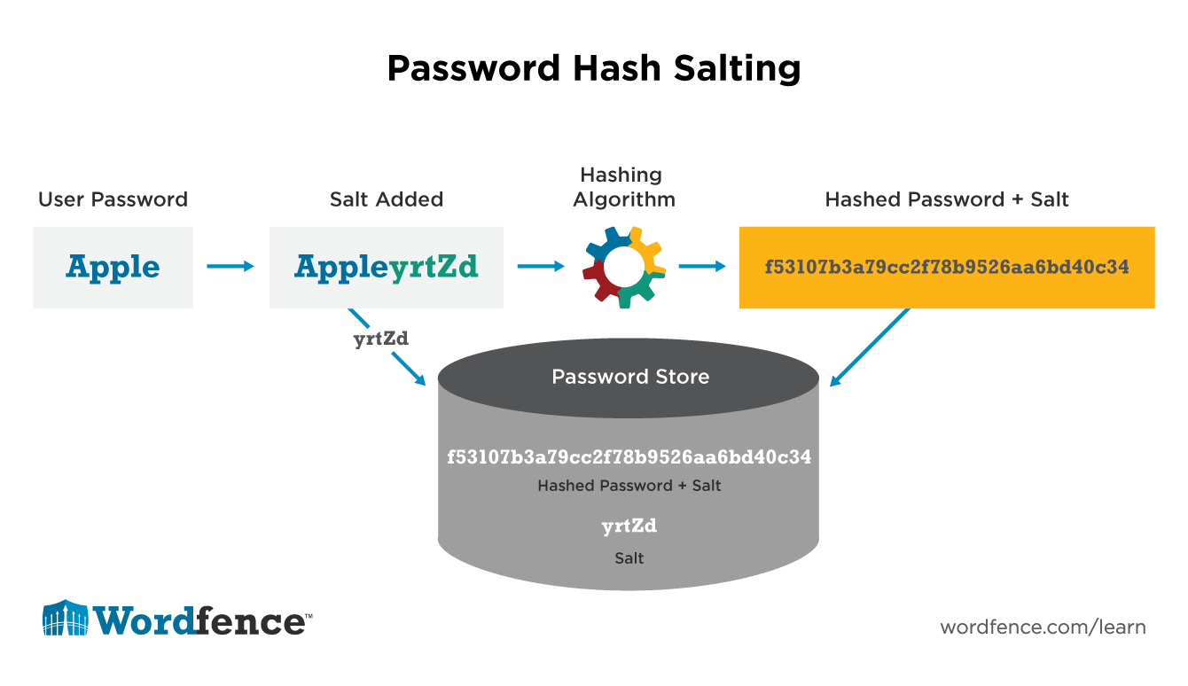
salting
additional data added to the password before encryption
knowing password requires you to also know the salt string
salting for different users:
unique
prevent entire system being compromised
must know salt string and user string
store salt in database separate from password
hash the salt for extra security
Notes:
Talk about encryption/decryption, public keys, private keys
https://www.cloudflare.com/learning/ssl/how-does-public-key-encryption-work/
https://www.youtube.com/watch?v=_IOgHtmNKp8
https://www.wordfence.com/learn/how-passwords-work-and-cracking-passwords/

Slide 15
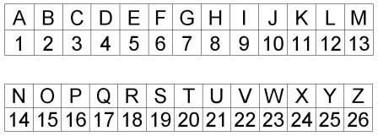
encryption activity
7-15 7-1-20-15-18-19
3-9-16-8-5-18
Notes:
Maybe use this https://sela.io/pgp-en/
GO Gators
Cipher

Slide 16
encryption activity
Key (Alphabet):
BECDAFGHXQPTJNOISWULMYRZVK
EBEV VODB
LHA RXLCHAW
ROR X CBNL EATXAYA VOM DACXIHAWAD LHXU
Notes:
Maybe use this https://sela.io/pgp-en/
Baby Yoda
The Witcher
Wow I can’t believe you deciphered this

Slide 17
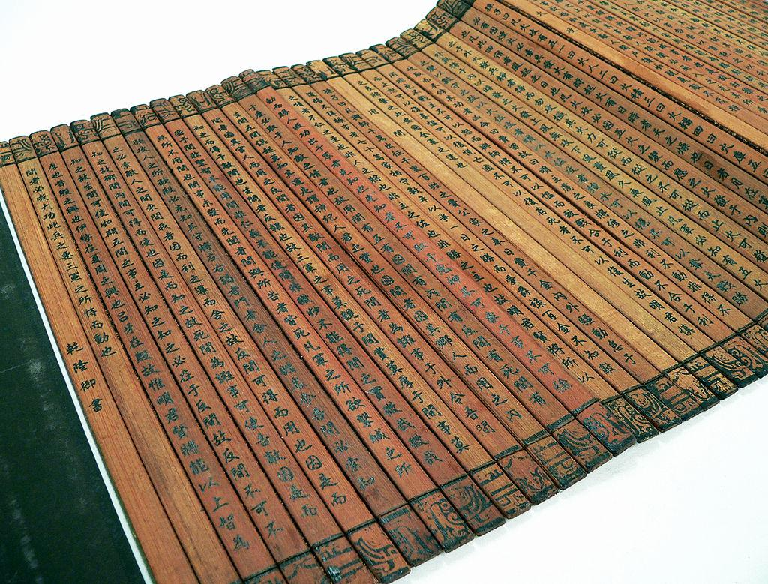
encryption activity
A1:D5
Glodm ounts ocme dkir ms
Notes:
Good luck on midterms

Slide 19
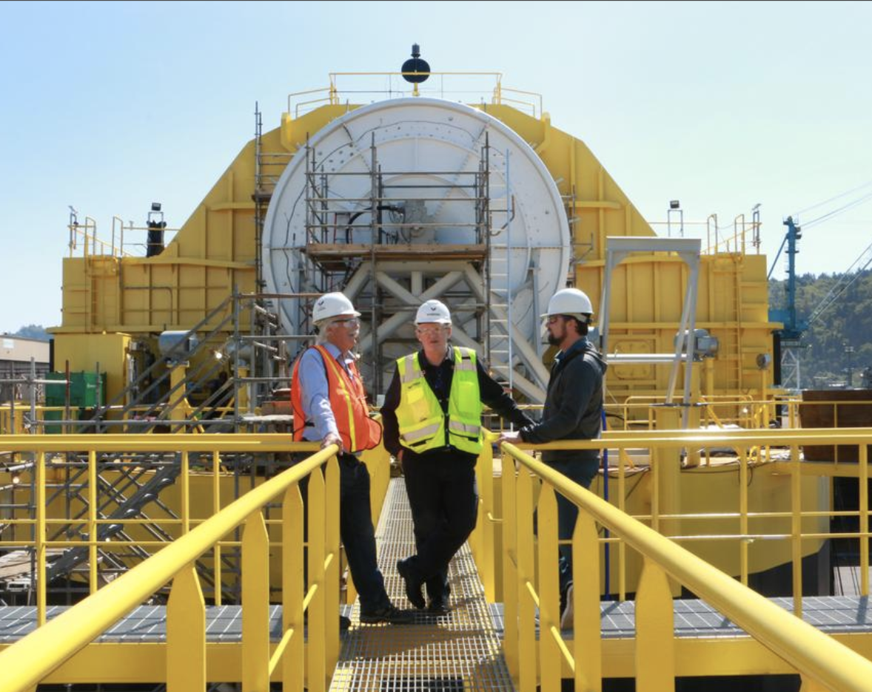
Porsche and Boeing’s ambitious partnership.
Portland’s Renewable Wave Machine

Slide 20
this week in tech:
New Advancements in Burn Treatment
Individuals Charged in Equifax Breach
Notes:
Hi matt

Slide 21
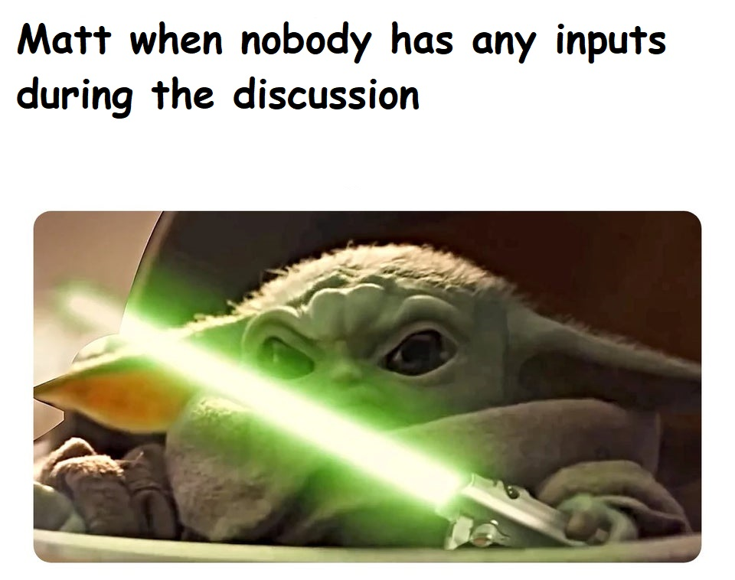
Tech Memes of the Week

