Slide 1
Notes:
Explain what gatortech is.

Slide 2
VP Marketing Application - http://bit.ly/GTMarketingApp
Tech & Marketing Coordinator Application - http://bit.ly/2020coordinator
April Elections
Slack Membership
Mods: AI /Machine Learning, Cybersecurity/Privacy, Mobile App Dev
Notes:
Go to mentimeter for the polls.
Hackathons: https://mlh.io/seasons/na-2019/events
ShellHacks: https://shellhacks.net/
HackGSU: http://hackgsu.com/
HackGT: https://2018.hack.gt/
HackFSU: https://hackfsu.com/
SwampHacks: https://2019.swamphacks.com/
MangoHacks: https://mangohacks.com/
KnightHacks: https://knighthacks.org/

Slide 3
4 Corners

Slide 4
Strongly agree
Front of the Room
Strongly disagree
I trust humans to make better decisions about some problems than computers.
Somewhat agree
Back of the Room
Somewhat disagree

Slide 5
Strongly agree
Front of the Room
Strongly disagree
I expect that the benefits of advanced AI will outweigh potential negative consequences
Somewhat agree
Back of the Room
Somewhat disagree

Slide 6
Strongly agree
Front of the Room
Strongly disagree
I believe there are some jobs / industries that artificial intelligence and machine learning should never touch.
Somewhat agree
Back of the Room
Somewhat disagree

Slide 7
Strongly agree
Front of the Room
Strongly disagree
I am okay if intelligent machines incorporate some bias in their decision making if it makes us more productive.
Somewhat agree
Back of the Room
Somewhat disagree

Slide 8
intro to
AI/machine
learning

Slide 9
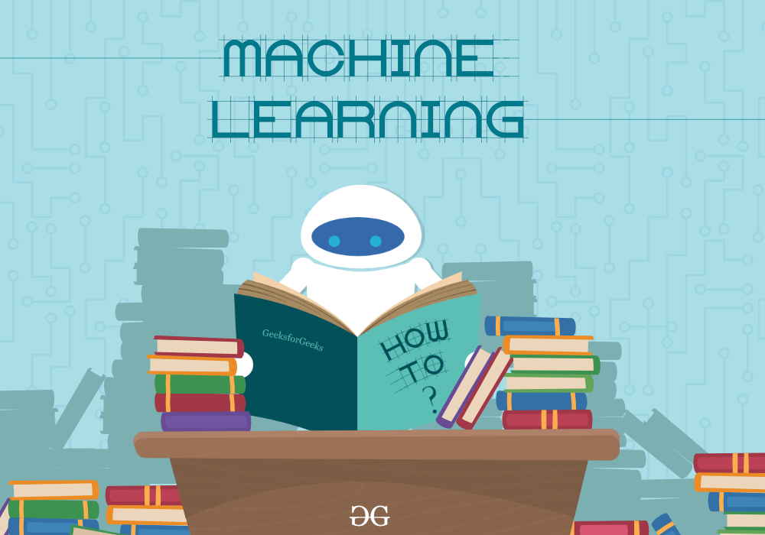
AI vs machine learning
AI - Artificial Intelligence
the intelligence of machines
capability to mimic human thought processes (thinking and learning)
Machine Learning
the concept of machines using patterns and inference to perform tasks
a subset of AI

Slide 10
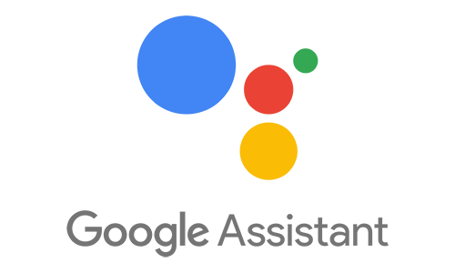
why AI
AI
automation
adds intelligence
adapts
learn
Notes:
The more data you feed to an AI the more it learns and the more it can do. They become more accurate and more capable of finding patterns and information that humans might not be able to
https://aws.amazon.com/rekognition/
https://www.youtube.com/watch?v=r7E1TJ1HtM0

Slide 11
how machines learn
training set - data set used to train the model to accomplish task
supervised learning
unsupervised
semi-supervised
reinforcement

Slide 12
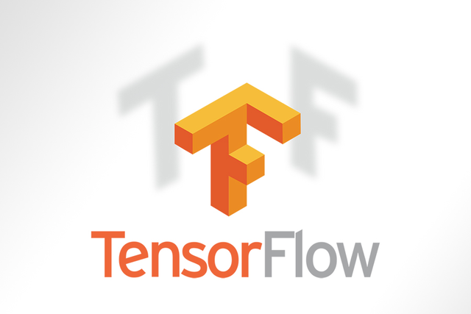
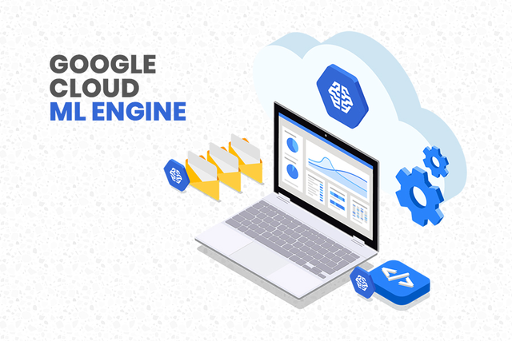
software
tensorflow - open source, flexible, trains and builds models
google cloud ML engine - trains complex models, can handle lots of data
shogun - open source, written in C++, offers algorithms, supports many languages

Slide 13
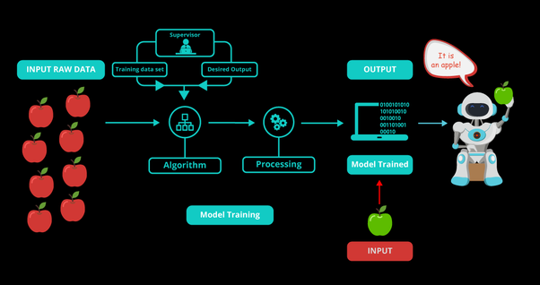
supervised
trained using labeled examples
algorithm attempts to sort the input and compares it with the correct output
uses classification and statistical data to improve
used in predicting future events from historical data
Notes:
https://medium.com/@gowthamy/machine-learning-supervised-learning-vs-unsupervised-learning-f1658e12a780

Slide 14
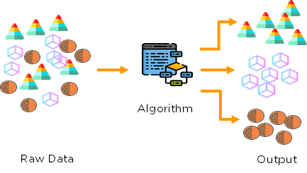
unsupervised
used for data with no historical labels
has to figure out what it sees in the training set
looks for pattern and sorts it
used for transactional data

Slide 15
semi-supervised
a combination of supervised and unsupervised training
provides a small labeled data set and a large unlabeled data set
used for classification i.e picking out faces, understanding audio
Notes:
Basically classifies unlabeled data based off of labeled data

Slide 16
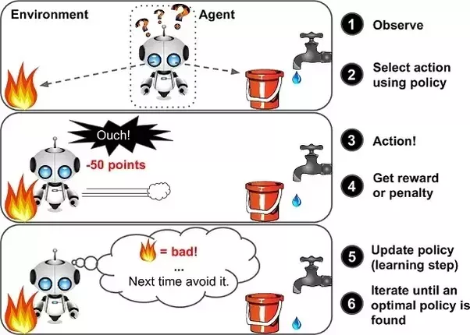
reinforcement
aims to find the action that yields the best result
as the machine interacts with its environment it gets point assigned based on it’s actions
Used in gaming, robotics, and navigation

Slide 17
activity
Be the Machine - unsupervised Sort the gods
Zeus Neptune Hades Juno Mars
Aphrodite Minerva Hephaestus Cupid Nike
Notes:
Greek: Zeus, Hades, Aphrodite, Heph, Nike QQ no more gods
Roman: Neptune, Juno, Mars, Minerva, Cupid
Male: Zeus, Neptune, Hades, Mars, Hephaestus, Cupid
Female: Juno, Aphrodite, Minerva, Nike

Slide 18
activity
Be the Machine - unsupervised Sort the animals
Zebra Shark Whale Emu Gorilla
Axolotl Octopus Dugong Platypus Hornbill
Notes:
Mammals: Zebra, Whale, Gorilla, Platypus, Dugong
Non-Mammals: Shark, Emu, Octopus, Hornbill, Axolotl
Land Animals: Zebra, Emu, Gorilla, Hornbill
Aquatic Animals: Shark, Whale, Axolotl, Octopus, Dugong
Semi-Aquatic: Platypus, Axolotl?

Slide 19
activity
Be the Machine - semi-supervised
Continents Countries Unsorted
North America United States South America
Antarctica Italy United Kingdom
Asia Japan Australia
Europe
Notes:
Greek: Zeus, Hades, Aphrodite, Heph, Nike
Roman: Neptune, Juno, Mars, Minerva, Cupid
Male: Zeus, Neptune, Hades, Mars, Hephaestus, Cupid
Female: Juno, Aphrodite, Minerva, Nike

Slide 21
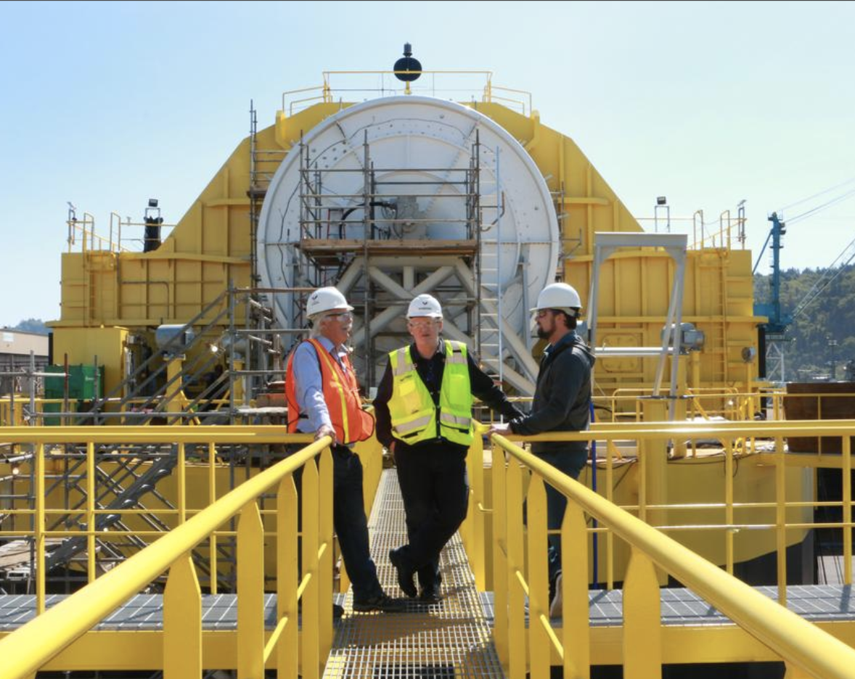
Porsche and Boeing’s ambitious partnership.
Portland’s Renewable Wave Machine

Slide 22
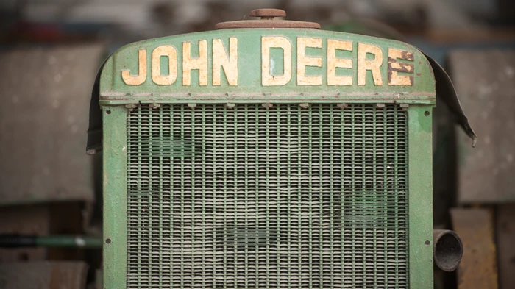
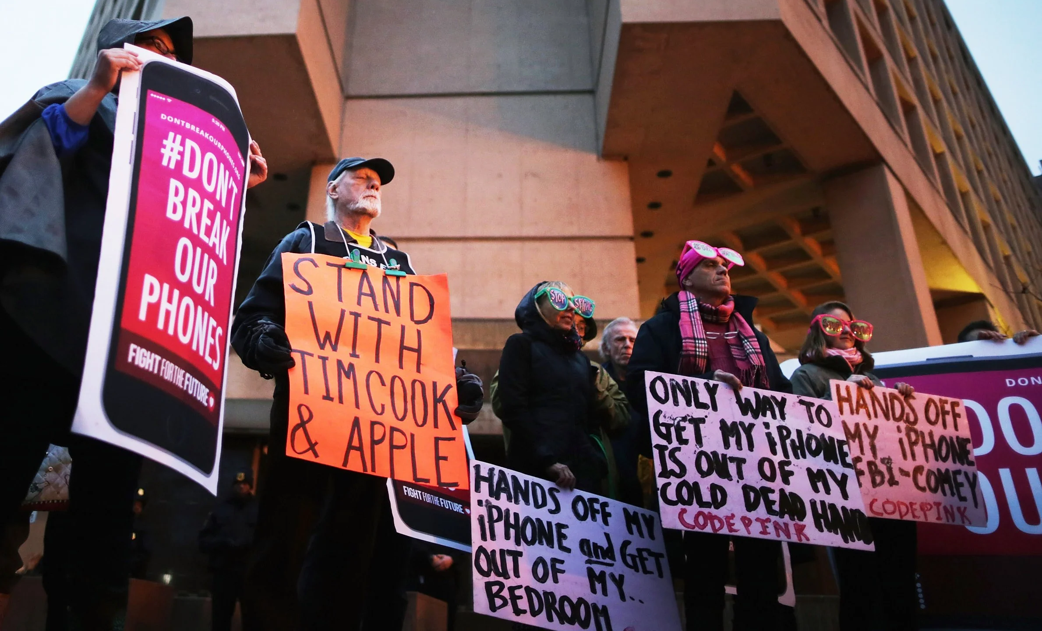
this week in tech:
Farmers Are Buying 40-Year-Old Tractors Because They're Actually Repairable
The FBI wants Apple to unlock iPhones...again

Slide 23
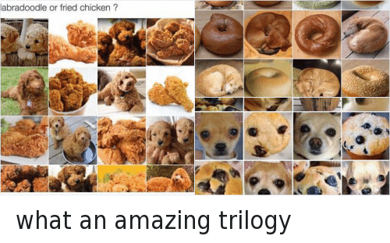
Tech Meme(s) of the Week

