Slide 1
Notes:
Explain what gatortech is.

Slide 2
Check-in on gatortechuf.com
Felipe’s social - today after GBM!
Coordinator meeting 11/29
Video game social - 12/3
Notes:
Go to mentimeter for the polls.
Hackathons: https://mlh.io/seasons/na-2019/events
ShellHacks: https://shellhacks.net/
HackGSU: http://hackgsu.com/
HackGT: https://2018.hack.gt/
HackFSU: https://hackfsu.com/
SwampHacks: https://2019.swamphacks.com/
MangoHacks: https://mangohacks.com/
KnightHacks: https://knighthacks.org/

Slide 3
Which Smash Bros are You?

Slide 4
Which Smash Bros are You?
https://www.buzzfeed.com/awesomer/which-super-smash-bro-are-you

Slide 5
game
development

Slide 6
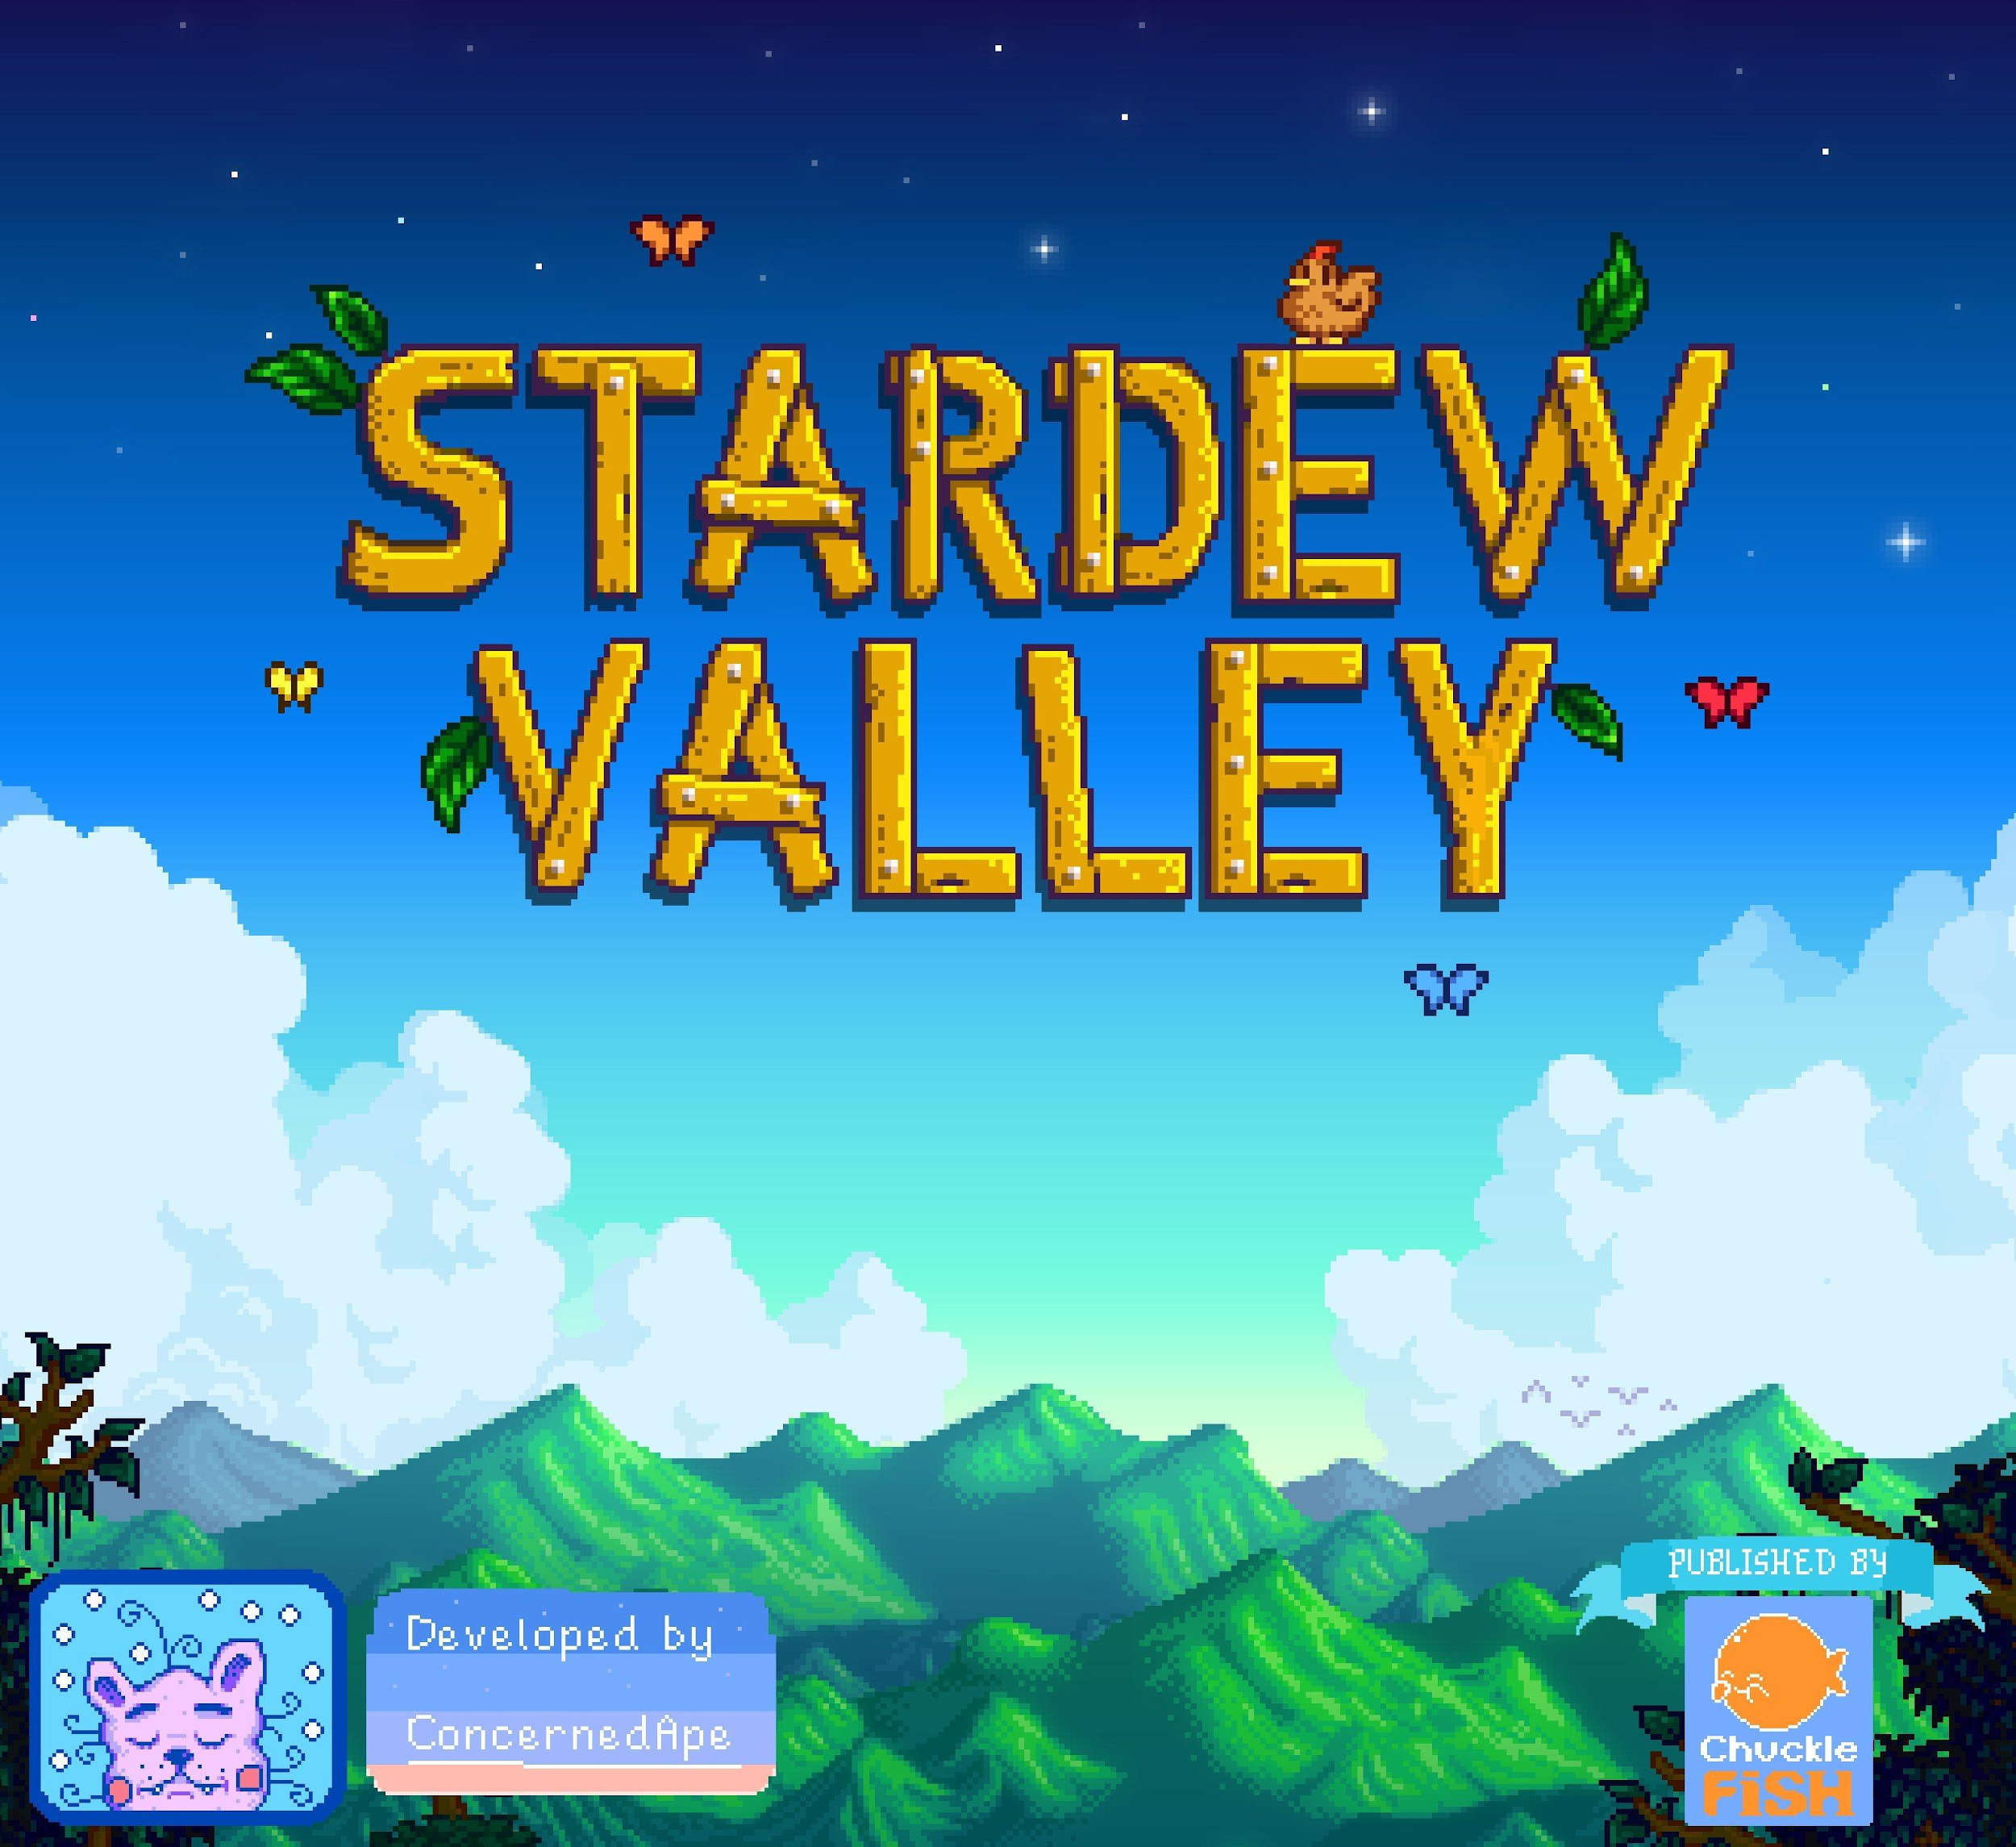
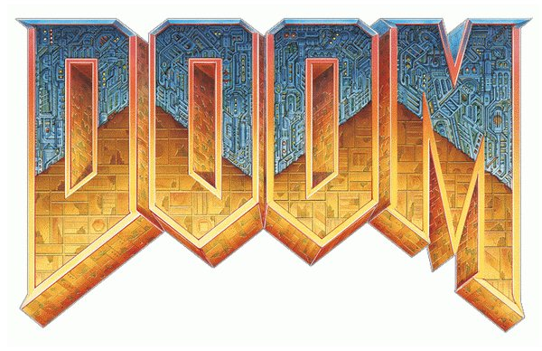
game development
The process of creating a video game
Transforming a concept into a full-fledged game
A booming field with multiple points of entry
Different from game design

Slide 7
software
Unity
Pros:
Everything you need in one
Free personal version
Cons:
Complicated to learn
GameMaker
Pros:
Simple
Doesn’t require programming
Cons:
Only for 2D games
Unreal Engine
Pros:
High quality graphics
Functionality
Cons:
Uses C++
Notes:
Unity: Supports 2D and 3D games, and just about every single platform (ios, android, desktop, AR, VR, Nintendo Switch), easy cross platform integration. However, its overwhelming at first.
GameMaker: Point and Click. However, it has programming limitations and only supports 2D games.
Unreal: Can make extremely high quality games, its well established for being able to handle very large and complicated games. Has a lot of tools and functions for optimization. However, it’s complicated to do most things because C++ is a difficult language to learn.

Slide 8
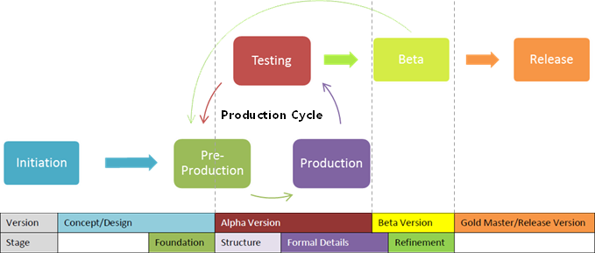
stages of game development
Initiation: inspiration/idea to make game
Pre-Production: foundation and concept planning. Paper Prototype
Production: Assets and source code
Testing: Quality Assurance, feature tests, alpha testing
Beta: minor bug fixes
Release: going Gold

Slide 9
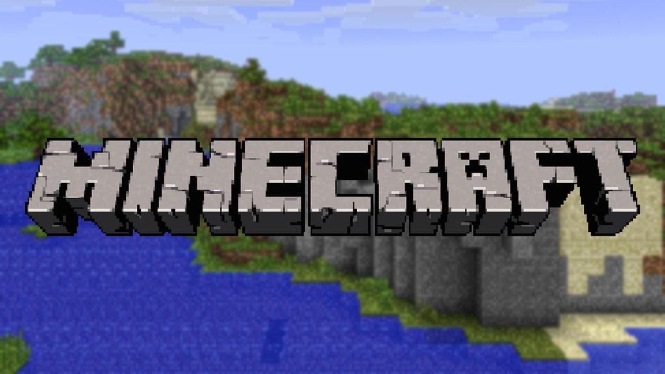
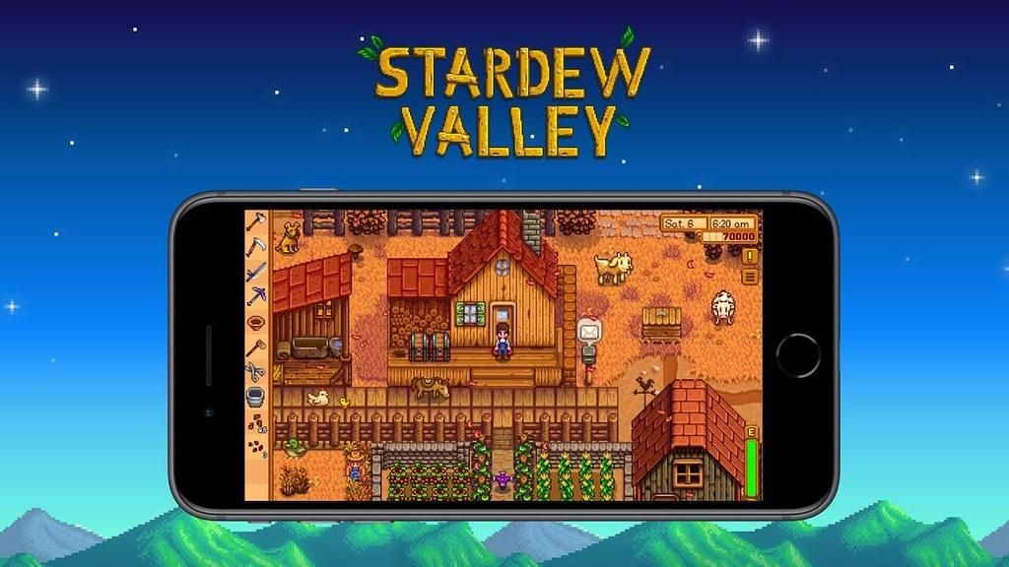
how to start
Have a plan in mind
Start simple and small
Create clones of games
Language does not matter
Reach out to online resources
Example of some successful indie games:
Minecraft
Stardew Valley
Cuphead
Don’t Starve
Notes:
https://humansofdata.atlan.com/2019/02/dos-donts-data-visualization/

Slide 10
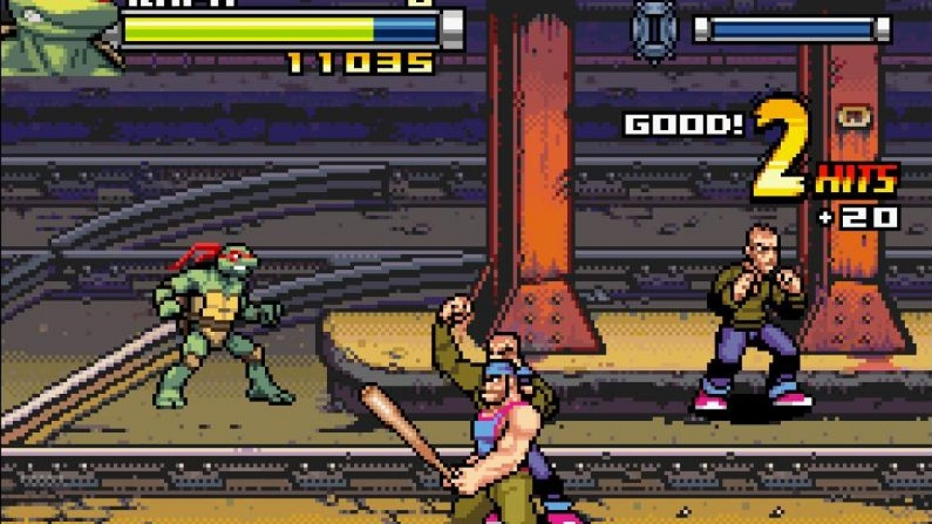
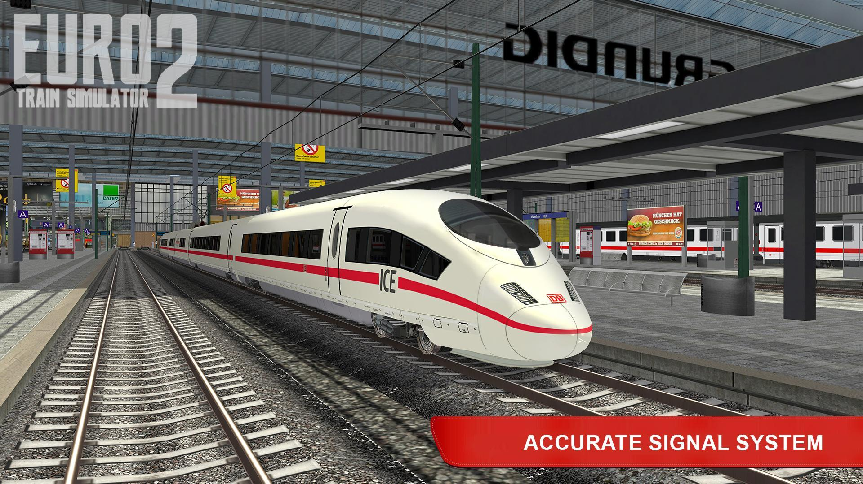
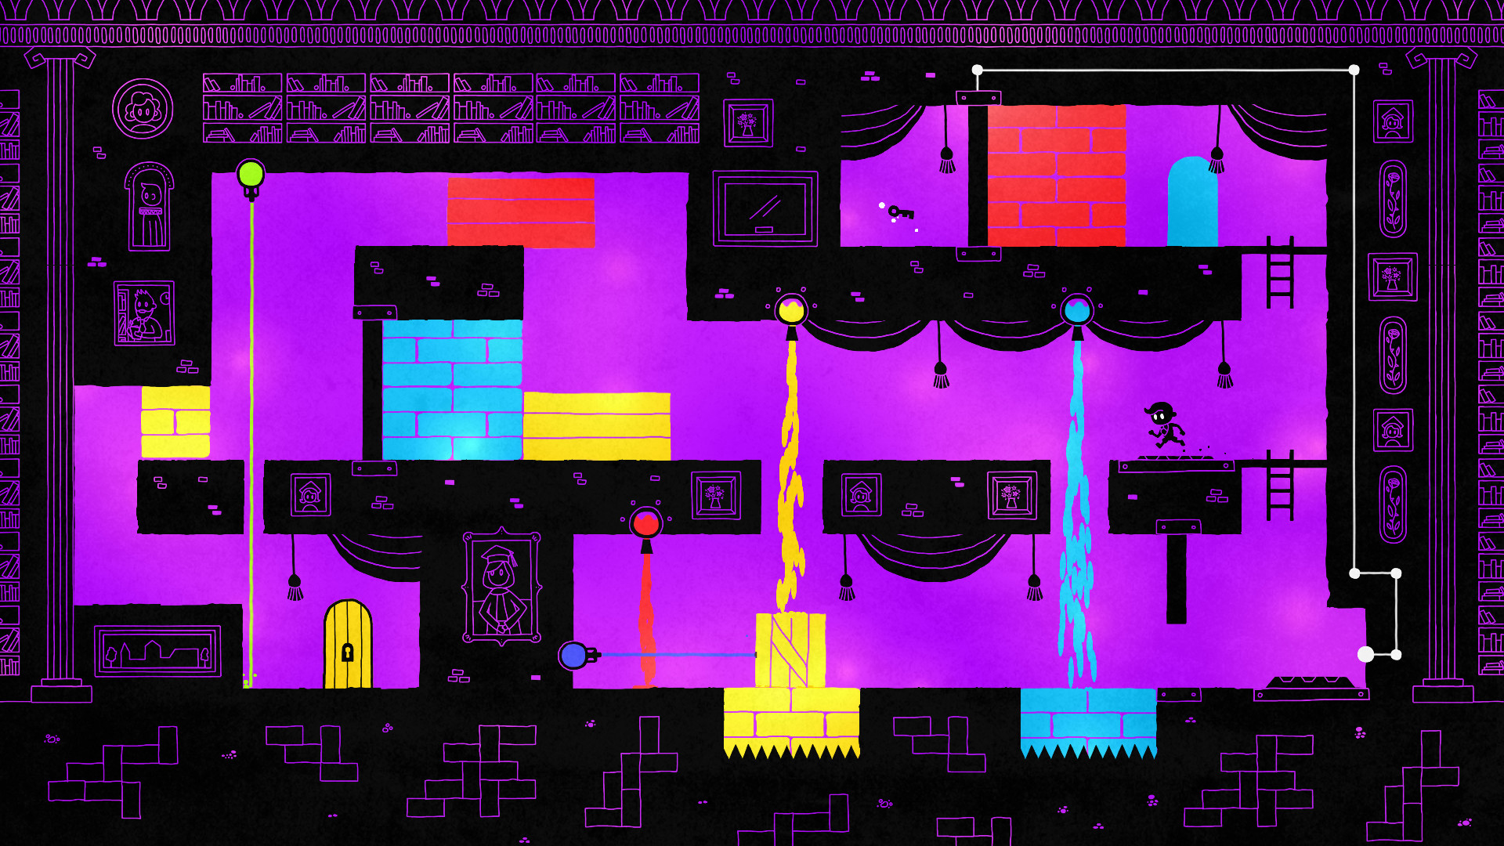
types of games
Role Playing: player takes the role of a character
Puzzle: player solves variety of puzzles for progression
Platformer: game focused on jumping and climbing
Beat ‘em up: players progress by beating waves of enemies
Fighter: player(s) fight against CPUs or one another
Party: contains a variety of mini-games
Simulator: focuses on simulating things i.e jobs, animals
Sandbox: minimal limitations and freedom to roam

Slide 11
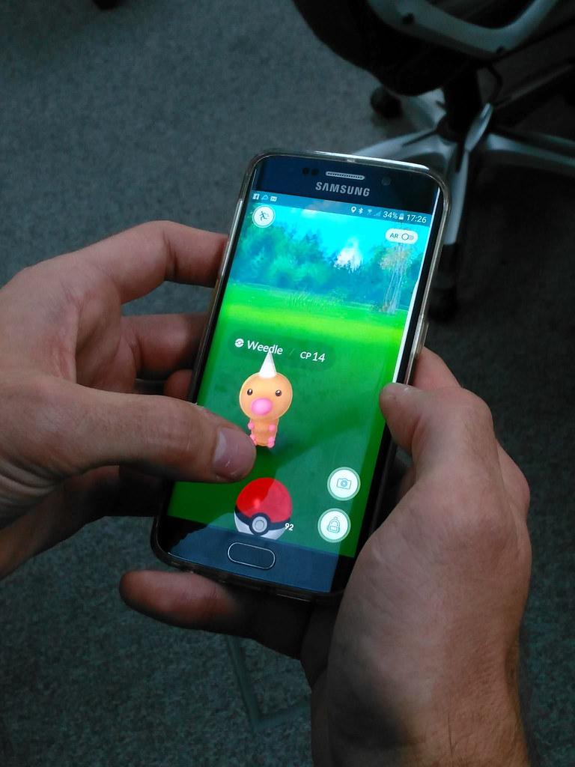
augmented reality
Augmented Reality is the integration of game visual and audio content with the user’s environment. They are typically more mobile compared to their Virtual Reality counterparts and are commonly are on phones.
The most famous AR game is currently Pokemon Go
Notes:
https://www.tableau.com/learn/articles/best-beautiful-data-visualization-examples

Slide 12
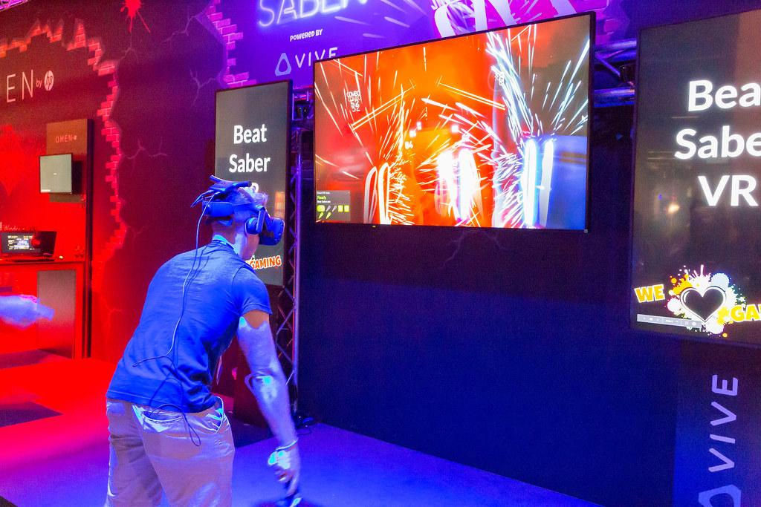
virtual reality
Allows a person to immerse, experience and interact with a 3-D environment. They are commonly on computers, consoles, and mobile devices.
They generally require the individual to wear a visual headset.
A very popular game is Beat Saber
Notes:
https://youtu.be/gOeGoxKR7fI

Slide 13
activity
Come up with a concept for a video game
What genre will it be?
AR? VR? Regular? Mobile?
Story Driven? Player Driven?
Single Player? Multiplayer? Party Game?
Software?
Objective?
Setting?
Notes:
Next week design an area/character, and then basic modeling/hud

Slide 14
activity
Player Driven
Single Player
RPG
Unity
Multiple Areas w/quests that change the world and its characters
Inventory focused, set in the future

Slide 16
Porsche and Boeing’s ambitious partnership.
Portland’s Renewable Wave Machine

Slide 17
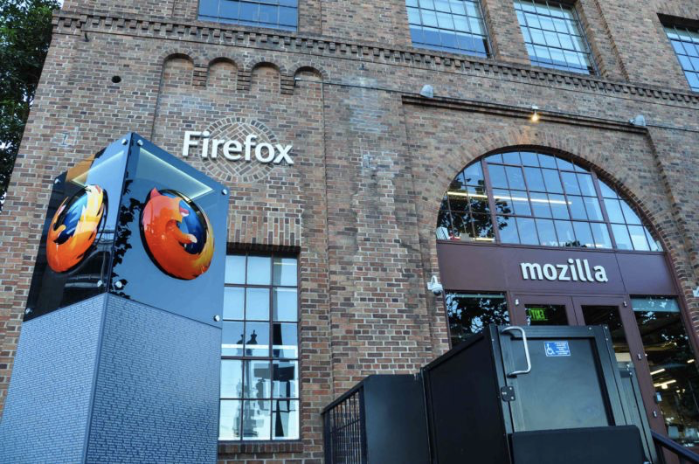
this week in tech:
Microsoft four-day work week 'boosts productivity'
ISPs Lied to Congress to Spread Misinformation about Encrypted DNS, Mozilla Says

Slide 18
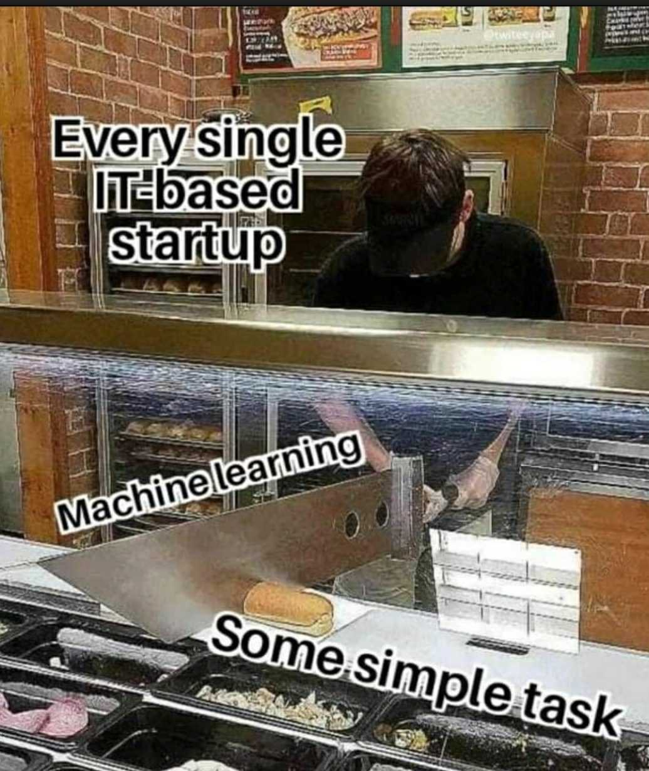
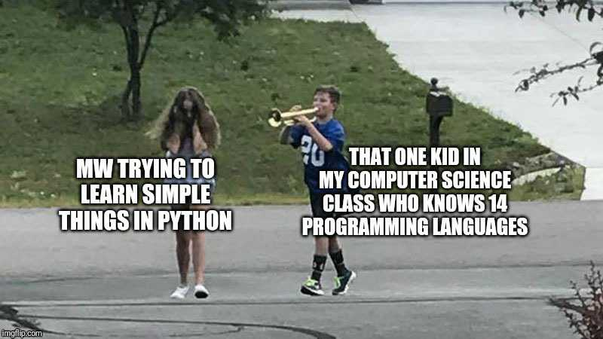
Tech Meme(s) of the Week

