Slide 1
Notes:
Explain what gatortech is.

Slide 2
T-shirts - $10 Venmo after GBM
Coordinator meeting - 2/18
Make sure to follow us on social media!
Insta - @gatortechuf
facebook.com/gatortechuf
Notes:
Go to mentimeter for the polls.
Hackathons: https://mlh.io/seasons/na-2019/events
ShellHacks: https://shellhacks.net/
HackGSU: http://hackgsu.com/
HackGT: https://2018.hack.gt/
HackFSU: https://hackfsu.com/
SwampHacks: https://2019.swamphacks.com/
MangoHacks: https://mangohacks.com/
KnightHacks: https://knighthacks.org/

Slide 3
M & M Game

Slide 4
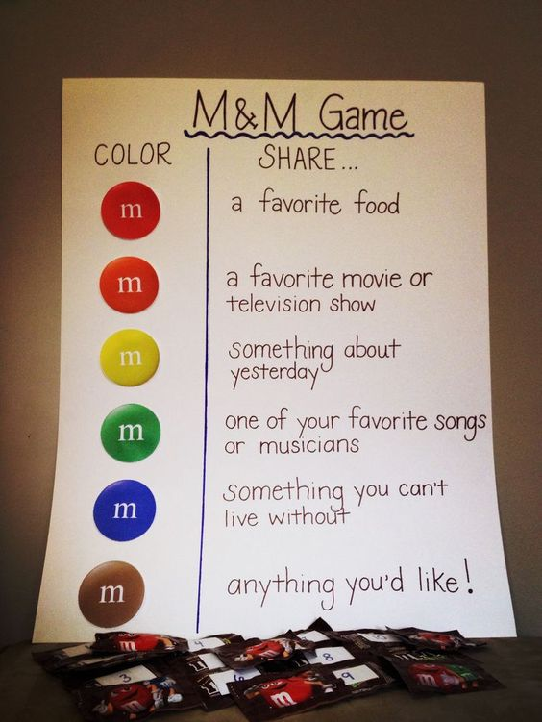
M & M Game

Slide 5
cybersecurity

Slide 6
cybersecurity
measures taken to protect a computer or computer system against unauthorized access or attack
ICA - integrity, confidentiality, and availability
Notes:
https://www.merriam-webster.com/dictionary/cybersecurity
https://www.forcepoint.com/cyber-edu/cybersecurity

Slide 7
why cybersecurity
encompasses everything that pertains to keeping sensitive information and data private from cyber criminals
businesses use cybersecurity to protect confidential information
legal responsibility, liability, business reasons
Notes:
such as social security numbers, and customer information

Slide 8
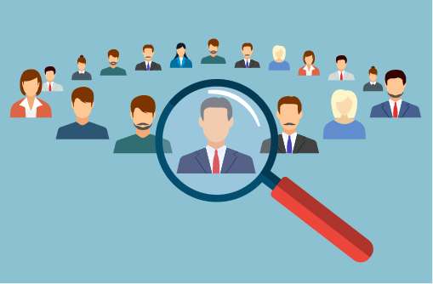
types of cybersecurity
network security
controls in and out connections
cloud security
protects cloud data
identity and access management
authentication and encryption
anti-virus/anti-malware
scans used to mitigate

Slide 9
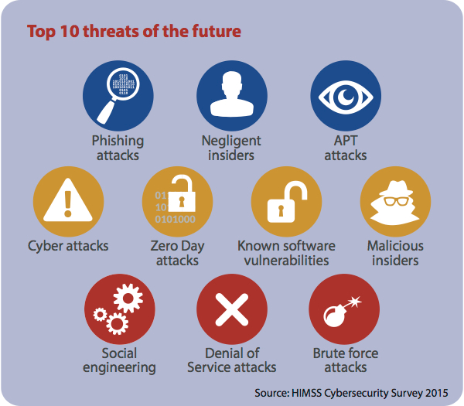
threats
phishing
interception
DDoS
data breach
malware
social engineering
Notes:
https://preyproject.com/blog/en/what-are-cyber-threats-how-they-affect-you-what-to-do-about-them/

Slide 10
major cybersecurity attacks
Equifax
2016 - security researcher “could have downloaded the data of all of Equifax's customers in 10 minutes”
2017 - security and data breaches
one of the biggest data breaches in history
information on over 145 million people from the US, Canada, and the UK was compromised
Sony Pictures Hack (2014)
The Interview Movie
Notes:
https://en.wikipedia.org/wiki/Sony_Pictures_hack
https://en.wikipedia.org/wiki/Equifax#Security_failings
Equifax = credit reporting agency
2016: a security researcher examined an Equifax online portal, apparently created for Equifax employees only, was accessible to the open Internet.
The same types of sensitive private information of American consumers (names, birth dates, social security numbers, etc.) were exposed as in the May–July breach

Slide 11
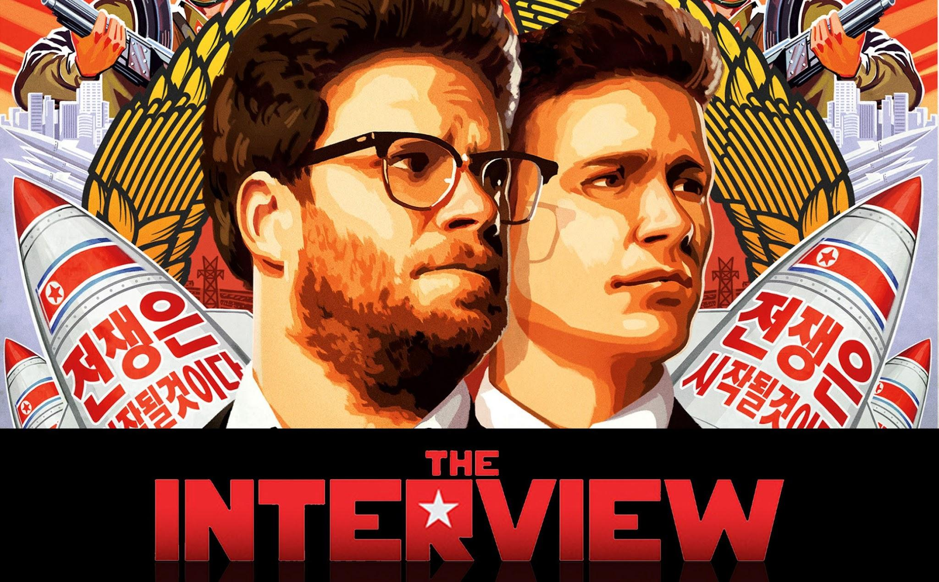
Sony Pictures Hacked(2014)
triggered due to the film The Interview, which was about the assassination of Kim Jong-un.
there were multiple leaks with the first being all employee information such as emails, contracts, copies of passports
Notes:
https://en.wikipedia.org/wiki/Equifax#Security_failings

Slide 12
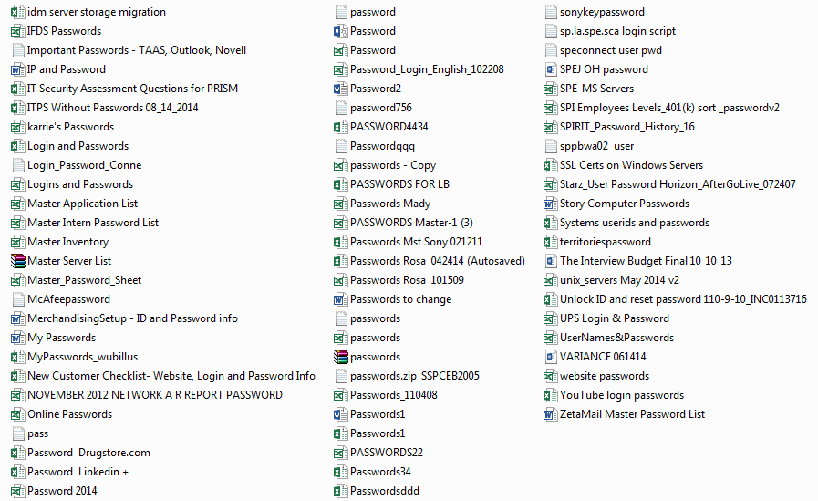
Sony Pictures Hacked(2014)
The Second data leak compromised by the IT Director.
Notes:
https://en.wikipedia.org/wiki/Equifax#Security_failings

Slide 13
Sony Pictures Hacked(2014)
“As a result of our investigation, and in close collaboration with other U.S. government departments and agencies, the FBI now has enough information to conclude that the North Korean government is responsible for these actions.”
Notes:
https://en.wikipedia.org/wiki/Equifax#Security_failings

Slide 14
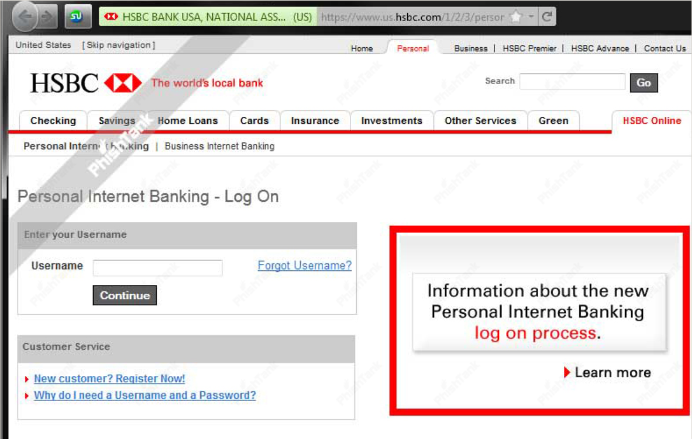
gone phishing

Slide 15
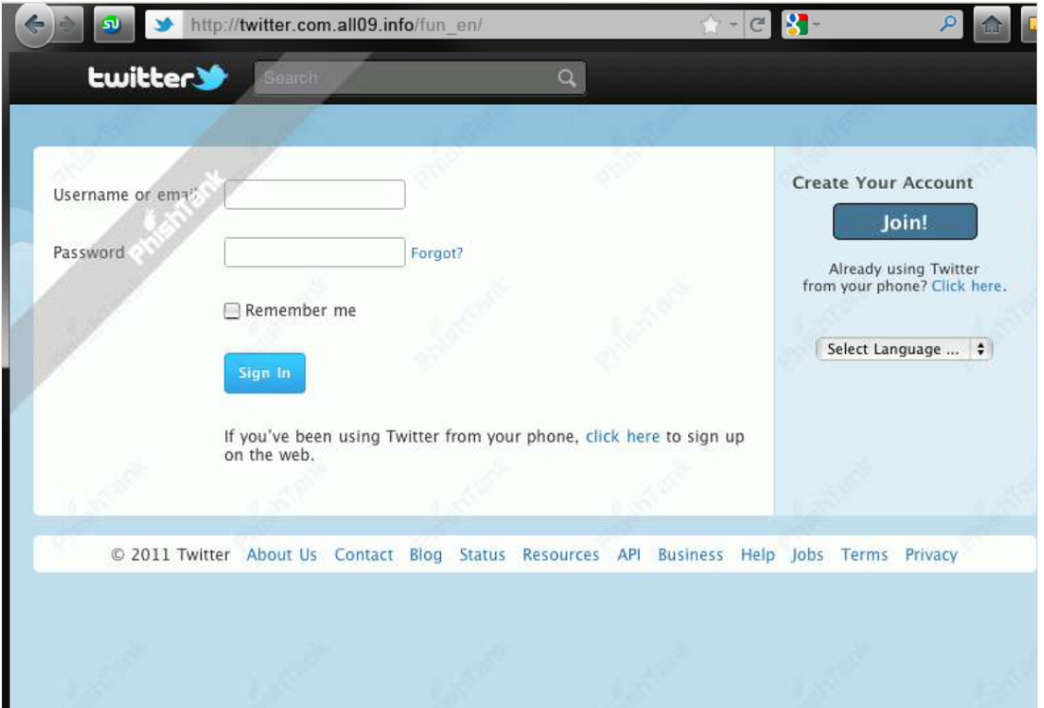
gone phishing

Slide 16
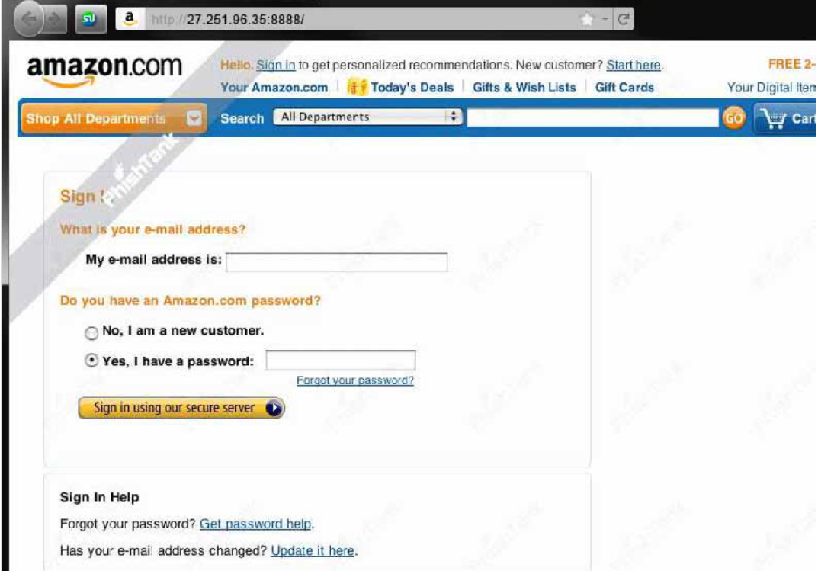
gone phishing

Slide 17
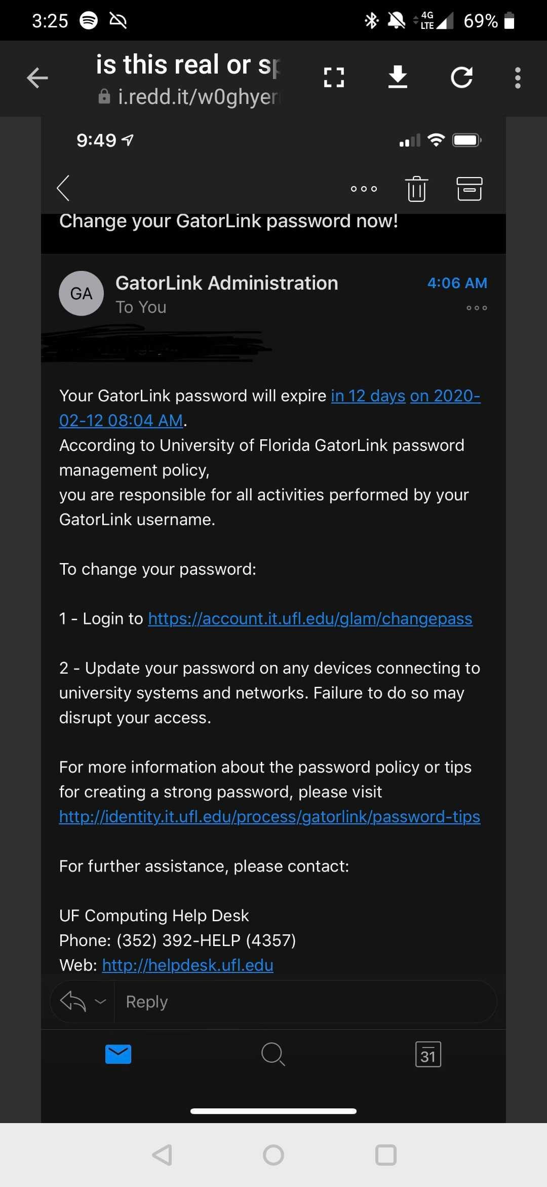
gone phishing

Slide 18
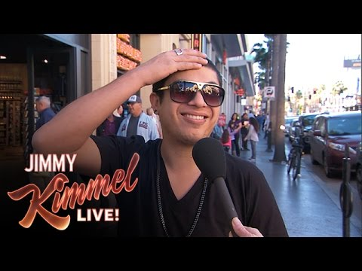

Slide 20
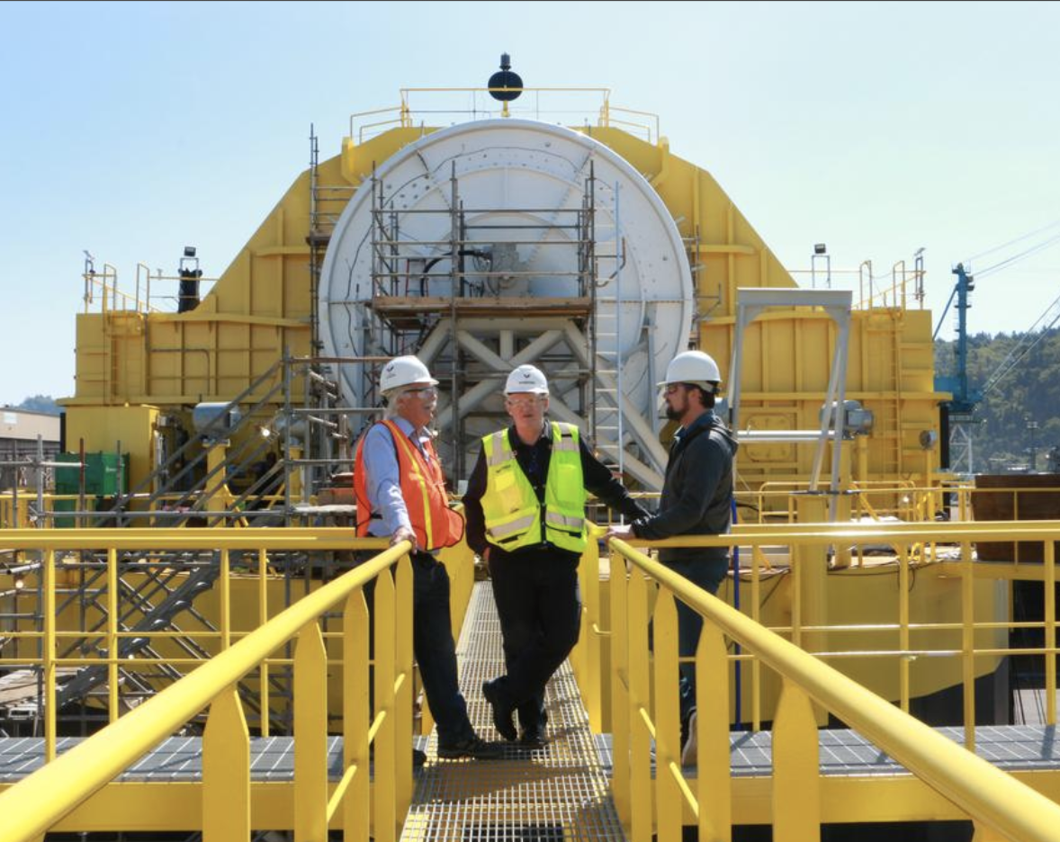
Porsche and Boeing’s ambitious partnership.
Portland’s Renewable Wave Machine

Slide 21
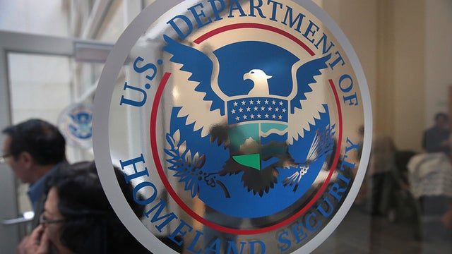
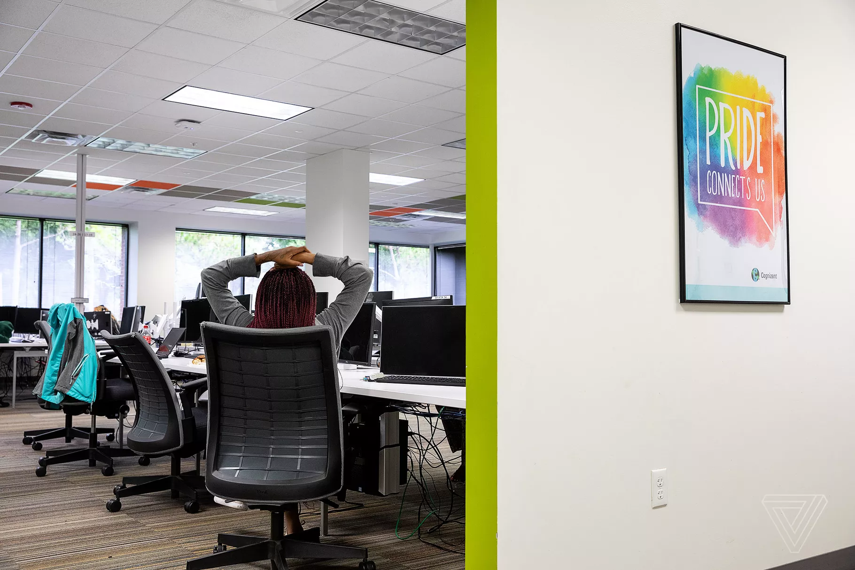
this week in tech:
DHS Chief Says Offer to Vet Caucus App was Declined
The Life of a Tech Content Moderator

Slide 22
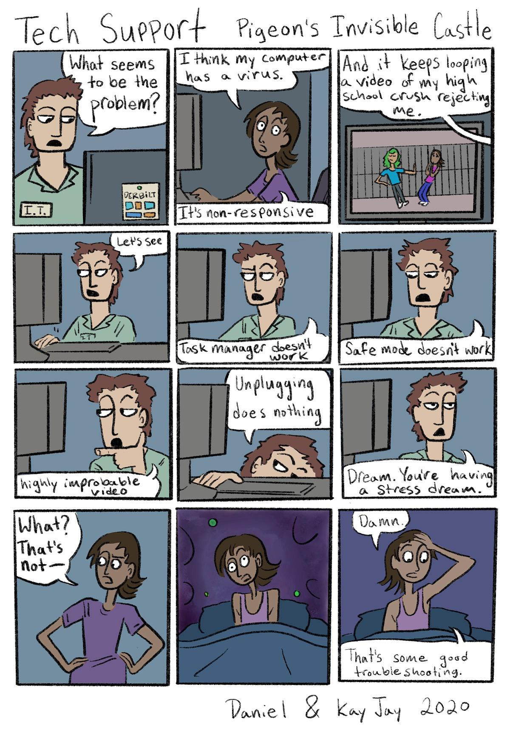
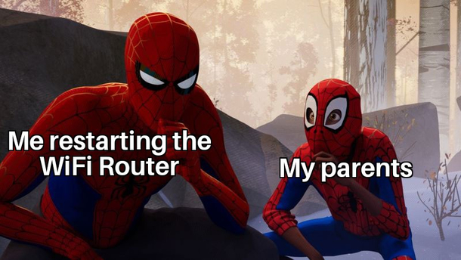
Tech Memes of the Week

