Slide 1
Notes:
Explain what gatortech is.

Slide 2
Check-in on gatortechuf.com
Get Tableau installed!
https://www.tableau.com/academic/students
UF Apps
Felipe’s social - Nov 5 after GBM
Notes:
Go to mentimeter for the polls.
Hackathons: https://mlh.io/seasons/na-2019/events
ShellHacks: https://shellhacks.net/
HackGSU: http://hackgsu.com/
HackGT: https://2018.hack.gt/
HackFSU: https://hackfsu.com/
SwampHacks: https://2019.swamphacks.com/
MangoHacks: https://mangohacks.com/
KnightHacks: https://knighthacks.org/

Slide 3
Improving Everyday Technology

Slide 4
Improving Everyday Technology
Get in a group of 3-5
Think of one local Gainesville business that you like to frequent (ex. Mi Apa, Beach Break, etc.)
List different ways in how technology could improve sales
Remember to use your unmatched creativity to come up with something unique!

Slide 5
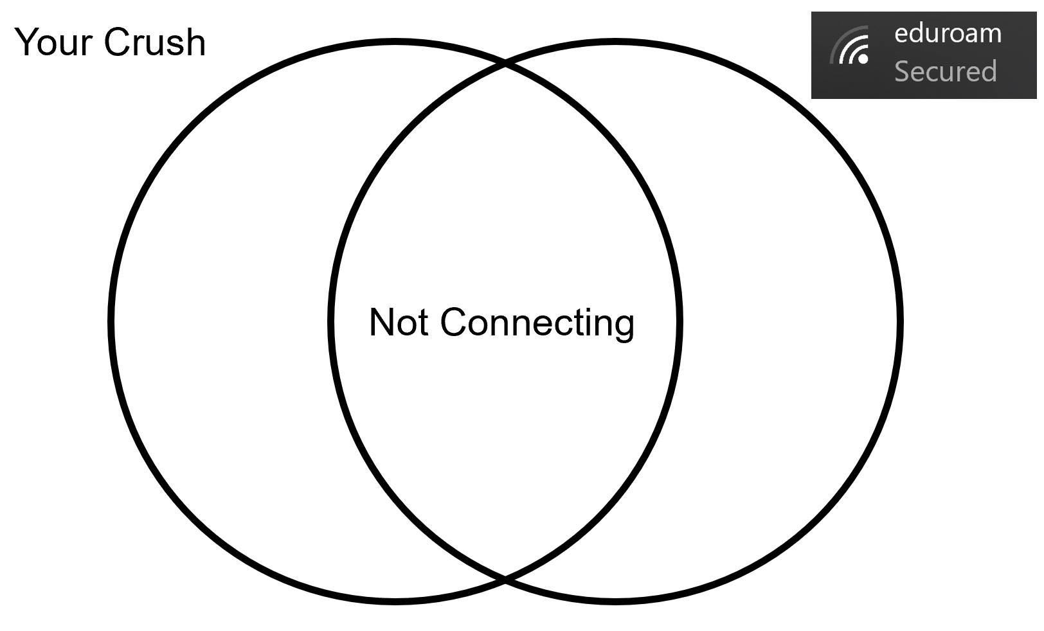
Tech Meme(s) of the Week

Slide 6
data science

Slide 7
data visualization
Data visualization is graphical representation of information and data. By using visual elements like charts, graphs, and maps, data visualization tools provide an accessible way to see and understand trends, outliers, and patterns in data.
Notes:
https://www.tableau.com/learn/articles/data-visualization
Why is it important? It is a lot easier to identify the difference between colors, shapes, and other visual techniques
Makes data readable and easier to understand at a glance

Slide 8
software
Tableau - allows for simple drag and drop
Microsoft Power BI - connectivity with microsoft apps
QlikView - data discovery and in-memory storage
Notes:
Data Discovery is a user-driven search for patterns and trends in data sets.

Slide 9
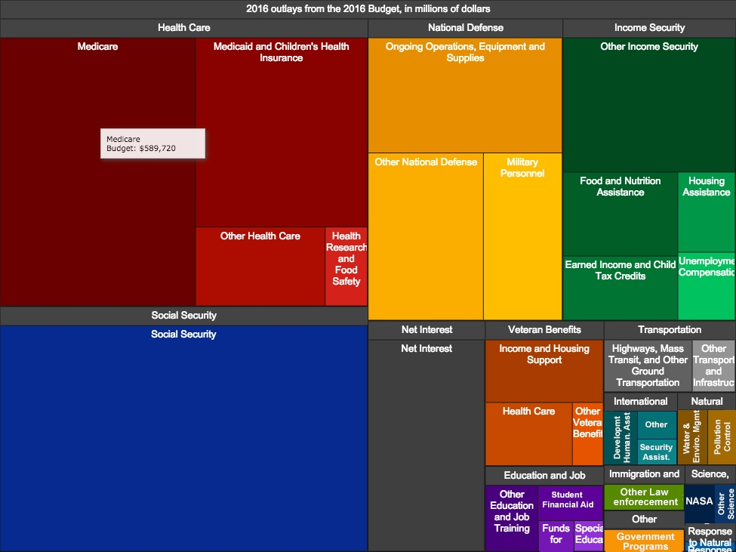
application
Helps visualize trends and insights related to data
Allows for easier data curation
Stores relevant data into easy to read/view formats
Removes noise from data

Slide 10
do’s and don’ts
do
make smart use of color
make sure your visualization conveys the message you want
check your labels and numbers
don’t
overload your visual with data
intentionally misrepresent data
use bad data
choose the wrong type of visualization model

Slide 11
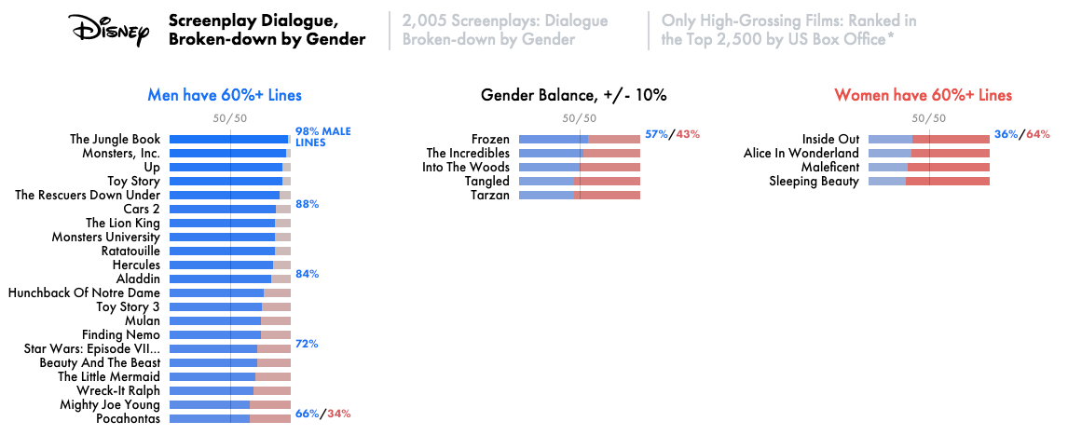
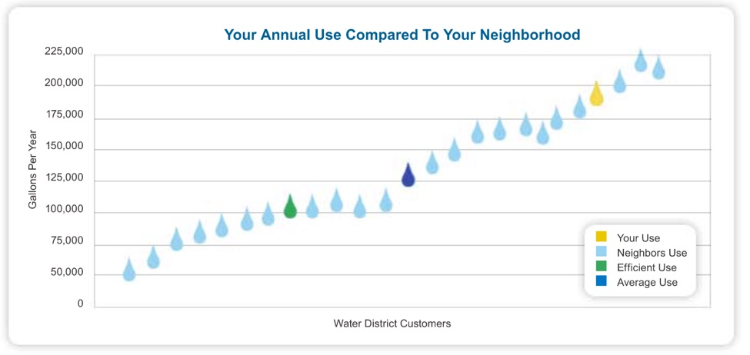
examples
Notes:
https://www.tableau.com/learn/articles/best-beautiful-data-visualization-examples

Slide 12
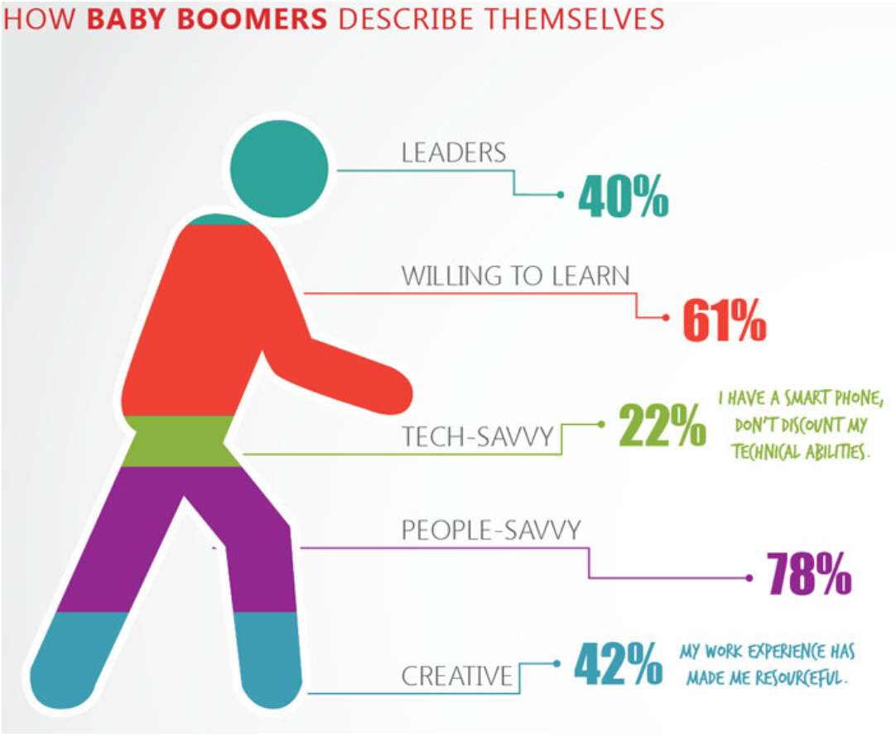
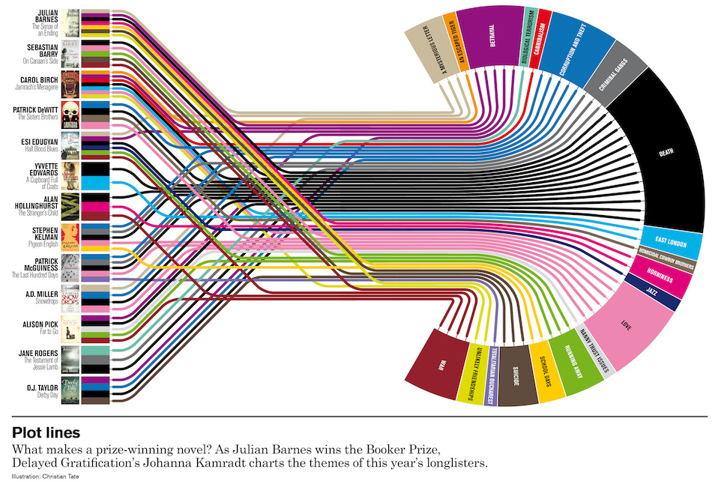
examples
Notes:
https://humansofdata.atlan.com/2019/02/dos-donts-data-visualization/

Slide 13
activity
Where’s That From?!
Location
Date
Time
Resolution
OS
Battery Status
Cookies
Date
Time
Location
Device Name
Size
Location
Device Name
Battery Status
OS
Cust. Name
Payment Method
Tax Details
Website
Pager
Picture
Point of Sale System
Cellphone

Slide 14
activity
Where’s That From?!
Location
Date
Time
Resolution
OS
Battery Status
Cookies
Date
Time
Location
Device Name
Size
Location
Device Name
Battery Status
OS
Cust. Name
Payment Method
Tax Details
Website
Pager
Picture
Point of Sale System
Cellphone

Slide 16
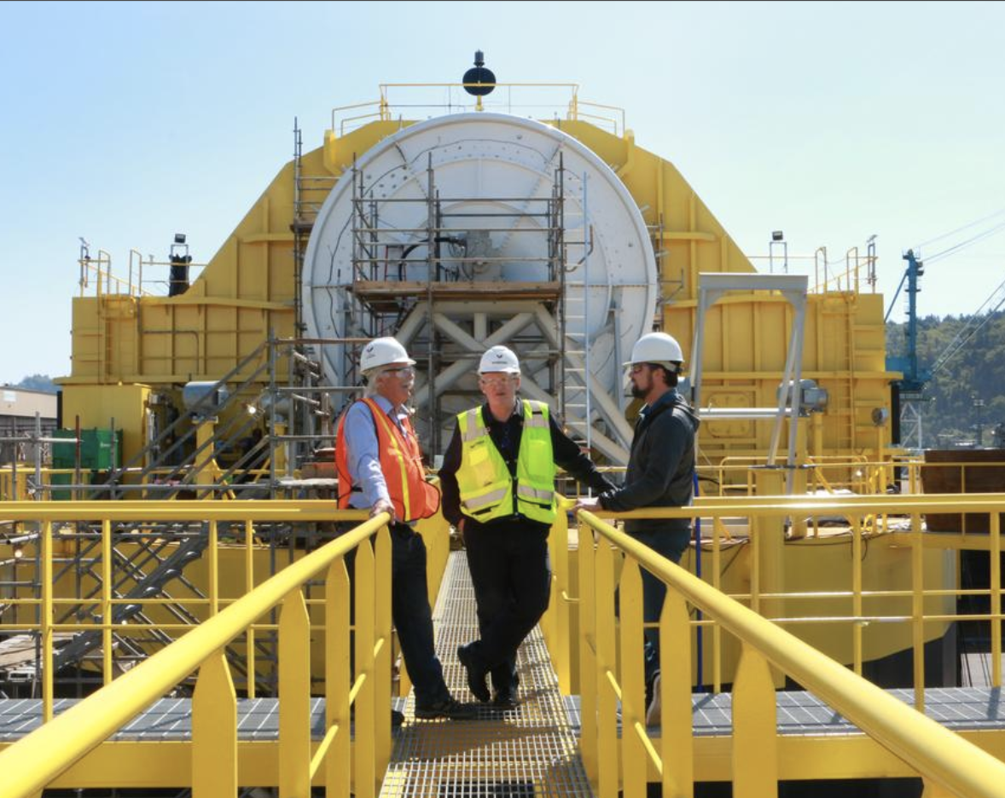
Porsche and Boeing’s ambitious partnership.
Portland’s Renewable Wave Machine

Slide 17
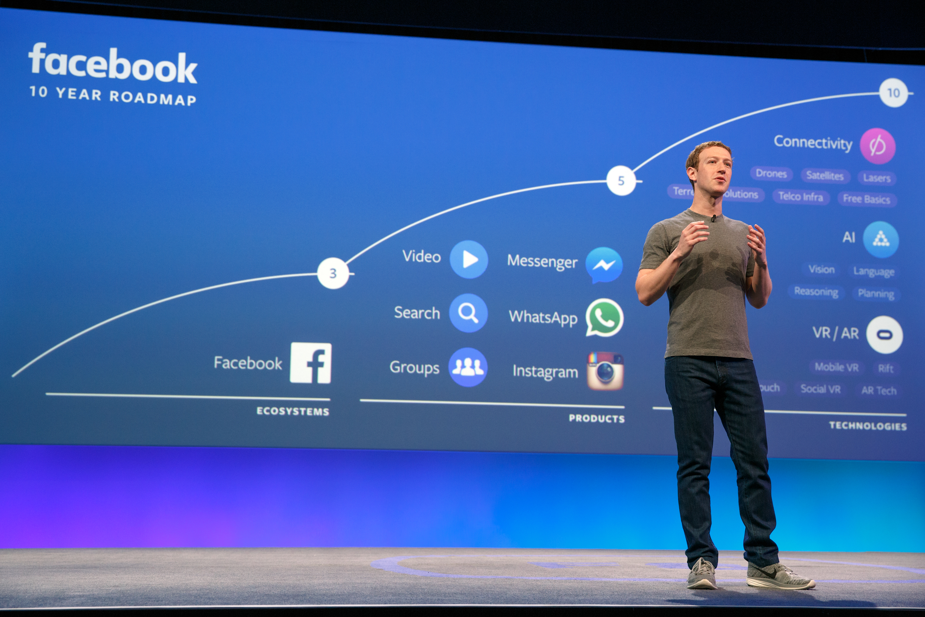
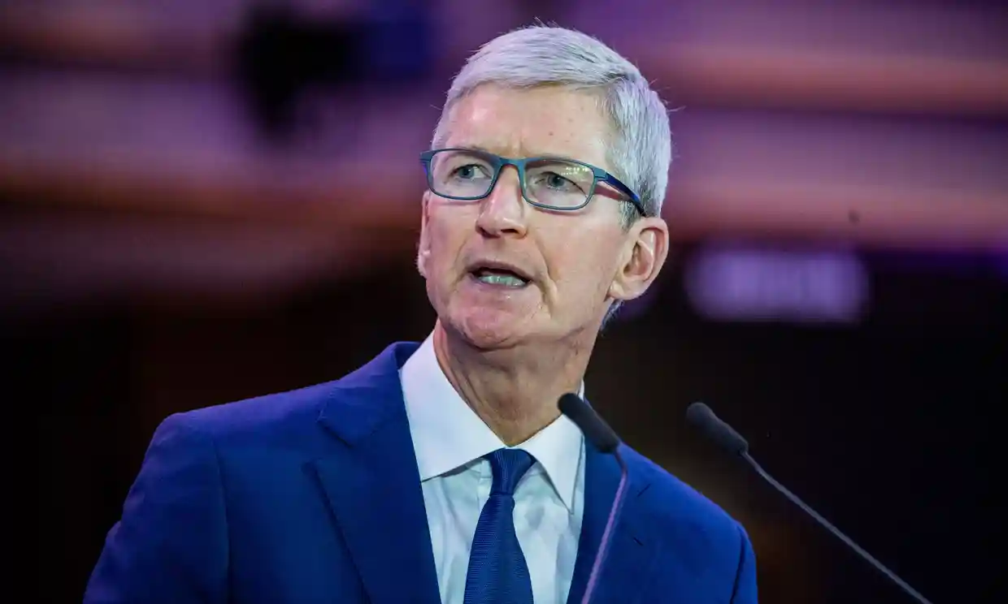
this week in tech:
Tim Cook defends Apple’s decision to remove HKMap app.
Is Facebook: “optimized for outrage?”

