Slide 1
Notes:
Explain what gatortech is.

Slide 2
Check-in on gatortechuf.com
Coordinator meeting TODAY after GBM!
Video game social - 12/3
Notes:
Go to mentimeter for the polls.
Hackathons: https://mlh.io/seasons/na-2019/events
ShellHacks: https://shellhacks.net/
HackGSU: http://hackgsu.com/
HackGT: https://2018.hack.gt/
HackFSU: https://hackfsu.com/
SwampHacks: https://2019.swamphacks.com/
MangoHacks: https://mangohacks.com/
KnightHacks: https://knighthacks.org/

Slide 3
4 Corners

Slide 4
Strongly agree
Front of the Room
Strongly disagree
Do you think mobile gaming will surpass traditional gaming as an industry?
Somewhat agree
Back of the Room
Somewhat disagree

Slide 5
I don’t play Video Games
Front of the Room
1-3 Hours
How much time do you spend playing video games per week?
4-6 Hours
Back of the Room
6+ Hours

Slide 6
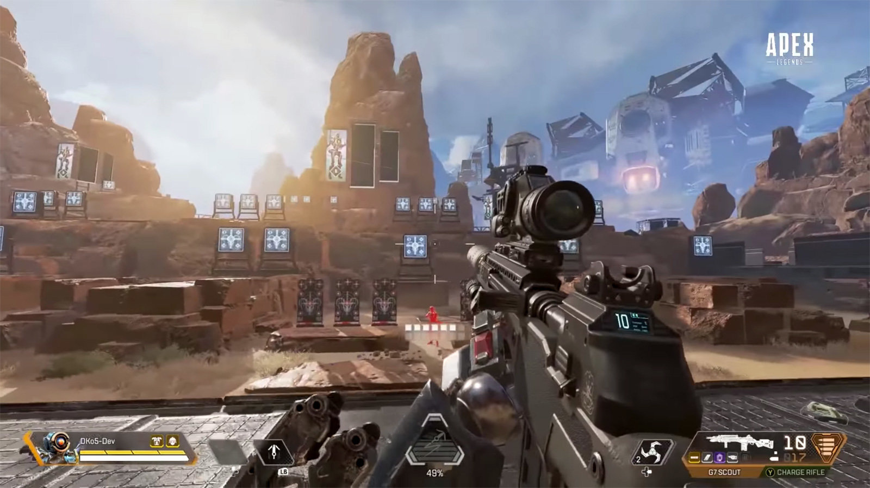
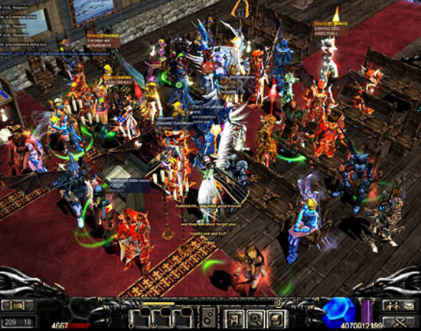
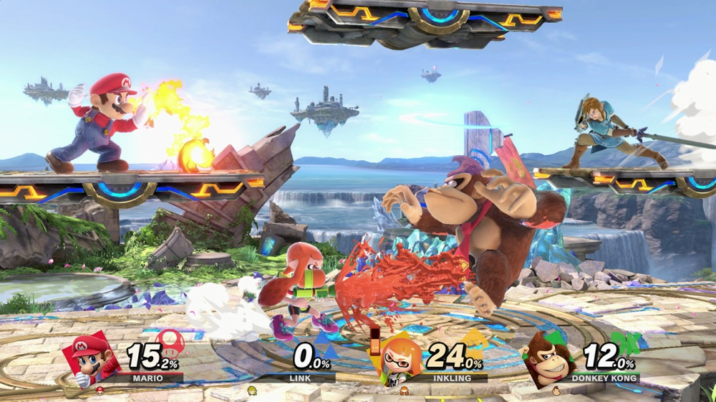
Shooter
Action
Front of the Room
What is your genre of game to play?
Other
Role-Playing
Back of the Room

Slide 7
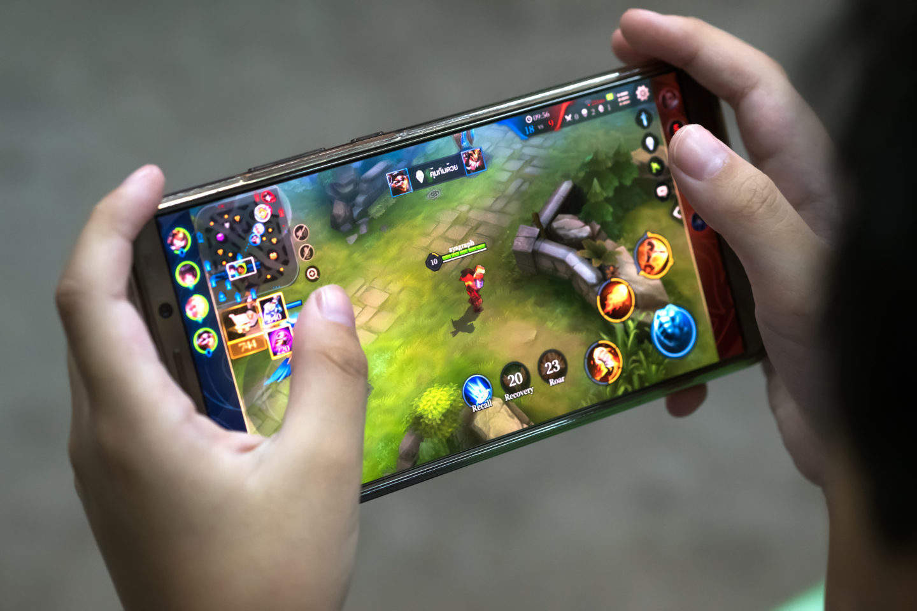
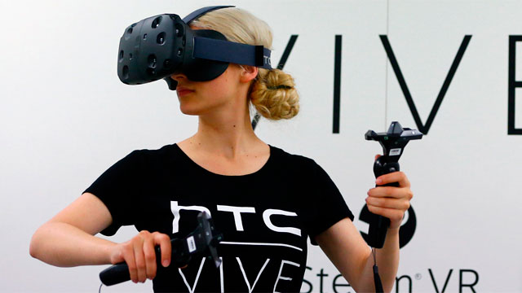
Mobile
PC
Front of the Room
What method do you prefer to use to play games?
Virtual Reality
Console
Back of the Room

Slide 8
fun w/
modeling

Slide 9
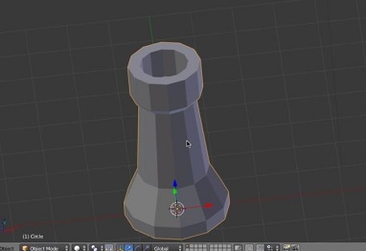
Modeling
NURBS Modeling (Non-Uniform Rational Basis Spline) - a mathematical modeling type commonly used to generate curves and surfaces
Polygon Modeling (also known as meshes) - a collection of vertices, edges and faces that define the model, which allows for easy and precise editing of parts of your object
Subdivision Surfaces/NURMS Modeling (Non-Uniform Rational Mesh Smooth) - a method used to smoothen out those pixelated meshes.
Notes:
https://i.materialise.com/blog/en/3d-modeling-terms/

Slide 10
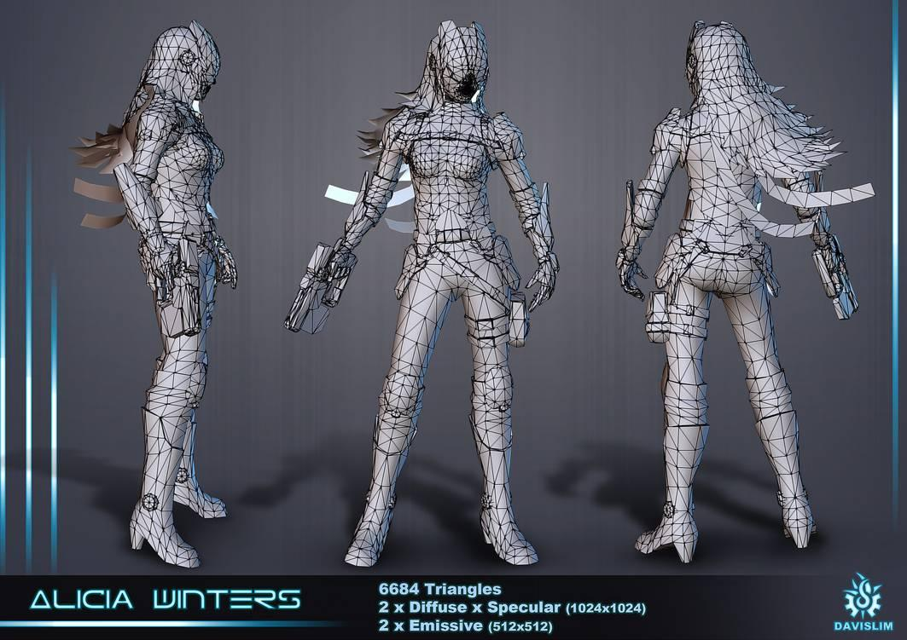
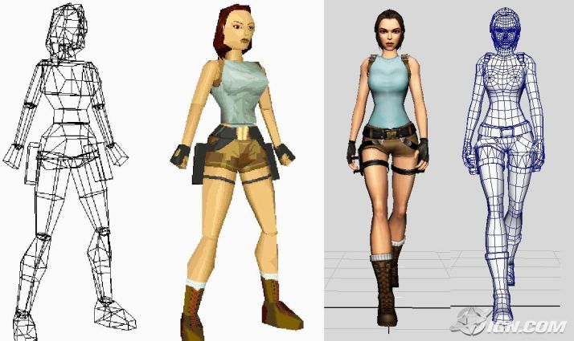
3D Modeling
The use of computers to create graphics that look to have three dimensions. They are not only limited to gaming but are also used for special effects, films, and architecture.
It uses programs such as Cinema4D, ZBrush, or Blender create connecting set of points, lines, and curved surfaces to create a wireframe
Notes:
Modeling is much akin to drawing, in that the user needs creativity and attention to detail
3d Modelers need to know some sort of coding familiarity and possibly a sculpting language

Slide 11
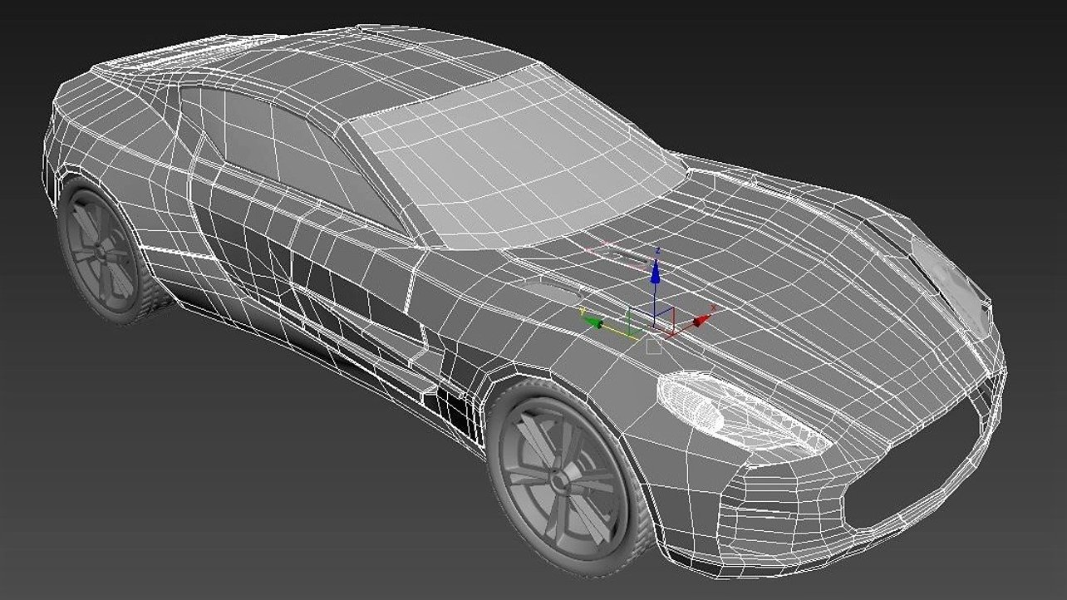
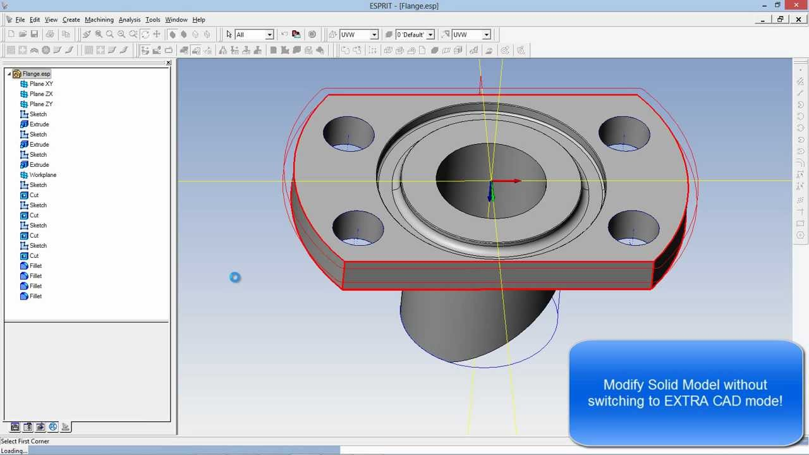
Other types of modeling
Surface: Represents the skin of an object with no thickness or type of material. Mostly used shipbuilding, automotive, aircraft industry.
Solid: Works with objects with a legitimate thickness (ex. 5mm), have holes, and surfaces for manufacturing purposes.

Slide 12
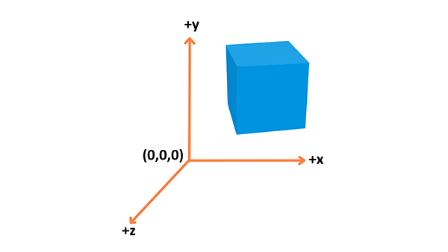
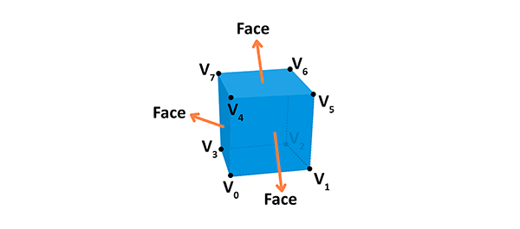
3D Theory
Coordinate System - representation of shapes in a 3D space
Objects - Built using vertices
Vertex - a point in space having its own 3D position in the coordinate system. Attributes of a vertex:
Position (x, y, z coordinate)
Color (RGBA value)
Normal (direction of vertex)
Texture (a 2D image the vertex can use)
Notes:
https://developer.mozilla.org/en-US/docs/Games/Techniques/3D_on_the_web/Basic_theory

Slide 13
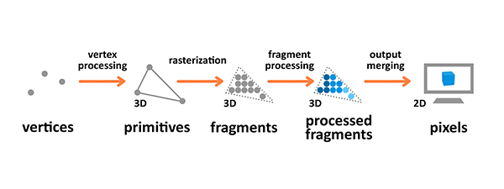
Rendering pipeline
The process by which images are prepared and output onto the screen.
Primitive: An input to the pipeline
Fragment: A 3D projection of a pixel
Pixel: A point on the screen arranged in the 2D grid, which holds an RGBA color.
Notes:
The graphics rendering pipeline takes the 3D objects built from primitives described using vertices, applies processing, calculates the fragments and renders them on the 2D screen as pixels.
Vertex processing is about combining the information about individual vertices into primitives and setting their coordinates in the 3D space for the viewer to see. It's like taking a photo of the given scenery you have prepared — you have to place the objects first, configure the camera, and then take the shot.
Rasterization converts primitives (which are connected vertices) to a set of fragments.
Fragment processing focuses on textures and lighting — it calculates final colors based on the given parameters.
During the output manipulation stage all the fragments of the primitives from the 3D space are transformed into a 2D grid of pixels that are then printed out on the screen display. During output merging some processing is also applied to ignore information that is not needed — for example the parameters of objects that are outside of the screen or behind other objects, and thus not visible, are not calculated.
https://developer.mozilla.org/en-US/docs/Games/Techniques/3D_on_the_web/Basic_theory

Slide 14
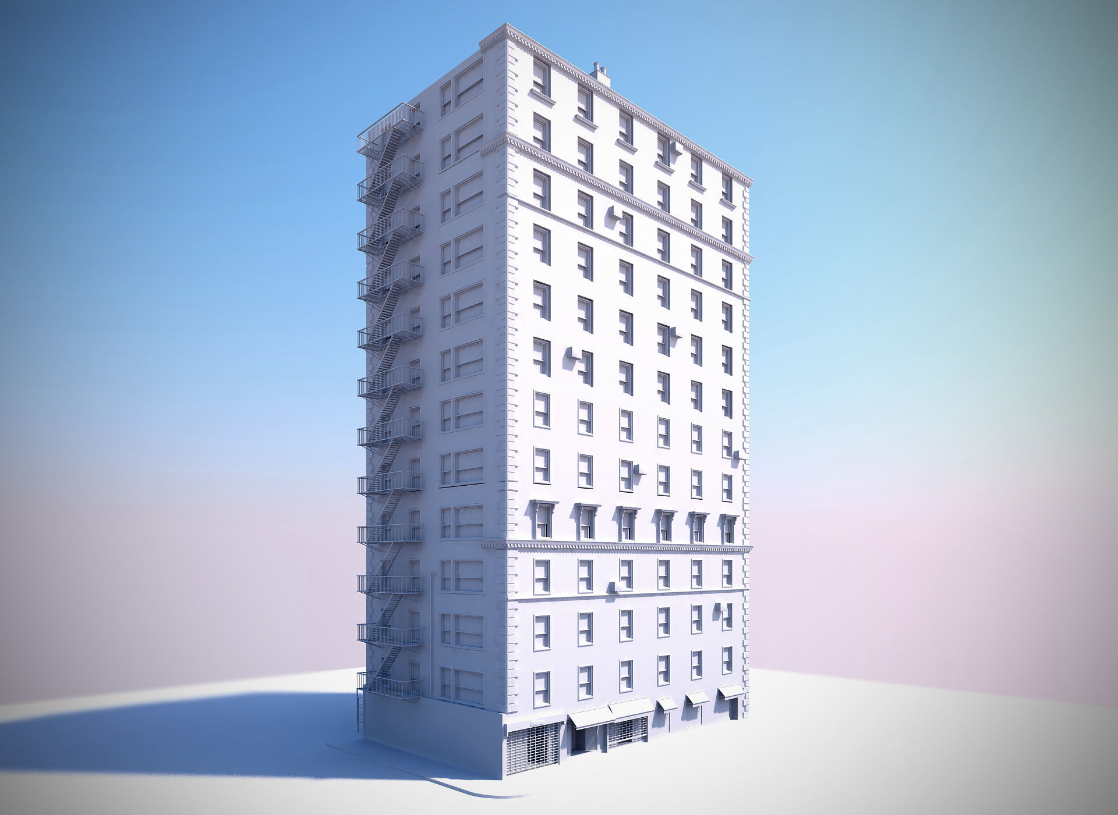
3D Modeling Careers
Medical Industry - 3D Models of Organs
Architects and Engineers - Showcase proposed buildings, designs, etc.
Scientists - 3D geological models
Movies and motion pictures
Video Games
Notes:
https://www.gamedesigning.org/learn/3d-modeling/

Slide 15
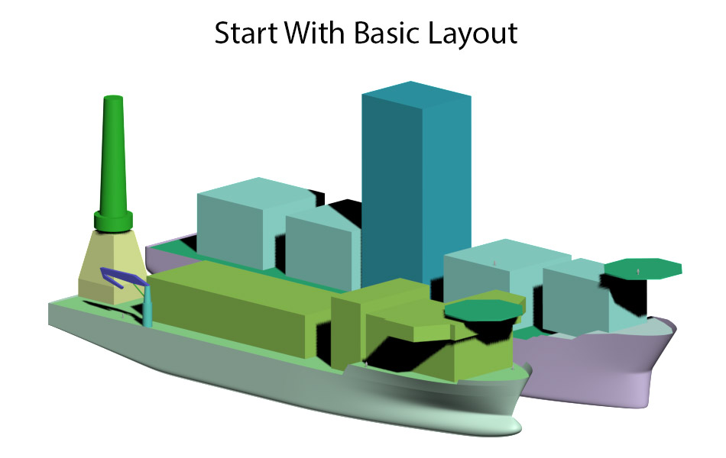
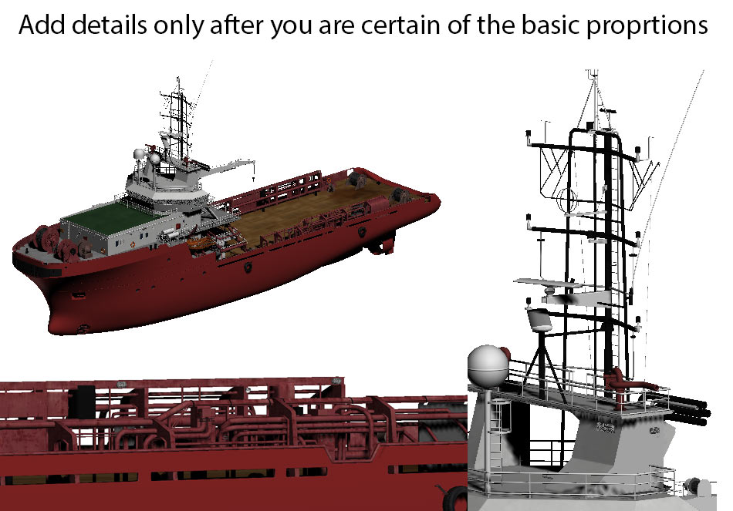
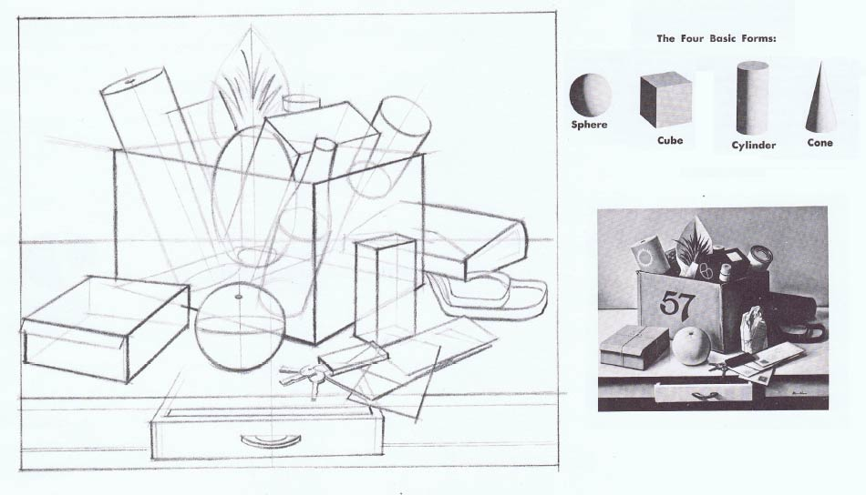
tips and tricks
Have object references
Proportions, can get better by drawing or using a photo as reference
Use photogrammetry and 3D scanning
Simplify forms
Notes:
https://www.ebalstudios.com/blog/3d-modeling-fundamentals

Slide 16
vectary tutorial
Go to Vectary.com, sign up, create a new project
Select the object tab, and under primitives select cylinder
Set the following parameters
Radius: 80, height: 200, radial segments: 20, height segments: 8
Make sure double sided material is on
Select convert to geometry, press z to switch to shaded rendering
Double click on any of the faces and press select all
Select the extrude option and drag the arrow to desired thickness
Select faces to create the mug handle, by using the bridge option (adjust segments for design)
Click mesh tools and select smooth
Notes:
https://www.vectary.com/3d-modeling-how-to/how-to-start-3d-modeling-from-scratch-in-vectary/

Slide 17
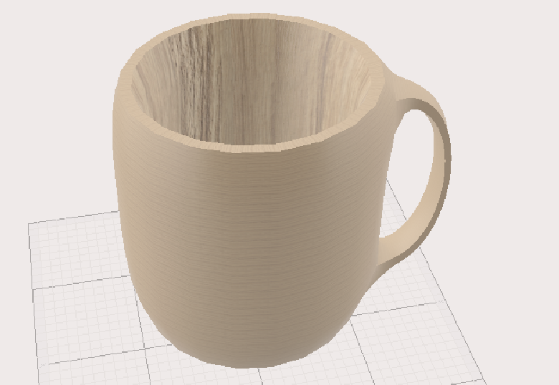
finished product
Notes:
https://www.vectary.com/3d-modeling-how-to/how-to-start-3d-modeling-from-scratch-in-vectary/

Slide 18
activity
Using the your new vectary knowledge create a rough 3d model of your last week’s design
Try and include a light source, multiple objects and textures/materials
Feel free to use existing assets for help
Notes:
Next week design an area/character, and then basic modeling/hud

Slide 20
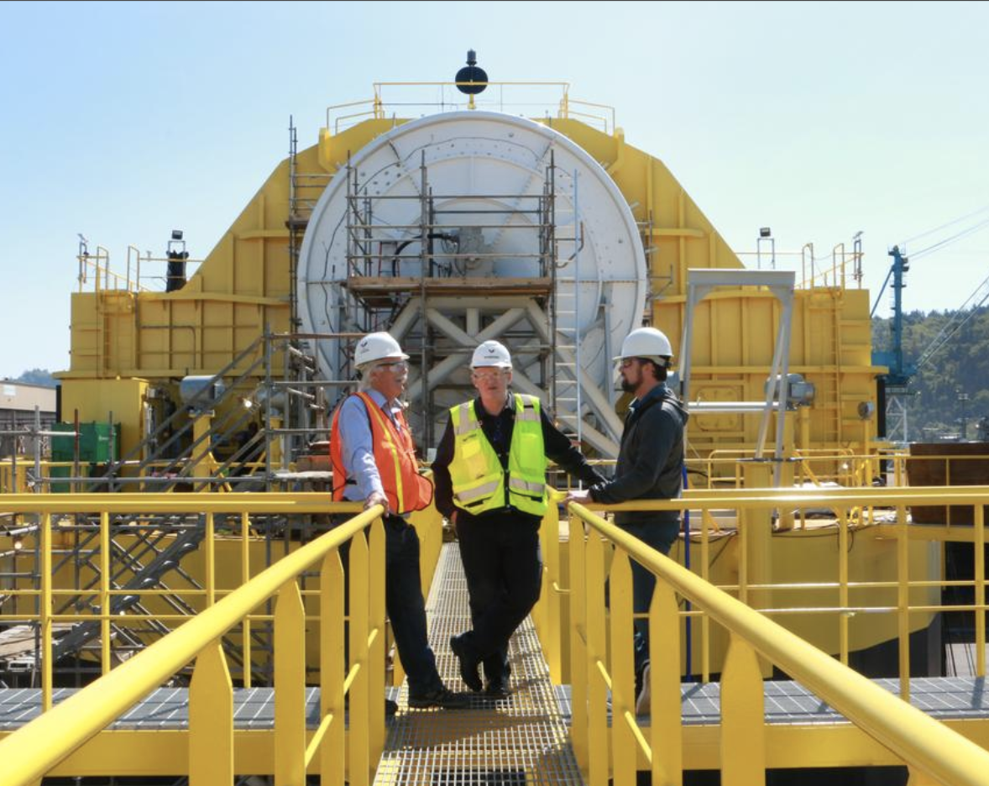
Porsche and Boeing’s ambitious partnership.
Portland’s Renewable Wave Machine

Slide 21
this week in tech:
Disney+ accounts compromised
Elon Musk congratulates new electric vehicle competition

Slide 22
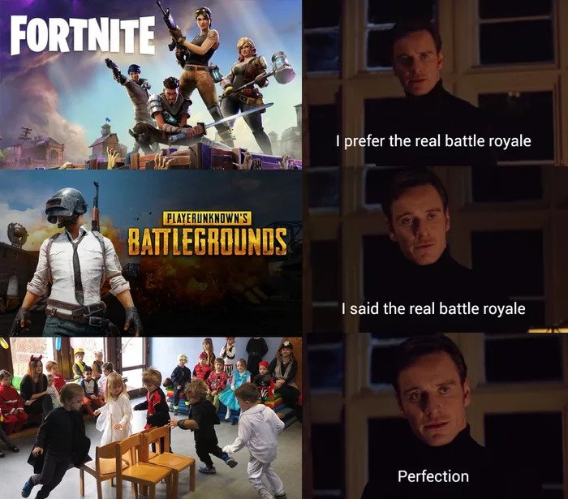
Tech Meme(s) of the Week

