Slide 1
artificial intelligence

Slide 2
what is AI?
Artificial Intelligence
The goal is creating a computer that:
Thinks
Learns
Makes rational decisions

Slide 3
(AI)ce breaker
What kind of chatbots would you use?
Would you use a financial chatbot?
Would you speak with a chatbot over a customer service rep?
How much information are you willing to give them?

Slide 4
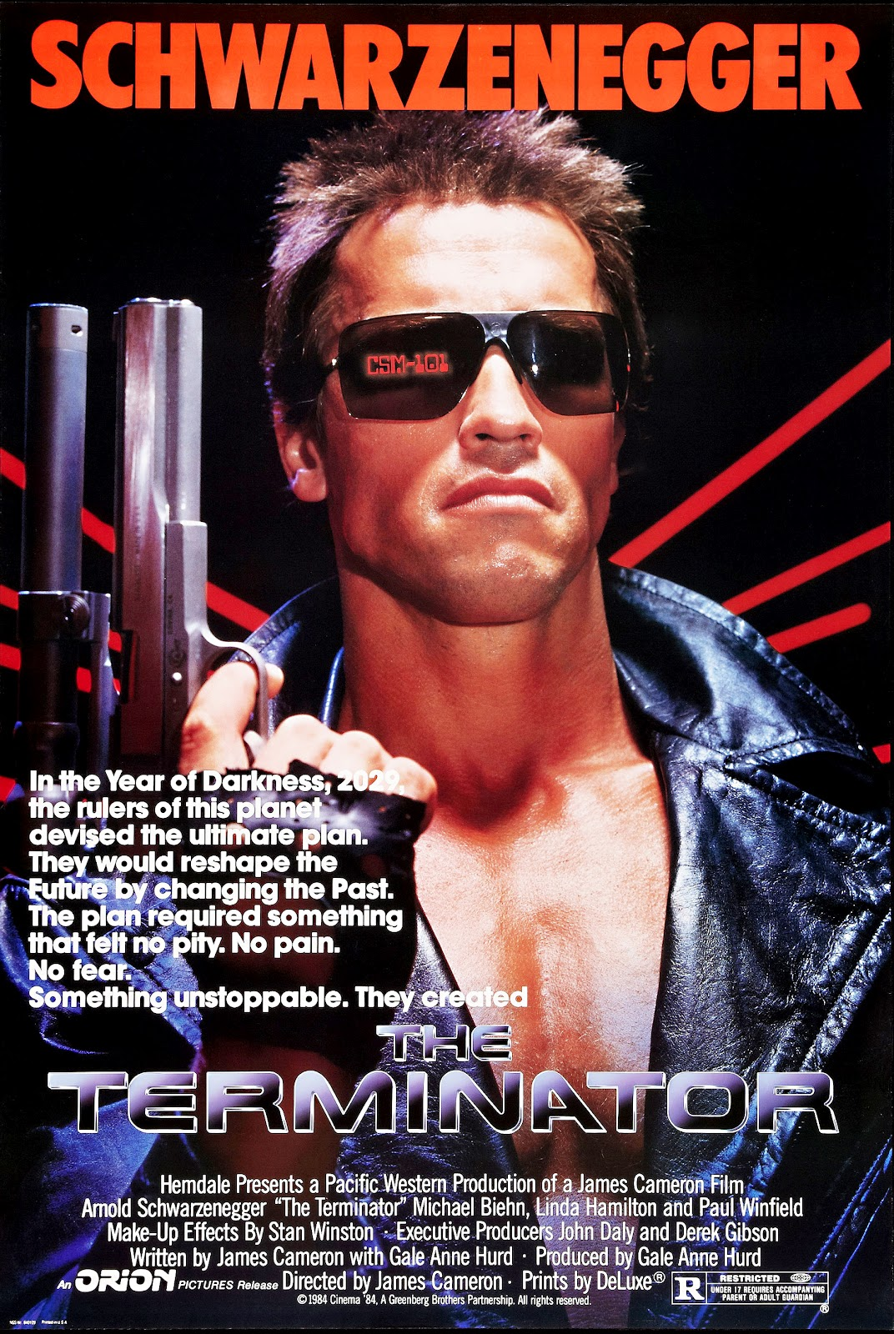
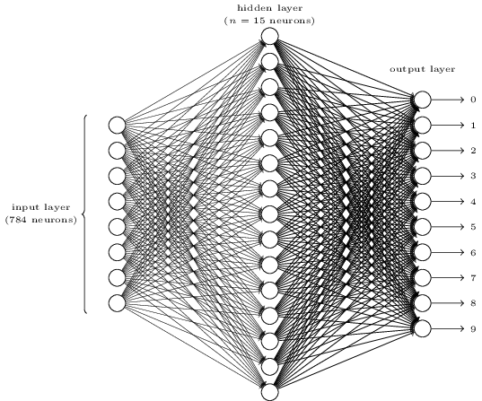
what exactly is AI?
AI right now:
Machine learning
Making predictions based on past data
AI in the future:

Slide 5
machine learning
Statistical methods
Learns based on data sets
Supervised learning
Like looking at a test with the answers
Figures out why a problem results in a specific answer
Unsupervised learning
Looking at a test with no answers or knowledge
Figure things about by trying everything

Slide 6
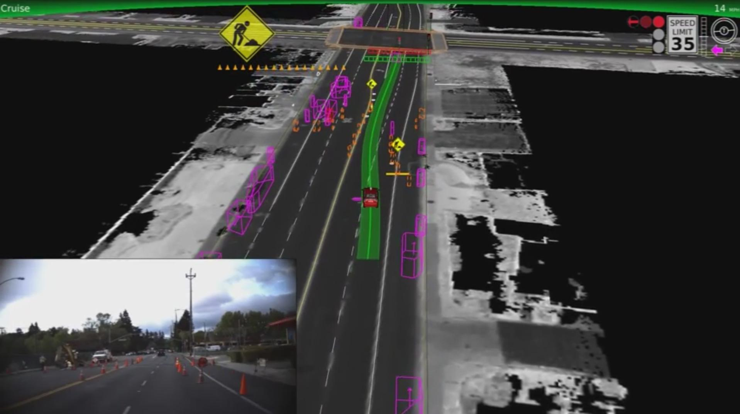
what is AI used for right now?
Tesla Autopilot and fleet learning
Google Search autotype
Amazon recommendations
Detecting credit card fraud

Slide 7
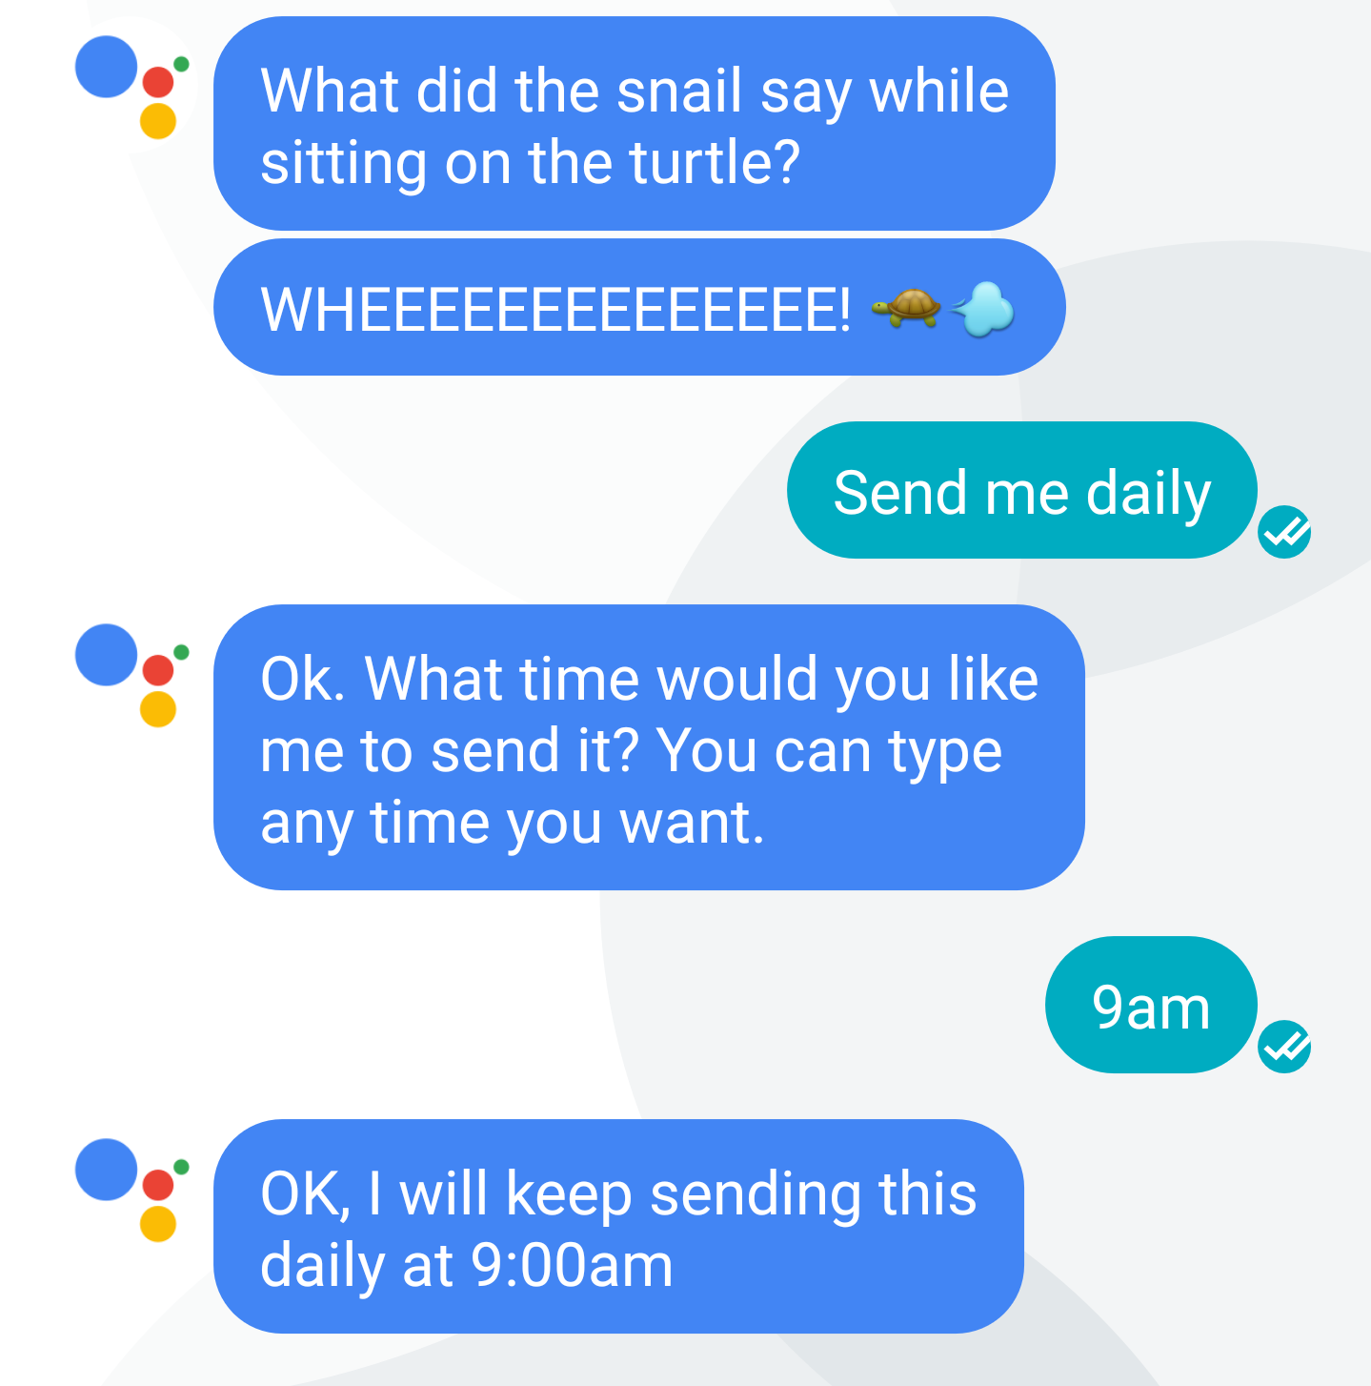
personal assistants & chatbots
Google Now/Google Assistant
Siri
Microsoft Cortana?
Amazon Alexa?
Chatbots
Meekan
Abe
Penny

Slide 8
impact of AI
Jobs
Self driving cars
Customer service reps
Journalists
Quality of Life
Having a personal assistant in your pocket
AI becoming better than us

