Slide 1
Notes:
Explain what gatortech is.

Slide 2
Check-in on gatortechuf.com
Coordinator applications are closed!
Hackathon: HackGT, October 25th-27th
Application extended until Sept. 27th
1st Workshop: October 1st @ 6pm
Technology Case Competition Team
Notes:
Go to mentimeter for the polls.
Hackathons: https://mlh.io/seasons/na-2019/events
ShellHacks: https://shellhacks.net/
HackGSU: http://hackgsu.com/
HackGT: https://2018.hack.gt/
HackFSU: https://hackfsu.com/
SwampHacks: https://2019.swamphacks.com/
MangoHacks: https://mangohacks.com/
KnightHacks: https://knighthacks.org/

Slide 3
fintech recruiters
FIS: Intern and FT
Capital One: Intern and FT
Citi: Intern and FT
Robinhood: FT
SSC Advent: Intern and FT
Accenture: Intern and FT
KPMG: Intern and FT

Slide 4
Tally Board!

Slide 5
fintech

Slide 6
personal finance

Slide 7
personal finance

Slide 8
some stats
The average U.S. household carries almost $17,000 in credit card debt alone.
Put in other kinds of debt like mortgage and student loans and the number balloons to almost $135,000.
Nearly 70% of Americans have less than $1,000 in savings, and a third don’t have anything saved for retirement.
Notes:
https://www.forbes.com/sites/nikolaikuznetsov/2017/04/21/fintech-gets-serious-about-personal-finance/#21c730254c25

Slide 9
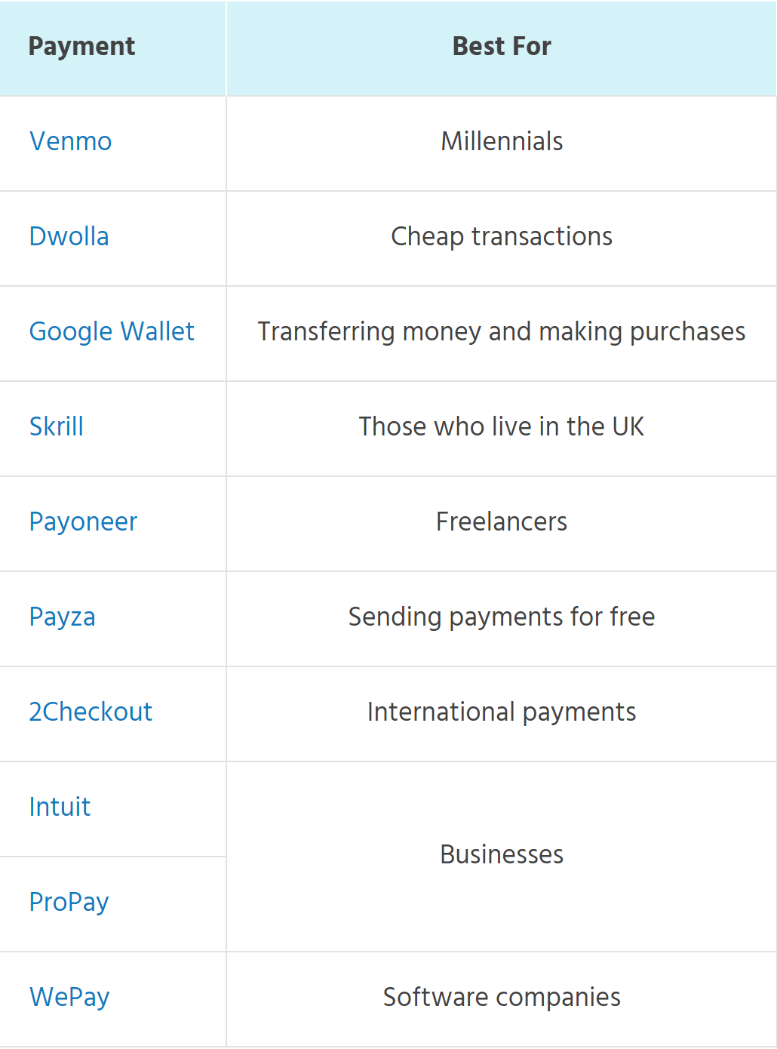
most popular cashless apps
Notes:
https://www.moneyunder30.com/paypal-alternatives

Slide 10
budgeting
Keeping score of income, expenses, savings and any debts that need to be paid.
Some apps to use:
Mint
Goodbudget

Slide 11
saving
Almost half of Americans couldn’t even afford a $400 emergency expense.
The bare minimum of an emergency fund is three months’ living expenses.
Some apps to use:
Level Money
Digit

Slide 12
investing
Saving for the future requires by relying on savings is not enough. This is a result of inflation.
Most financial advice encourage investing in order for money to grow.
More than half of Americans have nothing invested in stocks.
Some apps to use:
Acorns
Robinhood

Slide 13
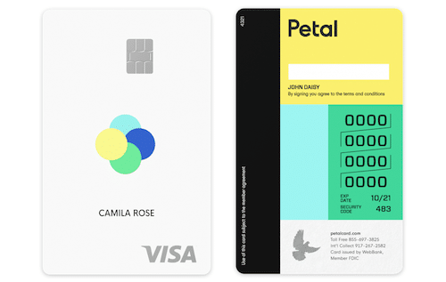
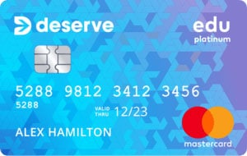
best cc for students
Deserve Edu Student Credit Card
Unlimited 1% Cash Back; Free Year of Amazon Prime Student ($59 Value)
The Petal Cash Back Visa Card
Innovative Underwriting Procedures; Up to 1.5% Cash Back
Notes:
https://www.moneycrashers.com/best-credit-cards-college-students/

Slide 14
best cc for rewards
Chase Sapphire Preferred Card
Earn 60,000 bonus points; Earn 2X points on travel and dining; Points are worth 25% more in travel redemption
Capital One Venture Rewards CC
Unlimited 2X Miles with
50,000 Bonus Miles
Notes:
https://thepointsguy.com/rewards-cards-pm/?utm_source=google&utm_medium=cpc&utm_campaign=NBDrewE1-best%20rewards%20credit%20card-323282413917&utm_term=best%20rewards%20credit%20card&utm_cmpid=1643051953&utm_adgid=61446148461&utm_tgtid=kwd-154420017&utm_mt=e&utm_adid=323282413917&utm_dvc=c&utm_ntwk=g&utm_adpos=1t2&utm_plcmnt=&utm_locphysid=1015033&utm_locintid=&utm_feeditemid=&utm_devicemdl=&utm_plcmnttgt=&utm_misc=&gclid=Cj0KCQjw_absBRD1ARIsAO4_D3t3vxhNg9vfAjQHvdcgDwvY3FXeLa61I-pTZHYcCeVP6nO4MppFgVMaAuAdEALw_wcB

Slide 15
activity
Setting Long-Term and Short-Term Financial Goals
Decide on a Long-Term Financial Goal
I.e. saving for future semesters, saving for a pet, a trip, etc.
Identify and explain two short-term goals that you could set today that would help you achieve the long-term goal identified.

Slide 17
Algae Bioreactor
Deepfake Technology

